Slide 1
NIU Case Study
Lynne M. Thomas
(former) Curator, Rare Books and Special Collections
This POWRR Institute is generously funded by the

Slide 2
Where We Came From
Digitization projects mostly grant funded over a decade.
Ongoing acquisition of born-digital archival materials.
Lots of information/expertise, but no plan or policy.
Multiple repository management platforms/software that didn’t play well together.
Open source, no direct funding.
Full case study (2014) http://powrr-wiki.lib.niu.edu/images/d/db/2014_Feb_NIU_Case_Study_Overall.pdf

Slide 3
What We Were Facing
Scattered collection– no idea what we had, how much of it, what formats, and where it lived.
Scattered staff: this was no one’s job and everyone’s job.
Library vs. campus IT in an age of scarcity.
Getting from “we need to do this, really” to “resources go here.”

Slide 4
Our Experience
A push-pull between…
Admin: “tell us what you will need at its most minimal level” and Us: “We won’t know what we will need until we know how we are doing it, which is dictated by what resources we have.”
At some point, we needed to make some choices and begin figuring out how to implement and fund them.

Slide 5
Steps We Took
Digital POWRR grant #1.
Advocacy, advocacy, advocacy … and a few arguments.
Open source, sort of.
What do we STOP doing?
A chain of stopgaps and failures that led to more reasonable choices.

Slide 6
Failure Points
IT considered us a low-priority project .
Relationship frustrations and how to navigate them.
Allocations didn’t always match actual needs.
Two-year state budget stalemate.

Slide 7
Further Failure Points
Loss of web developer position.
“There are over 1.4 million files on the NAS that are over 3 years old.”
Multiple server failures.
We need a deaccessioning policy.
Problems with software used to sync cloud storage.

Slide 8
Lessons Learned
Brutal honesty and occasional public shaming can work wonders.
You will have multiple false starts and failures, and THAT IS OKAY.
What you learn from the failures is what matters.
This is a slower process than you think.
When there is no budget, try to make reasonable choices.
But. Make. Choices.

Slide 9
Steps After Failures
Adjustments to storage solution.
Committee to create policy & plan.
Spelling out required maintenance for IT.
Adjustments to the team.
Willingness to re-engage.

Slide 10
What We Have Now
Digital preservation policy: http://digital.lib.niu.edu/policy/digital-preservation/digital-preservation-policy
Digital preservation plan: http://digital.lib.niu.edu/policy/digital-preservation-implementation-plan

Slide 11
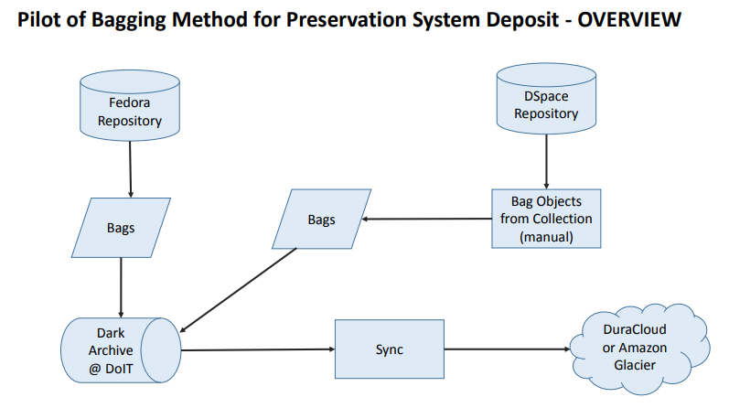
What We Have Now

Slide 12
A Rudimentary, Plausible Workflow
Document as it arrives. (Archon, spreadsheets)
Get. It. Off. Original. Carrier. And. Onto. Local. Server. Space.
“Clean Machine” where feasible.
Basic preservation metadata added.
Bag it and preserve it in the cloud.

Slide 13
Lessons Learned
What can you do NOW is always more productive than Nothing Can Be Done.
Stubbornness counts … and it can work.
When time is a bigger resource than money, focus on policy & planning.
Make your plan & policy person-proof – people leave but the needs don’t.
This is iterative. And that is okay.

Slide 14
Technology Module: NIU Case Study
QUESTIONS?

