Slide 1
Welcome to the POWRR Institute!
@digitalPOWRR
This Institute is generously funded by the
and co-sponsored by the ASU Library.

Slide 2
Welcome to the POWRR Institute!
Logistics
Cohort Model & Instructor Introductions
POWRR Plan
Agenda
POWRR Approach to the Digital Curation and Preservation Lifecycle NDSA Levels of Preservation
@digitalPOWRR

Slide 3
Logistics
Facilities
Breaks & Noms
Evaluations
Technology
Other Stuff….
Notes:
Accessibility!
EVALUATIONS – paper evals after each sessions and final eval at the end
WE WILL BE FOLLOWING UP WITH YOU IN 6 MONTHS
Technology….who is left on Martin’s clipboard?!?!
Dorm checkout instructions

Slide 4
Cohorts & Instructors
Stacey Erdman Martin Kong
Nick Krabbenhoeft
Illustrations by Jørgen Stamp digitalbevaring.dk CC BY 2.5 Denmark
Meg Miner
Dorothea Salo
Jaime Schumacher
Notes:
Big thank you to Rene Tanner and ASU!!!!
The POWRR Team would like to thank Rene Tanner and the ASU Libraries for the incredible support and effort in bringing the POWRR Institute to Tempe.
Rene – You first posed the idea of bringing POWRR to ASU in 2016 and have worked tirelessly to make it a reality. We deeply appreciate you!!! Rene and Your Colleagues at the ASU Libraries – From the provision of meeting space and equipment to the wrangling of affordable lodging and catering, your generosity in sponsoring the POWRR Institute, demonstrates the POWRR *wink wink* of community-led efforts to bring practical professional development opportunities to those who need it most, but to whom it is often unattainable. Thank you on behalf of POWRR and all the POWRR Cohorts!
This Institute is also generously funded by an Institute of Museum and Library Services’ Laura Bush 21st Century Grant. POWRR *hearts* the IMLS!!!
Stacey talks about the cohort model

Slide 5
Your POWRR Plan
Document the current state of your digital preservation activities
Define your organization’s needs and set goals accordingly
Determine which particular challenges and advantages will guide your decisions
Document the knowledge acquired during the POWRR Institute
Capture a pilot solution model(s) and proposed workflow
Create an action plan with goals and activities defined at 3, 6 and 12 months
Notes:
Open a sample POWRR Plan!!!!
THEY NEED TO START THINKING ABOUT WHAT MATERIALS THEY HAVE IN THEIR BACKLOG (for instance) THAT THEY WANT TO SELECT FOR A PILOT. THIS IS WHAT WE WILL BE CONSULTING TOWARDS AND DEVELOPING A PLAN OF ACTION. THIS IS ALSO HOW WE ARE GOING TO TACKLE ASSESSMENT…THEY ARE GOING TO RATE WHERE THEY ARE WITH THAT “COLLECTION” ON THE NDSA LEVELS TODAY/TOMORROW, AND THEN AGAIN WHEN WE FOLLOW UP WITH THEM IN 6 MONTHS.
Your advisor and other instructors will be adding to your POWRR Plan throughout the Institute
The POWRR Plan is a customized document for each member of an Institute’s cohort and is the primary deliverable for each event. You will take it back to your institution with you and use it to inform your development of a digital preservation workflow there. The POWRR Plan is a cloud-based document (Google Doc), divided into four sections, which will be initiated once a participant is accepted into an Institute.
IS EVERYONE ABLE TO ACCESS THEIR POWRR PLANS?

Slide 6
We’re gonna do WHAT???
Full Group Sessions
Now
Guest Speaker
Storage 101
Cohort Stuff
Sharing Circles
Meeting
Dinner! Individual Consultations
Modules
Case Study
Preservation Models & Packages
Walk The Workflow
Choose Your Own Adventure
Tech Skills 201
PROUD
Web Archiving Archivematica
Notes:
Have them get out the agenda

Slide 7
QUESTIONS?
@digitalPOWRR

Slide 8
The POWRR Approach to the Digital Curation & Preservation Lifecycle
@digitalPOWRR
Notes:
Since it’s creation in 2012, POWRR has been investigating reasonable digital preservation solutions and providing education and training opportunities to folks like you. What we’ve discovered…(next slide)

Slide 9
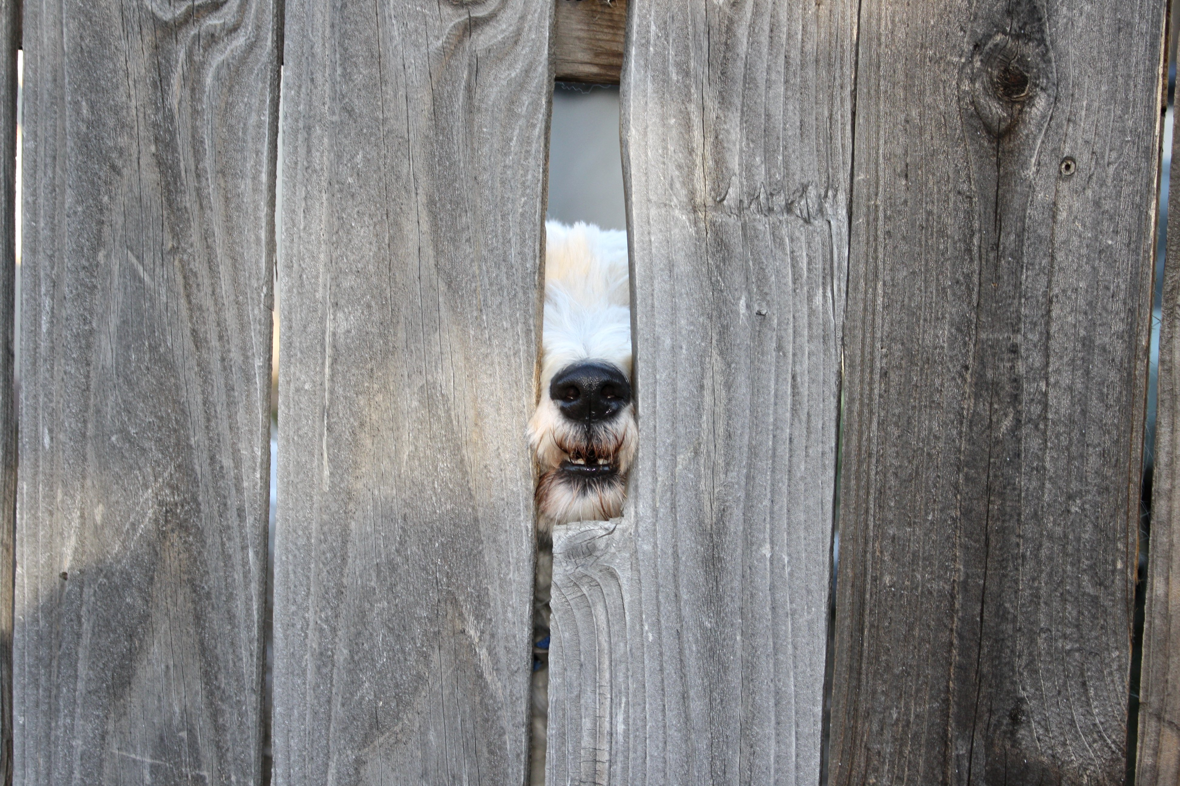
What We Discovered…
…it is NOT a lack of tools, services, and solution models preventing folks from making progress
Notes:
Sooooo….what IS keeping folks from making progress??

Slide 10
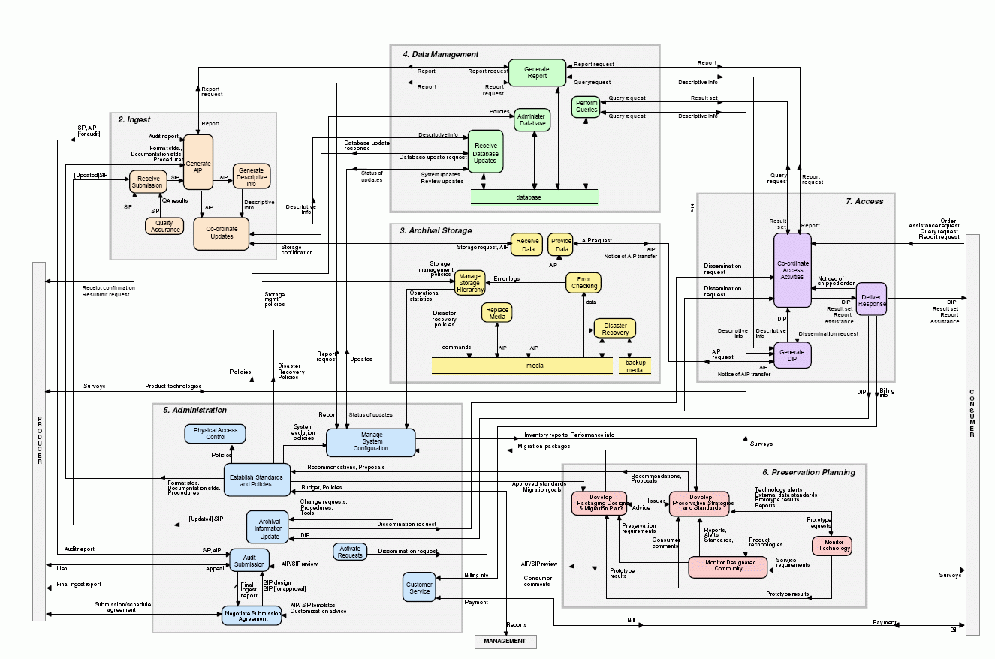
Scary OAIS Spaghetti Monster
Notes:
If you Google digital preservation, you may come across this!
OAIS (Open Archival Information Systems) and other schematic models….resulting in ANALYSIS PARALYSIS
HEY THERE IS NO STEP 1!!!!!
Analysis Paralysis – Google Search!
Isolation – everyone else has it figured out
Uncertainty – can’t even see what all we have (opaque backlog)
Misconceptions- one size fits all for your collections, FREE tools!, we need to get this all figured out before making the first step (see analysis paralysis!)
No money – for training/travel or a slick vendor-based solution
Technology Barriers – Lack of robust infrastructure to lack of IT department to personally being less savvy with technology
A Note: These are all valuable things that benefit the field of digital preservation greatly…. And theoretical-based training, like some of you have taken, is important!
We just don’t want you to become overwhelmed by them and grind to a halt before you take your first steps…like we did
TRAC Certification (Trustworthy Repositories Audit & Certification)
TDR ISO 16363 (Trustworthy Digital Repository ISO Standard)
Curation Lifecycles that don’t look a thing like our current workflows
In just over 10 years, there are 6 repositories that have been able to become certified!!! (Chronopolis Report; Hathitrust Report; Portico Report; Scholars Portal; CLOCKKS, which received the highest score of any org, and now Canadiana.org) OAIS was conceived in 1996 and accepted as an ISO standard in 2002.

Slide 11
The POWRR Approach
What you need to consider when thinking about your digital stuff…
….looks a LOT like the same things you consider for your physical materials.
Ingest
Processing
Access
Storage
Maintenance
Other
Getting it
And a few other odds & ends…
Letting people use it …or not!
Understanding it
&
Documenting it
Taking care of it
Notes:
For folks who are not rocket scientists
Understanding the world in which we need to operate -> comapre to physical process
Books, journals, documents, weird objects, pages within
Paper types, permissions (can we make it available to patrons? Can they copy it?)
Cataloging
Finding Aids
Metadata
Boxes
Shelving
Space issues
Handling

Slide 12
The POWRR Approach
Pragmatic
Realistic
Incremental
Notes:
Pragmatic – Yes, in order to get anywhere with this we will need to develop a basic understanding of scary things like AIPs SIPs DIPSs, Open Source Software, Cloud Storage, Checksums….but we are going to approach these topics pragmatically. You’ll see….
Realistic – We do not set our goals and measure our progress by schematics we don’t understand, or by checklists that few can ever hope to achieve. We take a look around us to see what’s actually keeping us from making progress (and it’s never about what they say it’s about!), we make note of the advantages we have, we find our sweet spots, and we jump in with potential solution, often working ass-backwards from how we were trained to approach things in our profession (research, plan, research some more, form a committee, write some policies, and so on)
Incremental – We are not so concerned with the “big picture” at this point. We want to triage what we have now, and what we are getting in the immediate future, so that we can begin to understand what our workflows may look like. We measure our progress in small steps, using things like the tool I’m about to show you, knowing that in a year or 2 we’ll have a better feel for this thing called digital preservation and will begin to develop a more refined, long-term approach.

Slide 13
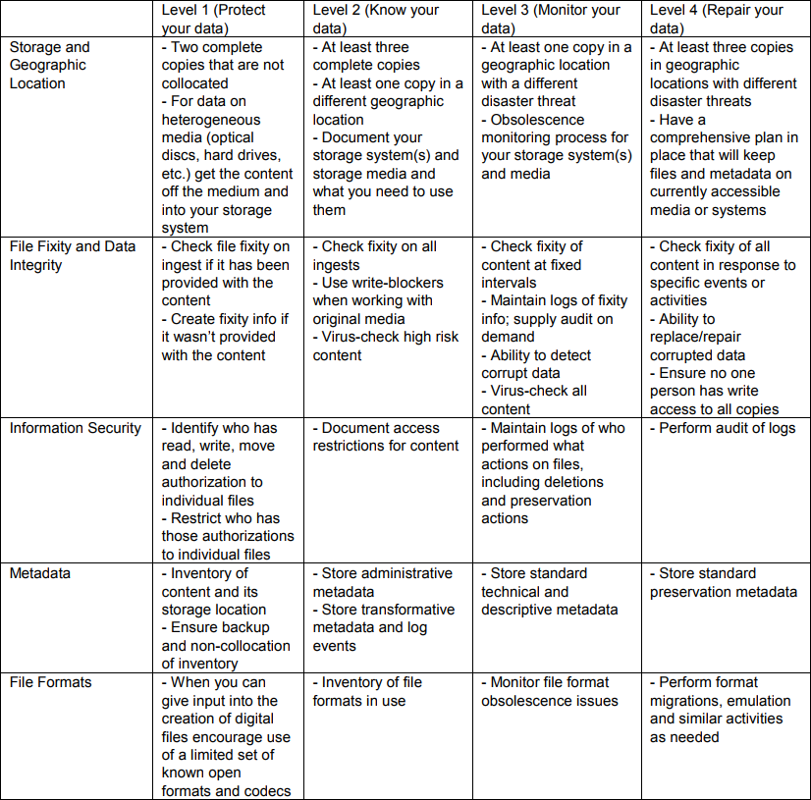
http://ndsa.org/activities/levels-of-digital-preservation/
Notes:
This epitomizes the incremental approach!!!
For those of you that are able to identify a set of materials for a pilot project, we need to look hard at where you are with those materials, what progress we think you can realistically make in the next 6 months, and where your landing spot will be. For example, at our last Institute we had a participant that had a stack of CD’s containing the only known copies of legacy renderings of engineering projects for Chicago’s public transit infrastructure…. Explain how that pilot is helping her to define the workflow for the archive’s incoming CAD files…
“In any of these areas, are folks at a level 4? Level 3? Level 0.5?”

Slide 14
The POWRR Approach
Focus on workflows! Today’s hot new tools are tomorrow’s orphans.
You will likely have different workflows for different sets of materials:
Backlog
Digitization Output
Born-digital Acquisitions
Not all tools and services are created equal.
~ Start with the least scary project and approach it as a pilot ~
Notes:
Don’t overthink it…especially tools. Choices of tools are not forever. They serve what you need now, selected with an eye to later. Focus on workflows! Today’s hot new tools are tomorrow’s orphans:
IRONICALLY, your first pilot workflow will be determined in part by the tools you select. The idea is to TRY SOMETHING and then make adjustments to/refine your workflow as necessary, and then find the tool or service that fits the refined workflow well enough.
Would it be easier to start with an inventory of your backlog?
Or would it be easier to start piloting a workflow for digital materials you need to actively collect and preserve? (scans of theses? Organizational newletters? Images from an event?)
You will likely be handling your backlog and your acquisitions going forward *very* differently…that’s ok!
You don’t have to pick the tools/services that will do ALL of the steps from the get go.
- Some tools/services do specific tasks (microservices). - Some tools/services combine multiple microservices (you guessed it….macroservices!).
Start with a step or two. And it doesn’t even have to be with a fancy schmancy tool!
Starting with a simple microservice tool will get you closer to your goals AND you can use them NOW! - Baby steps still move you forward….. See “Walk This Way”.

Slide 15
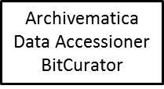
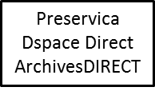
The Spectrum of Tools & Services
There are back-end storage/ preservation tools & services like…..
There are front-end/processing tools like…..
MetaArchive DuraCloud Amazon Glacier
Fixity
Internet Archive
There are even some services that will pretty much do it all like….
Technical skill available + Amount of annual funding devoted to DP = Range of tools to consider
Notes:
You saw this in the eLearning module….we want to emphasize the equation at the bottom…because either (or both!) of the variables can be ZERO, and there are STILL tools you can consider

Slide 16
Discover Your Advantages
Quickly set up accounts/pilots with hosted services.
You only need to convince the person one level above you to get what you need.
Less red tape
Fewer levels between you and decision-makers
Self-administered workstations
Personnel-heavy operating model
Higher cash flows and less digital materials
Want to install a simple open source tool? Go for it!
Ideal for running a *free* robust tool that may require a developer and server administrator.
You can purchase a reasonably-priced, hosted soup-to-nuts solution.
Notes:
Smaller institutions with fewer resources likely have unique advantages…. We are small but mighty! This is where we find our sweet spot!
(aka no IT administrative lock downs)
No budget, personnel heavy - Ideal for running a *free* robust tool that may require a developer and server administrator like Archivematica or bitcurator
(like small, private institution)
Hopefully during the sharing circles folks will begin to uncover some of their institutional advantages!

Slide 17
The POWRR Approach

Slide 18
Introductions!
Cohorts…
5 -10 minutes to….
- Introduce yourself, with job title and institution
- Answer a question from the sheet
Whole Group…
Lightning introductions! Introduce the person on your left…
- Name
- Job Title
- Institution
- Fun Fact

Slide 19
Sharing Circles until 10:00
Dig In: What brought you to the POWRR Institute?
What are the biggest challenges you’ve faced thus far?
Just let it all out!
Discuss: How can we make the most out of this opportunity?
What are some of the “sweet spots” we may have?
What do we think will be served at lunch?
Rules of Engagement: Each participant will not exceed 5 minutes “digging in”
No interrupting… jot down your thoughts and share during the discussion Be an active listener
Notes:
ADVISORS NEED TO BE TIMEKEEPERS - and remember to fill out the POWRR PLANS!!!!!

Slide 20
Individual POWRR Plan Work
Document the current state of your digital preservation activities
Define your organization’s needs and set goals accordingly
Determine which particular challenges and advantages will guide your decisions
Document the knowledge acquired during the POWRR Institute
Describe your pilot materials and capture a solution model(s) and workflow
Create an action plan with goals and activities defined at 3, 6 and 12 months
Break: 10:15 – 10:30
Notes:
If you haven’t already, start documenting your pilot project!
Section 4: POWWR Plan Action
Description of Pilot Project Materials

