Slide 1
The Life Cycle of Scholarly Research: Leaving a Legacy
Panelists: Dr. Winifred Creamer, Stacey Erdman
Jaime Schumacher, Danielle Spalenka
Open Access Week 2013
Notes:
Thank you Dr. Creamer.
We are going to switch gears here slightly and I’m going to start out with a rather bold statement.
What if I told you that…..

Slide 2
Preserving Digital Objects
The digital objects that Dr. Creamer has created in the course of her research are more fragile than most of the artifacts she has excavated.
Notes:
The digital objects that Dr. Creamer has created in the course of her research are more fragile than most of the artifacts she has excavated.
I’m not saying that the artifacts she has unearthed are less valuable, I am saying that, in many cases they are less fragile.
Dr. Creamer, In your work, have you discovered things that are, say, more than 100 years old? The GIS data that your team created 10 years ago, are you able to study that now in its current state? Well GIS data is incredibly complex so that’s not very fair…let’s try something easier.
Dr Creamer, in the course of your work, is your primary of method of professional correspondence through the use of email? What are the chances that, let’s say, 100 years from now, if a researcher was trying to better understand your scholarly process and wanted to sift through your professional correspondence……what are the chances that she will be able to view your emails? What about 50 years from now? 30?
Hmmmm…. Here is a letter written to a young officer advising him not to ask for a raise. Nothing earth-shattering here…no reason to carefully ensure it’s survival. Maybe it was in a box in someone’s attic for a century or 2? And yet, over 300 hundred years after it was written, this letter survives.
Another quick example…let’s think about someone’s Tumblr account. If a researcher regularly post updates, video clips, whatever about his ongoing work…wouldn’t that be a useful artifact to keep around in case a future scholar required it to inform her own efforts?
I present to you a 150 year old Tumblr account. Back then they called it a commonplace book. This one is still around. Will your Tumblr account be accessible in 150 years?

Slide 3
Preserving Digital Objects
The Dead Sea Scrolls 408 B.C.E – 318 C.E.
vs.
The First Presidential Campaign Website 1995
Notes:
So far these have been hypothetical examples of loss….a lot of what if’s and cool stuff from our Rare Book Library.
But let me give you a real example of a piece of history that was lost only because it was digital in nature, and compare it to another physical artifact that was sorely neglected for much longer, yet is still around today.

Slide 4
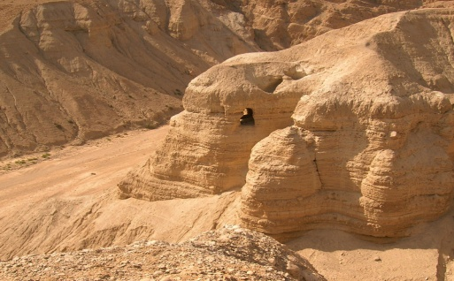
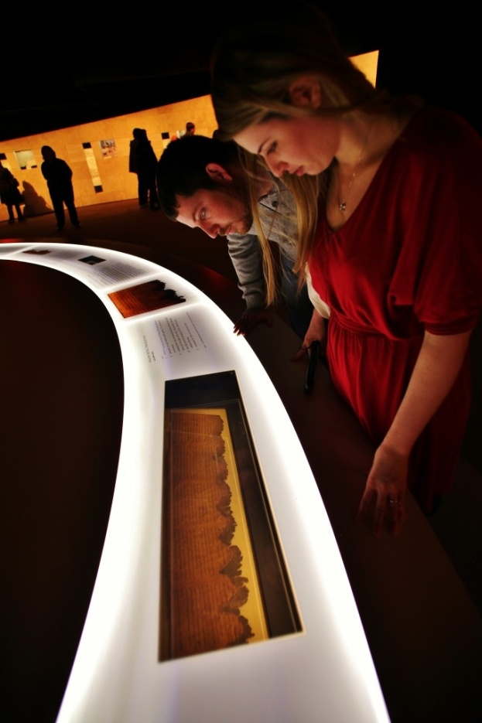
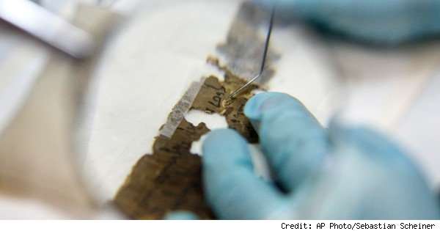
Preserving Digital Objects
Neglected for centuries…
…in a cave.
Carefully restored…
…and preserved for future generations.
Notes:
The Dead Sea Scrolls were discovered in 1947….historians believe they had been stored in clay jars for hundreds of years in harsh conditions. And yet…they survived. Despite the harsh environmental conditions they were exposed to in their cave over the years, including floods, conservators were able to carefully piece together many parts of the Dead Sea Scrolls, These artifacts are available today for public viewing and scholarly study…and will be preserved for future generations.

Slide 5
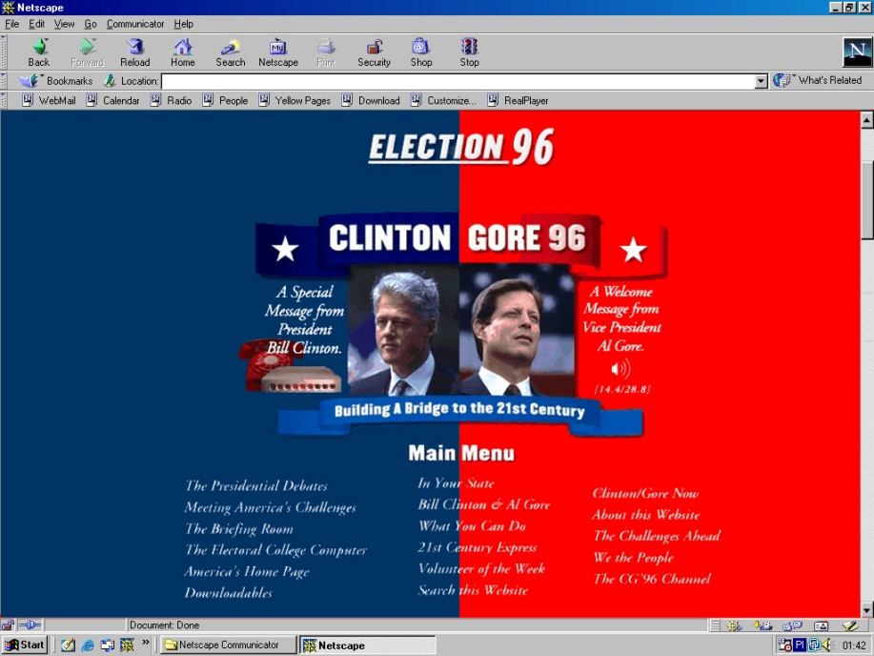
Preserving Digital Objects
1996: The first candidate to use the World Wide Web in his Presidential Campaign, William Jefferson Clinton, is elected.
18 Years Later: All that remains is a screen shot of the initial page.
“Historians studying the 1996 elections will have to write their accounts without these important pieces of historical evidence.”
–The Library of Congress
Notes:
The first presidential campaign ever conducted on the World Wide Web was the 1996 race between Clinton and Dole.
William Jefferson Clinton’s campaign website, while primitive by today’s standards. Was a pioneer in its time. The Web was still in its infancy and the potential power of its reach was yet unknown.
Unfortunately, this crucial piece of American history was not preserved. After more than a decade of efforts to restore the original site using the latest in digital forensic techniques, little has been recovered beyond a static image on the home page.
The rest is lost to history.

Slide 6
Preserving Digital Objects
But….. Why?
3 Reasons, Actually…
Media Obsolescence
Format Obsolescence
Bit Rot
Notes:
Many people believe that because something is digital or on the internet, it will last forever. Clearly, that is not the case. Why do digital objects become obsolete and unreadable so quickly? There are 3 reasons, actually.
The first is MEDIA OBSOLESCENCE. From the earliest computers (tape), to the gadgets of the 90’s (Palm), and on through today’s mobile devices (iPad)…digital objects are stored within physical components that become out of date and unusable. If an early manuscript of tomorrow’s Great American Novel is stored on a floppy disc, how will we be able to retrieve and study it in the future when there may be no working computers with Floppy drives?
What about the research and writing of today’s scholars? While seemingly safe backed up on a couple of thumb drives and some CD’s, these items may appear to be just as strange and unusable in 20 years as the 8 inch floppy or these other things look to us now!
The second reason digital objects become unusable is known as FORMAT OBSOLESCENCE. When a digital object, like a picture, blog post, graphic art, or a scholarly paper is created IT IS on a format that the originating program can understand. As new software is released, older formats can quickly become obsolete. Ever tried to open a document that was created several years ago?
Complex and proprietary audio visual formats are notorious for becoming unstable in a short amount of time. For example, if Dr. Creamer had taken pictures of her field work in progress that are stored in the Kodak RAW format, they will likely become irretrievable within a few years unless we intervene in some way.
BIT ROT sounds gross…and to a digital object it is fatal. Digital objects are made up of millions of bits, 1’s and 0’s. If any number of these bits are compromised, the entire object is affected. The corruption of a digital object can occur in a number of ways…………..CHANGE SLIDE

Slide 7
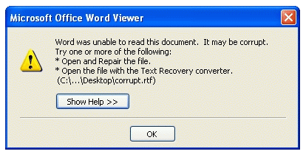
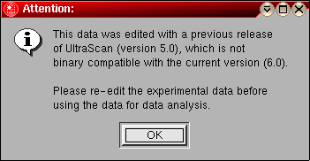
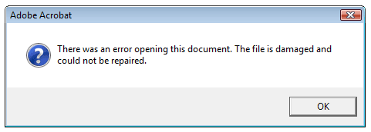
Preserving Digital Objects
Notes:
It can lose bits during a file transfer
OR When exposed to a virus or another cyber threat
OR as a result of environmental factors such as excessive heat, liquids, and physical damage.

Slide 8
Preserving Digital Objects
Hope Is Not Lost!
Utilize Personal Archiving Best Practices (Yes, there is such a thing!) (No, it does not involve printing out all your stuff!)
http://www.digitalpreservation.gov/personalarchiving/
Take Advantage of University Provided Services and Resources
Institutional Repository
University Archives
Notes:
But never fear, help is here!
As we have become more aware of the fragility of digital objects, research is being conducted and steps are being taken to help ensure that these objects will be accessible by future generations. Digital archival standards are being created and professionals in the information and preservation fields aka librarians!!! are hard at work fighting off what some are referring to as the Digital Dark Ages. Our job is to help you and researchers like Dr. Creamer ensure that, regardless of it’s physical form, your scholarly legacy is intact and available to future generations.
Here to describe a bit of what the library can do is Stacey Erdman, the curator for digital collections.

Slide 9
Huskie Commons – NIU’s Institutional Repository
Stacey Erdman

Slide 10
Huskie Commons: An Institutional Repository for NIU
An institutional repository is a secure virtual space that allows us to protect, promote, and showcase the work of the university (scholarly articles, campus publications, official administrative records, campus conference proceedings, research data, performances, student work, theses and dissertations) in digital form, in compliance with copyright laws.

Slide 11
Huskie Commons: An Institutional Repository for NIU
Huskie Commons mission statement:
The mission of the Northern Illinois University digital repository--hereafter Huskie Commons--is to collect, preserve, and share the intellectual output of the faculty, staff, and students in digital format. By centralizing the production of knowledge and scholarship into a one-stop "digital showplace," Huskie Commons stands poised to strengthen and extend NIU's teaching and learning environment more fully into a highly interdisciplinary digital realm. The Commons presents the best and brightest of NIU to the region, and even across the globe, helping the university become a true institution of "First Choice" for faculty, students, and staff.

Slide 12
Huskie Commons: An Institutional Repository for NIU
Faculty focus groups began in 2010, and a pilot program started up shortly thereafter.
Library is working with ITS to ensure adequate technical infrastructure.
A campus-wide taskforce convened by the Provost brought more visibility among faculty/departments.
Initially collected only peer-reviewed scholarly articles, have since widened scope.
Policies and procedures are still being ironed out, but faculty/staff/students can contact us to participate!

Slide 13
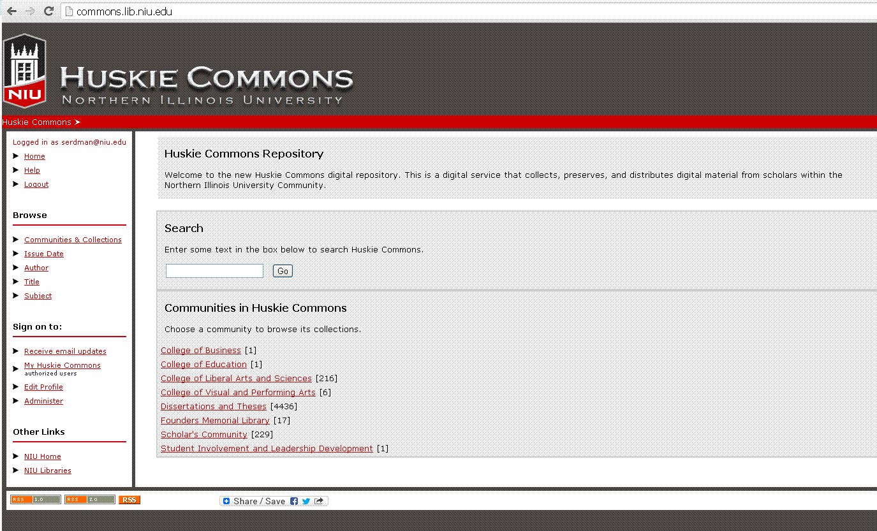
Huskie Commons: An Institutional Repository for NIU

Slide 14
For more information on depositing materials, please contact:
Stacey Erdman, Digital Collections Curator
97 Founders Memorial Library
serdman@niu.edu
815-753-1004

Slide 15
Regional History Center and University Archives
Danielle Spalenka

Slide 16
Regional History Center
Mission Statement:
Collect, preserve, and make available to the public the most significant records of the northern Illinois region
Three sets of historical records
University Archives
Regional Collections
Local Government Records

Slide 17
Regional History Center
What is an archive?
To collect, preserve, and provide access to documents and records that have enduring historical value
Original and unique documents
Research notes
Papers
Annual reports and meeting minutes

Slide 18
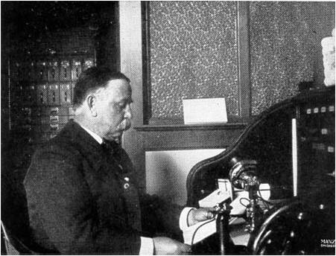
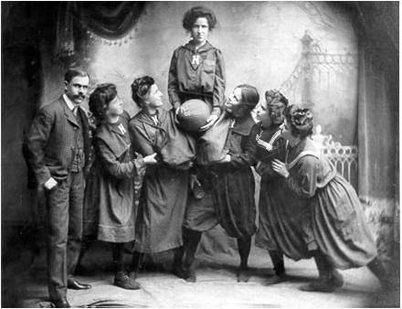
University Archives
The University Archives serves as the repository for all official records of NIU that have permanent historical or administrative value
We preserve all aspects of the University from its charter in 1895 to present

Slide 19
University Archives
Types of university records
Board of Trustees proceedings
President’s and Provost’s office
College and department records
Faculty and student papers
Extensive photographs of campus life

Slide 20
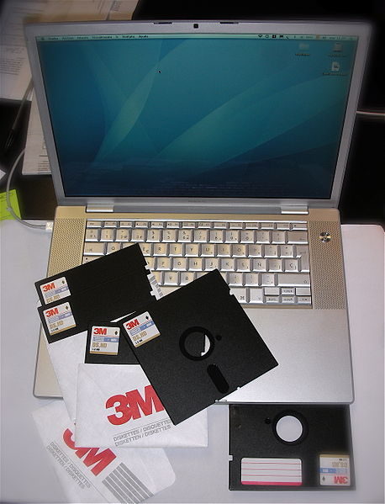
University Archives
Not only do we accept paper records but also born-digital and electronic records
Digital records preserved by University Archives will be made available to researchers through Huskie Commons

Slide 21
University Archives and You
Should I give my materials to the archives?
Yes! Your work helps tell the story of NIU
“Archival worthy”
Think about preserving your records NOW
It is much easier to simply “delete” a digital file that has archival value
Playing a more active role
E-mail us your stuff!
Memos, meeting minutes, notes, newsletters
Notes:
Dr. Creamer’s example of not realizing her material is “archival worthy”
Why would anyone want my stuff? Is it “archival worthy?”
We need your stuff now! Memos, meeting minutes, notes, newsletters, annual reports… things that are created digitally. We want to work with your while your records are being created and before you decide to hit the “delete” button
E-mail your materials to us – we’d be happy to set up a schedule or offer advice on what we’d like to keep and what can be deleted.

