Slide 1
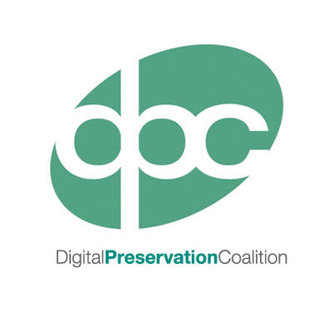
Next Steps
Notes:
This presentation will cover a number of activities you might consider undertaking after establishing the baseline digital preservation efforts we’ve described today.
A number of these activities are covered in our Making Progress workshops which we’ll be running later in 2016.
The presentation will also highlight some useful resources where you’ll be able to find more information on various digital preservation issues. Like all of the slides from today we’ll make these available on the DPC website after the event and you’ll find a wealth of information and links in the accompanying notes.

Slide 2
Advocacy
Develop a Business Case
Identify the benefits and risks
Identify stakeholders
Align with organisational goals
Illustration by Jørgen Stamp digitalbevaring.dk CC BY 2.5 Denmark
Notes:
An important first step is to ensure you have support within your organisation for digital preservation work and there are a range of advocacy activities that can help establish this.
Developing a sound business case will help you to gain support at an management level, particularly when trying to secure additional funding. There are a number of useful tools and guides available on this subject including:
Spruce – Sustainable Preservation Using Community Engagement) (JISC funded)
http://wiki.opf-labs.org/display/SPR/Home
Business Case Toolkit: http://wiki.dpconline.org/index.php?title=Digital_Preservation_Business_Case_Toolkit
APARSEN - Example Business Cases
http://www.alliancepermanentaccess.org/wp-content/uploads/sites/7/downloads/2014/06/APARSEN-REP-D36_2-01-1_0_incURN.pdf
4C Project – Collaboration to Clarify the Costs of Curation (EU funded)
http://www.4cproject.eu/
Being able to clearly state the benefits of digital preservation activities and the risks if no action is taken is also key in helping to convey the importance of digital preservation. Resources that can help with this include:
Keeping Research Data Safe - Benefits Framework which incorporates a list of generic benefits
http://www.beagrie.com/krds.php
And DRAMBORA which includes a similar list of risks
http://www.repositoryaudit.eu/
Successful advocacy also relies on identifying and engaging relevant stakeholders who can support your work through effort or funding, or by acting as advocates on your behalf.
You should also be careful to align preservation aims with your organisation’s wider goals by consulting corporate plans and strategy documents.

Slide 3
Policy and Strategy
Important to develop robust policy and strategy
An advocacy tool
Can set aims and objectives
Main reference point of decision-making
Lots of help available with what to include
Illustration by Jørgen Stamp digitalbevaring.dk CC BY 2.5 Denmark
Notes:
Evidence has proven that organisation’s with a robust and well-considered digital preservation policy are more successful at implementing digital preservation.
A good policy will
provide you with another advocacy tool to add to your arsenal
clearly state your aims and objectives, and can be aspirational when you start out
Act as the main reference point for decision-making in relation to digital preservation
There are a wide variety of resources which will guide you in what to include within your digital preservation policy (links below). Also be careful to consider your own organisation and it’s approach to policy development: make sure your policy is aligned with other organisational policies, using an established format and is ratified by relevant stakeholders.
APARSEN Recommendations for DP Policies
http://www.alliancepermanentaccess.org/wp-content/plugins/download-monitor/download.php?id=D35.1+Exemplar+good+governance+structure+and+data+policies
National Archives
http://www.nationalarchives.gov.uk/documents/information-management/digital-preservation-policies-guidance-draft-v4.2.pdf
Jisc Digital Preservation Policies Study
http://www.jisc.ac.uk/publications/reports/2008/jiscpolicyfinalreport.aspx
Library of Congress
http://blogs.loc.gov/digitalpreservation/2013/08/analysis-of-current-digital-preservation-policies-archives-libraries-and-museums/
SCAPE Catalogue of Policy Elements
http://wiki.opf-labs.org/display/SP/Catalogue+of+Preservation+Policy+Elements
DPM Tools and Techniques
http://dpworkshop.org/workshops/management-tools

Slide 4
Storage and Systems
Plan for development and ongoing management
Requirements analysis and system procurement
Clear policy and procedures
Preservation Planning
Illustration by Jørgen Stamp digitalbevaring.dk CC BY 2.5 Denmark
Notes:
APARSEN Storage Report
http://www.alliancepermanentaccess.org/wp-content/uploads/sites/7/downloads/2014/06/APARSEN-REP-D23_2-01-1_2_incURN.pdf
Preservation Planning
PLANETS
http://www.planets-project.eu/
Scape – Scalable Preservation Environments (EU funded)
http://www.scape-project.eu/
http://wiki.opf-labs.org/display/SP/Home

Slide 5
Keep Track of Your Data
Ongoing programme of collection audits
Manage access and fixity checks
Procedures for updating Digital Asset Register
Illustration by Jørgen Stamp digitalbevaring.dk CC BY 2.5 Denmark

Slide 6
Collaboration
Establish Digital Preservation working party
Identify allies in relevant departments
Engage Stakeholders
Develop joint-projects
Illustration by Jørgen Stamp digitalbevaring.dk CC BY 2.5 Denmark

Slide 7
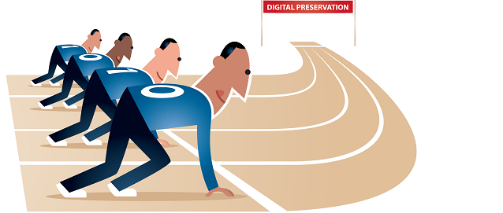
Staff Training & Development
Skills audit
Plan for staff development
Identify useful resources
Illustration by Jørgen Stamp digitalbevaring.dk CC BY 2.5 Denmark
Notes:
Important to identify the skills you already have in-house through a process such as a skills audit. Following this up with ongoing plans for staff development based on the gaps identified. A highly regarded resource in this area is the DigCurV Curriculum Framework (http://www.digcur-education.org/) which describes key competencies for staff working in digital preservation at various points in their career, identified in the framework as ‘Practitioner’, ‘Manager’ and ‘Executive’. The framework is an excellent basis for both a skill audit and ongoing development. It is also reassuring as specialist digital preservation knowledge forms only a small fraction of the skills identified as necessary for carrying out digital preservation!
We’ve also found that peer to peer learning and support is key to developing your digital preservation skills, and contacts made at events such as this can prove endlessly useful.
DPTP - http://dptp.org/

Slide 8
Accreditation/Certification
Self-assessment
Peer assessment
Formal accreditation/certification
Illustration by Jørgen Stamp digitalbevaring.dk CC BY 2.5 Denmark
Notes:
European Framework for Certification agreed by EU
Basic Certification
Self-assessment using Data Seal of Approval
Extended Certification
Self-audit based on ISO 16363 or DIN 31644
Formal Certification
Full audit based on ISO 16363 or DIN 31644
Alternatives are also in development including coverage of digital issues within the ARA Accreditation scheme

Slide 9
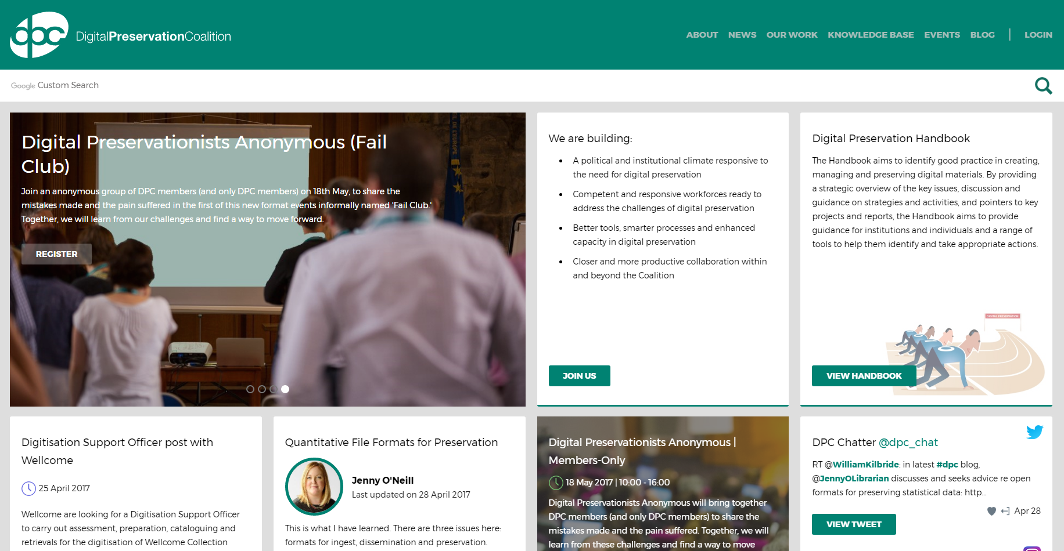
Digital Preservation Coalition
60+ Members
Commercial Supporters
Member Support
Networking
Training
Advocacy
Publications
Research and Practice
Notes:
http://www.dpconline.org

Slide 10
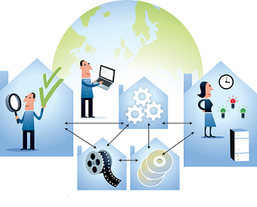
Some DPC Resources
Tech Watch reports
Events
Webinars
Digital Preservation Handbook
Leadership Programme
Illustration by Jørgen Stamp digitalbevaring.dk CC BY 2.5 Denmark
Notes:
Tech Watch Reports - (http://www.dpconline.org/publications/technology-watch-reports)
Events - (http://www.dpconline.org/events)
Making Progress: London, Dublin, Edinburgh – Sep/Oct 2016
Briefing Days: Accreditation and Certification, 25th May, London File Formats, 23rd June,

Slide 11
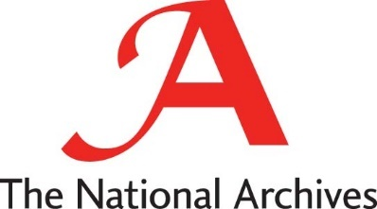
Other Organisations
Notes:
The National Archives
http://nationalarchives.gov.uk/information-management/projects-and-work/digital-preservation.htm
Parsimonious Preservation
http://www.nationalarchives.gov.uk/documents/information-management/parsimonious-preservation.pdf (2009)
http://www.nationalarchives.gov.uk/documents/information-management/parsimonious-preservation-in-practice.pdf (2013)
British Library
http://www.bl.uk/aboutus/stratpolprog/collectioncare/discovermore/digitalpreservation/index.html
DCC
http://www.dcc.ac.uk
Jisc
http://www.jisc.ac.uk/whatwedo/topics/digitalpreservation.aspx
Open Preservation Foundation
http://openpreservation.org/
National Library of Wales
http://www.llgc.org.uk/index.php?id=3970
NCDD
http://www.ncdd.nl/en/
Library of Congress
http://www.digitalpreservation.gov/

Slide 12
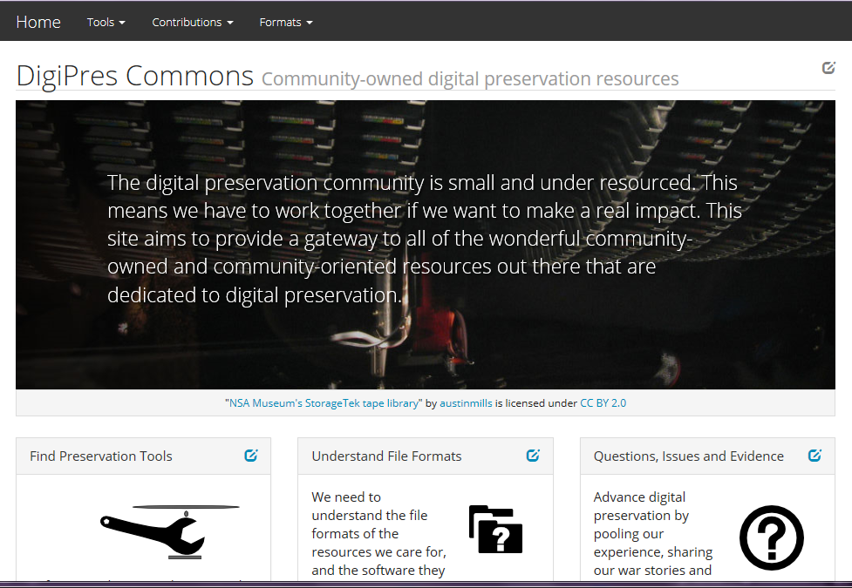
DigiPres Commons
Notes:
http://www.digipres.org/
A collaborative digital preservation community sharing solutions and experience. Particularly useful for:
Coptr – a digital preservation tools registry
Q&A section – allows users to pose questions/issues about digital preservation and the community will crowdsource answers. Interesting to browse the questions that have already been posed.
Also provides pointers to lots of other useful resources.

Slide 13
Information Resources
Mailing Lists
Journals
Training Events
Conferences
Blogs
Social Media
Illustration by Jørgen Stamp digitalbevaring.dk CC BY 2.5 Denmark
Notes:
Mailing Lists
Variety of digital preservation mailing lists exist with the most prominent and useful being the JiscMAIL DIGITAL-PRESERVATION@jiscmail.ac.uk
Journals
International Journal of Digital Curation - http://www.ijdc.net/, Dlib - http://www.dlib.org/
Training Events
DPTP – http://www.dptp.org
Conferences
iPRES - https://ipres-conference.org/, PASIG - http://www.preservationandarchivingsig.org/
Blogs
http://digital-archiving.blogspot.co.uk/
Digital Archiving at the University of York
http://blogs.loc.gov/digitalpreservation/
The Signal – Library of Congress digital preservation blog
http://blog.nationalarchives.gov.uk/blog/tag/digital-preservation-2/
The National Archives – entries tagged “digital preservation”
http://digipresnews.wordpress.com
Weekly DP news and opinion from DPC’s own Paul Wheatley
Social Media
Twitter
@WilliamKilbride
@prwheatley
@SharonMcMeekin
@sdaythomson
#digitalpreservation
LinkedIn
Various digital preservation related groups

