Slide 1
Writing a Digital Preservation Policy
Notes:
Writing a Digital Preservation Policy

Slide 2
What is a Policy?
“A course or principle of action adopted or proposed by an organisation or individual” (OED)
Written representation of the aims and objectives
Sets the environment for all other activities
Framework for Business Plan/Strategy
Influenced by many things: environmental, political, technical, financial and legal issues
Should be flexible and subject to regular review
Difficult to make policy in new & developing areas

Slide 3
What is a Digital Preservation Policy?
A digital preservation policy is the mandate for an archive to support the preservation of digital records through a structured and managed digital preservation strategy
The National Archives
A digital preservation policy facilitates the effective management of the digital records ensuring the organisation is able to carry out its mandated functions
InterPARES Project
Notes:
MANDATE

Slide 4
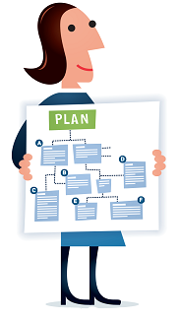
Digital Preservation Policy
The organisation’s aims and objectives about the long term care of digital objects
Preservation strategies and acceptable actions
Decisions about the digital objects (formats, metadata)
Standards
Who the material is being preserved for
Resourcing
Responsibilities
Illustration by Jørgen Stamp digitalbevaring.dk CC BY 2.5 Denmark
Notes:
High level – not specifics
1- Preservation strategies and acceptable actions
For example, the UKDA (Woollard 2008) preservation policy claims that it is committed to ensuring “the reliability and logical integrity of the data collection” but that “…some significant properties of a data collection may have to be altered in order to ensure a level of software independence”
2- Decisions about the digital objects
For example, also from the UKDA Policy: “When there is a new edition of a data collection, all descriptive and structural metadata must be recreated, and the old file and the previous AIP and DIPs retained within the preservation system and identified as not for issue.”
3- Standards: how they are selected and applied but not necessarily naming specific standards
For example “HathiTrust employs a number of strategies to ensure the long-term integrity of deposited materials. These include: … Reliance on standards for metadata such as METS and PREMIS (see HathiTrust Digital Object Specifications)”
4- Resourcing
For Example, Dartmouth College Library:’s policy states under a ‘Sustainability’ heading: “Digital preservation activities will be planned and implemented in ways that best manage current college resources and can be sustained into the future. Future access to digital resources cannot be assured without institutional commitment to necessary resources.”

Slide 5
Part of a Wider Policy Landscape
IT Infrastructure Policy
Organisational Resourcing Policy
Collections Management Policy
Digital Preservation Policy
Notes:
Try to emphasise how digital preservation benefits other areas of policy within your organisation

Slide 6
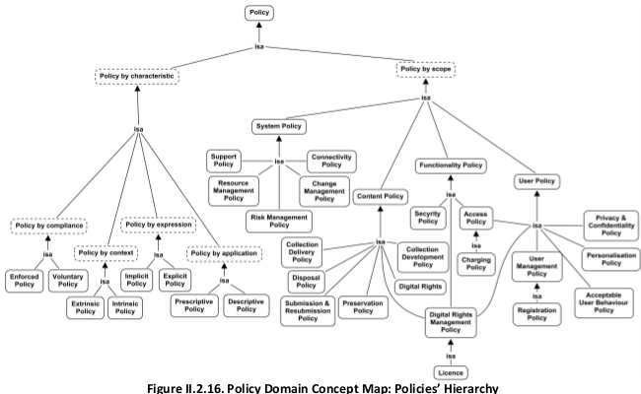
Digital Library Ref Model
Fig. II.2.16 Policy Domain Concept Map: Policies’ Hierarchy
Notes:
Fig. II.2.16 Policy Domain Concept Map: Policies’ Hierarchy
The Policy concept represents the set or sets of conditions, rules, terms and regulations governing every single aspect of the Digital Library service including acceptable user behaviour, digital rights management, privacy and confidentiality, charges to users, and collection formation. Policies may be defined within the Digital Library or be superimposed by the Institution establishing the Digital Library, or outside of that (e.g., Policy governing our Society). The policies can be extrinsic or intrinsic policies.
Definition of new policies and re-definition of older policies, is part of the policy-related functionality that must be supported by a Digital Library. This concept is fundamental to characterise the Digital Library universe because it captures the rules and conditions regulating the overall Organisation.

Slide 7
Benefits of Developing a DP Policy
Helps to raise awareness of digital preservation
Guide staff in their activities related to DP
Supports decision making
Helps support a business case for DP solutions
Gains buy-in from senior management
Solidifies commitment of the institution/organisation
Illustration by Jørgen Stamp digitalbevaring.dk CC BY 2.5 Denmark

Slide 8
Developing Your Policy
Establish Purpose
Research
Develop Structure
Identify Elements
Develop Content
Stakeholder Review
Gain Approval
Regular Reviews

Slide 9
Jisc Digital Preservation Policies Study
Outline model for DP Policies
Analyse role of DP in supporting and delivering key strategies for HEIs
Produced two tools:
Model/framework
Mappings to other institutional policies/strategies
http://www.jisc.ac.uk/publications/reports/2008/jiscpolicyfinalreport.aspx

Slide 10
What Your Policy Should Contain
Principle Statement
Contextual Links
Preservation Objectives
Identification of Content
Procedural Accountability
Financial and Staff Responsibility
Intellectual Property
Distributed Services
Standards Compliance
Review and Certification
Auditing and Risk Management
Stakeholders
Preservation Strategies
Guidance and Implementation
Glossary
Version Control
Illustration by Jørgen Stamp digitalbevaring.dk CC BY 2.5 Denmark
Notes:
Preservation Objectives: These objectives are very similar to the principle statement but tie in more with the actual preservation process itself. For example, the Inter-University Consortium for Political and Social Research (ICPSR) (McGovern 2007) states under ‘Administrative Responsibility/Objectives’ that it will “Maintain a comprehensive and responsive digital preservation program that identifies, acquires, verifies, archives, and distributes core social science digital assets”

Slide 11
SCAPE Project
Particular focus on policy relating to preservation actions
http://www.scape-project.eu/deliverable/d13-1-final-version-of-policy-specification-model
Defined set of policy levels
Catalogue of policy elements
http://wiki.opf-labs.org/display/SP/Policy+Elements
List of policies available online
http://wiki.opf-labs.org/display/SP/Published+Preservation+Policies
Notes:
Specifically policy statements addressing preservation actions
Authenticity
1.1 Integrity
Ex. Parliamentary Records: “The record must be maintained to ensure that it is complete, and protected against unauthorised or accidental alteration. In this Policy, integrity is ensured through the bitstream preservation function […], and through the provision of metadata to describe all authorised actions undertaken in the course of content and bitstream preservation.”
1.2 Reliability
1.3 Provenance
2. Bit Preservation
3. Functional Preservation
4. Digital Object
5. Metadata
6. Rights
7. Standards
8. Access
9. Organisation
10. Audit and Certification

Slide 12
SCAPE Policy Levels
Guidance
High Level
General objectives
Preservation Procedure
More detailed level
Control
Specific, measurable objectives
Applies to specific collections or formats
Applies to all parts of organisation and collections
Written in natural language to be read by a human being
General approaches
Written in natural language to be read by a human being
In two forms: natural language and machine readable form (RDF)
Notes:
Guidance policies
On this level the organisation describes the general long term preservation goals of the organisation for its digital collection(s). One example is that an organisation decides that the infrastructure in place to provide digital preservation will be guided by the OAIS model.
Preservation Procedure level policies
These policies describe the approach the organisation will take in order to achieve the goals as stated on the higher level. They will be detailed enough to be input for processes and workflow design but can or will be at the same time concerned with the collection in general.
Control Policies
On this level the policies formulate the requirements for a specific collection, a specific preservation action or for a specific designated community

Slide 13
SCAPE Policy Elements
Authenticity
Bit Preservation
Functional Preservation
Digital Objects
Metadata
Rights
Standards
Access
Organisation
Audit and Certification
Illustration by Jørgen Stamp digitalbevaring.dk CC BY 2.5 Denmark
Notes:
Authenticity
1.1 Integrity
Ex. Parliamentary Records: “The record must be maintained to ensure that it is complete, and protected against unauthorised or accidental alteration. In this Policy, integrity is ensured through the bitstream preservation function […], and through the provision of metadata to describe all authorised actions undertaken in the course of content and bitstream preservation.”
1.2 Reliability
1.3 Provenance

Slide 14
APARSEN Project
Analysis of policies in Cultural Heritage and Research sectors
Based on desktop research and survey
Produced a set of 15 recommendations for data policies
Final report:
http://aparsen.digitalpreservation.eu/pub/Main/ApanDeliverables/APARSEN-REP-D35_1-01-1_0.pdf

Slide 15
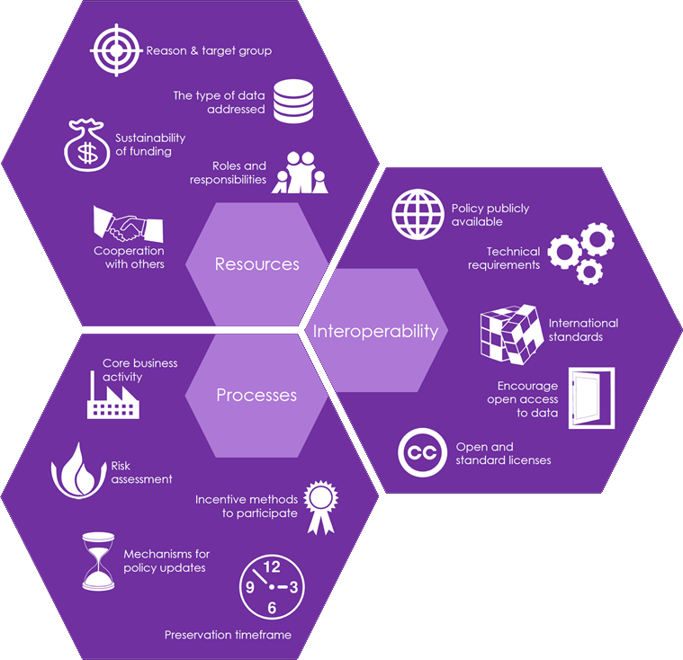
Recommendations for Preservation Policies
Notes:
These policy documents focus on issues relevant to preservation management, even if not explicitly related to the preservation process itself, such as: legal conformity, protection of intellectual property, formal responsibility, professionalism, interoperability, quality, security, accountability, sustainability, retention of policy management mechanisms and repository restrictions, and metadata requirements. This gives rise to the first fundamental challenge of defining the scope and focus of our research: what is a policy and, more specifically, what is a policy for digital preservation?

Slide 16
Library of Congress
Analysis of available preservation policies
http://blogs.loc.gov/digitalpreservation/2013/08/analysis-of-current-digital-preservation-policies-archives-libraries-and-museums/
Taxonomy of topics covered
Short report with lots of additional resources!

Slide 17
LoC Taxonomy
Access and Use
Accessioning and Ingest
Audit
Bibliography
Collaboration
Content Scope
Glossary/Terminology
Mandates
Metadata or Documentation
Policy/Strategy Review
Preservation Model/ Strategy
Preservation Planning
Rights and Restriction Management
Roles and Responsibilities
Security Management
Selection/Appraisal
Staff Training/Education
Storage, Duplication, and Backup
Sustainability Planning
Notes:
Alphabetical, not hierarchical

Slide 18
Other Useful Resources
TNA - DP Policies: Guidance for Archives
Includes why important
Links to examples
http://www.nationalarchives.gov.uk/documents/information-management/digital-preservation-policies-guidance-draft-v4.2.pdf
DCC Policy Tools and Guidance
http://www.dcc.ac.uk/resources/policy-and-legal/policy-tools-and-guidance/policy-tools-and-guidance
Illustration by Jørgen Stamp digitalbevaring.dk CC BY 2.5 Denmark

Slide 19
Discussion
Handout with elements from 4 key resources
Consider how they might apply to your organisation
Select one? Mix and match?
Start to arrange into the order they might appear in a policy
If you have time, note down a few points you would include in your policy

