Slide 1
Technology Module:
Walk The Workflow
@digitalPOWRR
This POWRR Institute is generously funded by the
Notes:
Curriculum created by Jaime Schumacher and the POWRR team

Slide 2
Expected Outcomes
Become familiar with basic steps that will take you through a simple digital preservation workflow.
Learn about common open source tools currently available to perform this work.
Learn how to acquire and transfer digital files from a source using the tool DataAccessioner.
Learn how to prepare files for upload to a preservation system using the tool Bagger.
Learn how to create a checksum and check file fixity for digital materials using the tool Fixity to confirm they remain unchanged.
Notes:
Understanding what eXtensible Markup Language (XML) is and how it is used in digital preservation.
Understanding how to acquire and transfer digital files from a source using the tool DataAccessioner.
Understanding what is a file checksum and its relation to digital preservation.
Understanding how to create a checksum and check file fixity for a digital file or files using the tool Fixity to confirm that it has not been altered or corrupted.
Understanding how to prepare files for upload to a preservation system using the tool Bagger.

Slide 3
Walk The Workflow
Walk, step-by-step, through an actual workflow for a sample case study, using simple tools on your laptops.
It’s ok (and important!) to triage what you have now
Remember: It’s a relay….not a marathon
Start with a simple workflow, with the expectation that it WILL change
Notes:
It’s ok (and important!) to triage what you have now
It’s going to take some time for pilot projects (like the one you’ve identified for your POWRR PLAN) to turn into established, refined workflows that are just another part of our normal workdays. It’s going to take even longer to build community awareness and support, create long-term approaches, refine policies, etc. MEANWHILE the stuff we have languishing in *places* is at a high risk of loss…digitally, contextually, physically.
THUS, we have to triage that material so it is even AVAILABLE to hand off to whomever is running next leg of the race (keeping in mind…that person may be YOU!).

Slide 4
The POWRR Approach
Notes:
Remember from Day 1?…it is NOT a lack of tools, services, and solution models preventing folks from making progress. This simple workflow is intended to get you past whatever it ACTUALLY is that’s keeping you from getting started in the first place OR from reaching the next level OR from trying something different because the solution in place isn’t cutting it.

Slide 5
Walk The Workflow
Ingest
Processing
Access
Storage
Maintenance
Other
Getting it
And a few other odds & ends…
Letting people use it …or not!
Understanding it
&
Documenting it
Taking care of it
STEP 1 – Don’t Panic
Notes:
REMEMBER: What you need to consider when thinking about your digital stuff…looks a LOT like the same things you consider for your physical materials.
The workflow we will walk through today touches on each part of this, with the exception of ACCESS, though you will have any opportunity to relay rights information for digital materials to the next person (or system)! in your relay.

Slide 6
We’ve Acquired WHAT?!?!
Ingest
Processing
Access
Storage
Maintenance
Other
Spreadsheet DataAcessioner
DA: Metadata Transformer
AV Preserve’s Fixity
Bagger
There are other open-source tools that can perform these activities.
Notes:
Case Study
Inventory
Triage with DataAccessioner
Visualizing the output with DataAccessioner: Metadata Transformer Tool
Bagging Your Materials in preparation for handoff
Monitoring long-term health with AVPreserve’s Fixity
These will cost you time, not money…(remember free like kittens?)
INSERT OTHER TOOLS THAT CAN DO THIS!!!

Slide 7
Open Source Software – an Interlude
Two main types of OSS for digital preservation:
Large-scale applications
Repository systems
Storage
Workflow
Tools for particular functions
Characterization
Migration
De-duplication
…
Notes:
INTERLUDE HMMMMMMMM
When looking at OSS software for digital preservation there are two main types of product you may consider using.
The first are large scale applications which can be used to manage multiple processes.
These can include complete repository systems, software for managing storage and workflow management systems for implementing potentially complex process.
The other main type of OSS for digital preservation is smaller tools that carry out particular functions, which can be smaller-scale processes or a step in larger processes.
These can include tools for characterising a digital collection, for migrating a particular file type or to check a folder for duplicate file.
There are many of these smaller tools and often several that will carry out the same function.

Slide 8
A Note About the Word “Free”…
NOT
Open source software requires resources to install, maintain, and improve it.
Notes:
Some tools are free open source tools. But it’s important to note that open source tools are free like kitties, and not like beer. There’s A LOT of work and maintenance that goes along with that free kitty, whereas a free beer allows you to sit back and enjoy.
Getting a free kitten doesn’t cost money up front, but there’s a lot of maintenance. Sadly, Open Source is not like a free beer you can sit back and enjoy.
Open source software requires resources to install, maintain, and improve it.

Slide 9
Comparison with Vendor Solutions
Issue | OSS | Vendor
Initial Cost
Installation
Source Code
Customization
Licenses
Bugs
Support
Documentation
Training
Motivation for Developments
Succession
Notes:
The table on this slide shows a simplified visual comparison of using Open Source Software versus vendor provided solutions. Green = good in this area, yellow = mixed, some strengths and weaknesses, red = not available.
Both have their strengths and weaknesses. Looking at these in a little more detail:
Initial Cost - Much OSS is free but even if there is an initial cost in procuring OSS it likely to be small in comparison with vendor solutions which may require a significant investment as well as an ongoing commitment to additional services or updates.
Installation – Vendors are likely to provide support with the installation of more complex pieces of software and simpler pieces are distributed in an executable format that is usually easy to install. Installation of OSS is more variable and may require an invest of resources and more technical skills to get it up an running.
Source Code – OSS provides access to the original source code whereas vendor supplied solutions are pre-compiled.
Customization – By having access to the original source code, this means it is possible to fully customise OSS for your organization if you have sufficient programming skills. There is also the potential for greater customisation and collaboration from the wider community. Customization of vendor solutions is usually limited to the in-programme options and tools. Any more significant customisation will depend on the vendor and their priorities. Some vendors will create customised modules for their software for a fee.
Licenses – It is generally only to acquire only one license for OSS no matter how many installations are needed. They are also more open to the creation of derivative works and redistribution. Vendor licenses tend to be far more restrictive, limiting how and where the software can be used. It also normal that multiple licenses may need to be purchased one for each user or installation of the software.
Bugs – Due to the collaborative nature of OSS development stable versions of the software tend to be less buggy and when bugs are identified they are addressed more promptly if a reasonable-sized community exists for the product. Vendor software tends to be more buggy when first released as getting the product on the market is a key. They may also be slower to address identified bugs later depending on their current commercial and/or development priorities.
Support – Vendor software often comes with a support package, or this can be purchased as an addition. Meaning that there is some expectation of good and prompt support. The situation is more mixed for OSS software and depends on factors such as the size and engagement of the user community or the availability of paid-for support services.
Documentation – Documentation was historically poor for OSS but the situation is much improved in recent years but it cannot be relied upon for all software. For vendor solutions, there is a reasonable expectation that good documentation will be provided when the product is procured.
Training – Like documentation, training for OSS is mixed and sometimes only available for larger/more established programmes. Commercial vendors will more likely have training resources available. Depending on the size and complexity of the software this may anything from online resources to the provision of in-house training for staff.
Motivation for Developments – One of the key strengths of OSS is that developments are normally motivated directly by the needs of the user community. The main motivations for vendors are usually focused on commercial concerns; such as making a profit and strengthening their position in the market. This can mean they are less responsive to user needs and will adhere to business models such as planned obsolescence.
Succession – No matter the type of solution chosen it is important to carry out succession planning to make sure data can be retrieved in the event of the discontinuation of the solution. With OSS the continued support and development of a product relies on the ongoing engagement of the community. If this abruptly ends, access to the source code means users are in a strong position as long as they have the skills/resources required. With vendors, it is very important to include succession planning in any service agreements but issues may still occur in cases on bankruptcy.

Slide 10
Use Cases
“I’d like our institution to be the home for your literary papers.”
Backlog What is THAT?
What is on it?
~ gets handed flash drive ~
Actual Conversation, ca. 2004
Digitization Workflow Now what?
Born Digital Acquisitions Huh?
Notes:
BACK TO OUR REGULARLY SCHEDULED PROGRAMMING………
We could pull a sample case study from any one of these types of use cases…there are endless flavors of each type!! Today we are going to use Case Study from a Backlog

Slide 11
Case Study
Small, processed collection in The Archives entitled: “The Archive’s Furry Residents”
Contains CD’s and floppy disks, among other things
A collection record in Archon
“CD’s and Floppy Disks – unknown content”
Notes:
To keep it fun, let’s say it is a collection of materials associated with the Archive’s beloved animal residents! through the years. The physical collections contains:
news articles
programs from local events
Photographs
Medical records from vet appointments
the manuscripts and associated materials of a best-selling children’s book entitled “Orbit the Cat Saves the Archives”
the occasional piece of fashionable cat clothing
It also contains some CD’s and a few floppy disks. Some are labeled, some are not.
This collection has an associated record in Archon, but the description for the box containing the digital media simply states “CD’s and Floppy Disks- unknown content”

Slide 12
Walk The Workflow
Starting from scratch:
Begin an Inventory Spreadsheet.
Our PC has a CD drive, so we’ll start with those while we look for a working floppy drive.
Run DataAccessioner. Creates basic preservation metadata files in XML for you! Allows us to add descriptive metadata. Moves everything to a stable carrier (The Archives has a network drive…we’ll put stuff there).
Make an Access Copy from the Master Copy.
Run the DA: Metadata Transformer Tool to make sense of the XML.
Continue populating the Inventory Spreadsheet.
Once you’ve grabbed everything you can, place everything in standards-based packages using Bagger.
Setup the ongoing fixity monitoring of the Bags using Fixity.
Notes:
1.) Inventory can be as simple as creating a spreadsheet. Stanford recently switched back to using a spreadsheet for documenting their born-digital material (https://saaers.wordpress.com/2016/04/19/recent-changes-in-how-stanford-university-libraries-is-documenting-born-digital-processing/)
2.) Run accessioning tools and move to stable carrier (these tools help tell you what you have
Consider using a clean machine and/or writeblocker – Dorothea’s PROUD tech module will talk about this more!!!
As you walk the workflow, you’ll have to make decisions like:
Do we keep original media?
Do we add a note in Archon that the materials have been harvested and placed in *a location*?
Update finding aid?
Other decisions?
Don’t let BIG decisions = game over…..sometimes your decision can be to NOR make a decision…just make sure you document what decision you are putting off and why in your procedures/workflow/job aid document so it can be re-visited later!!! Maybe use your POWRR plan for now????
NOTE: This is only ONE way to do this… Everyone’s workflow will be different, because LOCAL PRACTICE! Your workflow now likely will very different from your workflow 18 months from now!

Slide 13
WTW – Spreadsheet
Other
Ingest
Processing
Access
Storage
Maintenance
Collection Title
Archon ID
Box
Item
Label Notes
Media Type
Date of Review
Formats
Extent
Dates Covered
Master Copy Location
Access Copy Location
These are things we can’t tell by just looking at the stuff

Slide 14
WTW – Spreadsheet
Other
Ingest
Processing
Access
Storage
Maintenance
…and use DataAccessioner to discover this information
Fill out what we can……
Digital_POWRR_Workshop_Tools_and_Hands_On_Activities\Donated Collection DigitalCollectionsInventory.xls
Notes:
Other fields?
Don’t let decisions = game over…..sometimes your decision can be to NOT make a decision…just make sure you document what decision you are putting off and why in your procedures/workflow/job aid document so it can be re-visited later!!!
OPEN SPREADSHEET and start filling in (it’s already started)

Slide 15
Walk The Workflow
Begin an Inventory Spreadsheet.
Our PC has a CD drive, so we’ll start with those while we look for a working floppy drive.
Run DataAccessioner. Creates basic preservation metadata files in XML for you! Allows us to add descriptive metadata. Moves everything to a stable carrier (The Archives has a network drive…we’ll put stuff there).
Make an Access Copy from the Master Copy.
Run the DA: Metadata Transformer Tool to make sense of the XML.
Continue populating the Inventory Spreadsheet.
Once you’ve grabbed everything you can, place everything in standards-based packages using Bagger.
Setup the ongoing fixity monitoring of the Bags using Fixity.

Slide 16
WTW – DataAccessioner
Other
Ingest
Processing
Access
Storage
Maintenance
Who developed DataAccessioner?
- Originally created for tech services staff at Duke University RBMSC
- Updated by Seth Shaw for POWRR and other organizations
- dataaccessioner.org
What is DataAccessioner?
- Simple, open-source tool with a user-friendly interface used to migrate (copy!) content between media while also: - creating and validating checksums
- gathering metadata (via FITS)
- compiling an XML metadata file, with the option to include Dublin Core metadata as of v 1.0) for future reference.

Slide 17
On Your Flash Drives
Digital_POWRR_Workshop_Tools_and_Hands_On_Activities
Data Accessioner
DataAccessioner_v1_1
dataaccessioner-1.1
Open the file named dataaccessioner.jar
Notes:
If it isn’t already running on their machines!!!!
Now switch to DataAccessioner

Slide 18
XML – An Interlude
XML = eXtensible Markup Language.
Used to store and transport data
Is readable by humans* and computers.
Information in an XML file is stored in nested blocks that have opening and closing brackets.
*It actually is!!! You’ll see…
Notes:
INTERLUDE HMMMMMMMM
XML is an acronym for eXtensible Markup Language.
It is used to store and transport data and was created to be readable by both machines and humans
The basic structure of XML is that all of the data in the file is nested within blocks, that are sectioned off by opening and closing brackets.

Slide 19
XML – Example 1
<?xml version="1.0" encoding="UTF-8"?> <note> <to>Jane</to> <from>John</from> <heading>A Note</heading> <body>Please bring the work files with you.</body> </note>
Notes:
In this slide, you can see that this is a NOTE from Jane to John with a heading of “A Note”, and the text of the note stating: “Please bring the work files with you.” Notice each portion has a matching opening and closing bracket set.
It also helpfully let’s us know what version of XML it’s using…because apparently all things technology change. Fast.
This is how different emails systems can communicate with one another! How Google mail knows which part of the email to display as a subject in the message sent from a completely different software…like AOL *gags*

Slide 20
XML – Example 2
<?xml version="1.0" encoding="UTF-8"?> <books_to_purchase> <book> <name>What is XML?</name> <price>$35.95</price> <description> A book about XML. </description> <author>John Smith</author> </book> <book> <name>What is Digital Preservation?</name> <price>$55.95</price> <description> A book about Digital Preservation. </description> <author>Jane Doe</author> </book> </books_to_purchase>
Notes:
In this slide, you can see that this is a list of books to purchase. Each book has its own name, price, and description. There can be as many books listed as needed in this XML file.

Slide 21
Where is XML Used in Digital Preservation?
XML files are used to store the metadata (a set of data that describes and gives information about other data) for the files in a digital collection.
XML metadata files are produced by the various tools that are used to process and ingest the digital files to prepare them for long-term digital preservation.
These XML files “describe” the properties of the original digital files that are ingested such as the
file format (including whether the file format is corrupted or not)
version of the file format (i.e. PDF file format version 2.0)
date the file was created
checksum of the file (to provide fixity)
description metadata you added yourself while ingesting the files…we added Dublin Core metadata using DataAccesssioner!
Notes:
XML metadata files contain the metadata about the digital files from a processed collection.
The XML metadata files are outputted from the various tools that are used to ingest and process your digital collections.
Some characteristics of files in an XML file include: file format and whether the format is properly formed, version of the file format, date the file was created, checksum of the file, and any additional metadata you may have added yourself.
Do you when you walked through using Data Accessioner and you added descriptive information? DA created XML files that described the files that were processed using that tool.

Slide 22
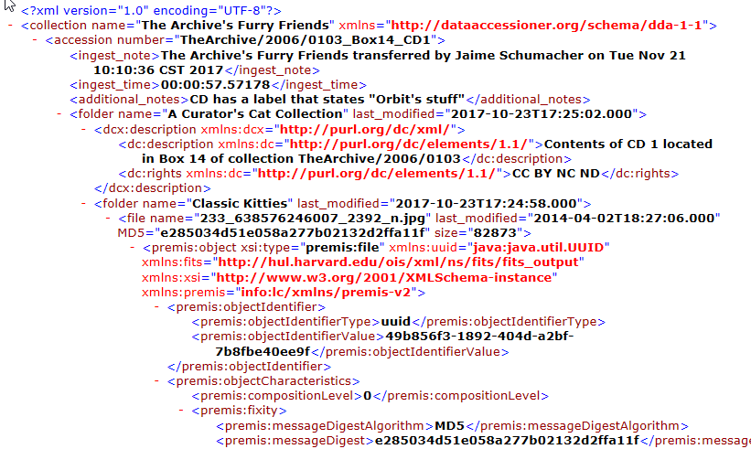
XML From Furry Friends Accession
Basic descriptive metadata you created
Extracted metadata:
Folder names
File names
Last modified
Size
…and more!
Dublin Core Metadata
MD5 Checksum
Notes:
As you can see in this screenshot, there are many different fields in an XML file.
Here you see the “extracted” metadata that the tool found in the file itself such as the folder name, file name, last modification date, etc.
You also see descriptive metadata that was added by the user such as the accession number, notes, and collection name.
The fixity or MD5 checksum value for each respective file was created by DA automatically.
You will also see on the next slide the results of the DROID and JHOVE file characterizations as well.

Slide 23
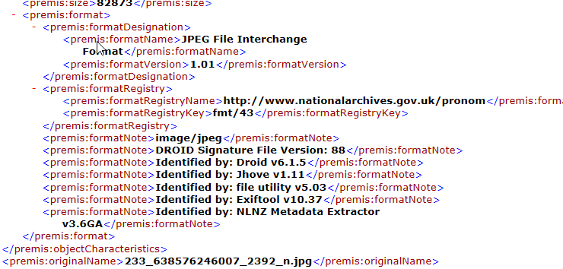
More XML From Furry Friends Accession
File Characterization Shenanigans!

Slide 24
Walk The Workflow
Begin an Inventory Spreadsheet.
Our PC has a CD drive, so we’ll start with those while we look for a working floppy drive.
Run DataAccessioner. Creates basic preservation metadata files in XML for you! Allows us to add descriptive metadata. Moves everything to a stable carrier (The Archives has a network drive…we’ll put stuff there).
Make an Access Copy from the Master Copy.
Run the DA: Metadata Transformer Tool to make sense of the XML.
Continue populating the Inventory Spreadsheet.
Once you’ve grabbed everything you can, place everything in standards-based packages using Bagger.
Setup the ongoing fixity monitoring of the Bags using Fixity.
E:\Digital_POWRR_Workshop_Tools_and_Hands_On_Activities\DataAccessioner
\da-mt-1.1\DAMetadataTransformer-1.1 XSLTProcessor.jar
Notes:
BACK TO OUR REGULARLY SCHEDULED PROGRAMMING………

Slide 25
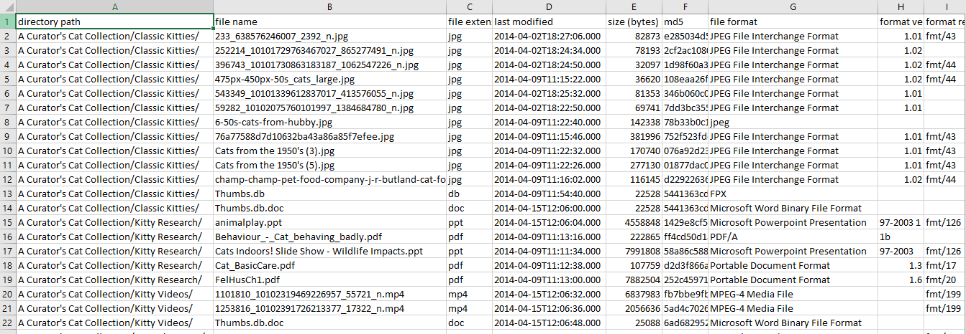
WTW – DA Metadata Transformer Tool
Other
Ingest
Processing
Access
Storage
Maintenance
Coverts XML Into CSV (Comma Separated Value….a spreadsheet!)
Notes:
Much prettier than the raw XML, right?

Slide 26
Walk The Workflow
Begin an Inventory Spreadsheet.
Our PC has a CD drive, so we’ll start with those while we look for a working floppy drive.
Run DataAccessioner. Creates basic preservation metadata files in XML for you! Allows us to add descriptive metadata. Moves everything to a stable carrier (The Archives has a network drive…we’ll put stuff there).
Make an Access Copy from the Master Copy.
Run the DA: Metadata Transformer Tool to make sense of the XML.
Continue populating the Inventory Spreadsheet.
Once you’ve grabbed everything you can, place everything in standards-based packages using Bagger.
Setup the ongoing fixity monitoring of the Bags using Fixity.
Notes:
BACK TO OUR REGULARLY SCHEDULED PROGRAMMING………

Slide 27
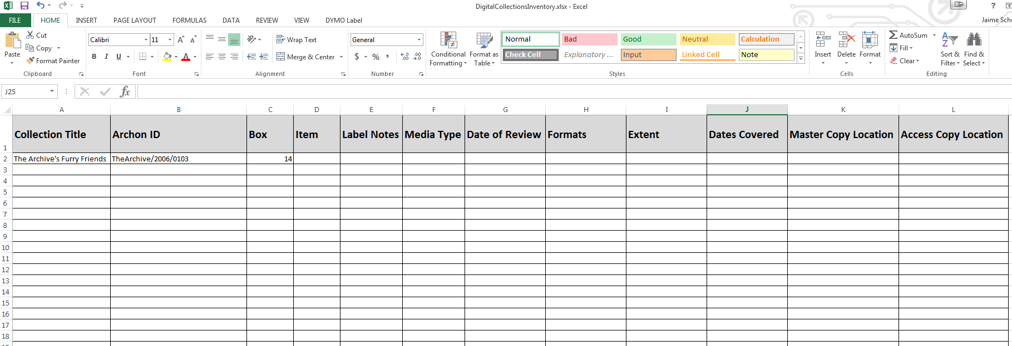
WTW – Spreadsheet
Other
Ingest
Processing
Access
Storage
Maintenance
Now we can fill these in!

Slide 28
Walk The Workflow
Begin an Inventory Spreadsheet.
Our PC has a CD drive, so we’ll start with those while we look for a working floppy drive.
Run DataAccessioner. Creates basic preservation metadata files in XML for you! Allows us to add descriptive metadata. Moves everything to a stable carrier (The Archives has a network drive…we’ll put stuff there).
Make an Access Copy from the Master Copy.
Run the DA: Metadata Transformer Tool to make sense of the XML.
Continue populating the Inventory Spreadsheet.
Once you’ve grabbed everything you can, place everything in standards-based packages using Bagger.
Setup the ongoing fixity monitoring of the Bags using Fixity.

Slide 29
WTW – Bagger
Other
Ingest
Processing
Access
Storage
Maintenance
Who developed Bagger?
The Library of Congress
What is Bagger?
It is a digital records packaging and validation tool based on the BagIt specification.
How does Bagger work?
- It allows creators and recipients of BagIt packages to verify that the files in the bag that was sent and received are complete and valid.
- Creates manifests of the files that are located in the bag and their corresponding checksum values
- The recipient uses those manifests to verify the bag and its content.
Notes:
What is Bagger?
It is a digital records packaging and validation tool based on the BagIt specification. This software allows creators and recipients of BagIt packages to verify that the files in the bag that was sent and received are complete and valid. This is done by creating manifests of the files that that exist in the bag and their corresponding checksum values.
Bagger is a Java program, and works in Windows, Linux and Mac. It is a graphical user interface application, and is a bit easier to work with than the command-line driven BagIt implementation.
Actually using Bagger starts on page XXXX pf the walk through/tutorial.

Slide 30
Bags – An Interlude
What are bags?
Digital collection packed into a directory (the bag) along with a machine- readable manifest file (the tag) that lists the contents.
What can you store in bags?
Documents, pictures, music, movies, folders, etc. Anything digital.
What is the purpose of a bag? To allow a sender to prepare a collection to send to a recipient* and allow the receiver to confirm all received contents. *the recipient could be future you!
Why use bags in digital preservation?
To help alleviate concern regarding the corruption or loss of files during transfer of content over a network.
Notes:
INTERLUDE HMMMMMMMM
BAGS ARE COMMONLY used as AIPs!!!!
Most likely, whatever longer-term solution model you settle on will be able to make use of the Bags we create now…so let’s go ahead and put our stuff in Bags as a part of our Triage.
First, what are bags?
It is where a digital collection is packed into a directory (the bag) along with a machine-readable manifest file (the tag) that lists the contents.
What can they hold?
Bags can hold documents, picture files, music files, movie files, and even other folders. Anything that is digital can fit in a bag.
What is the purpose of a bag?
To allow a sender to prepare a digital collection for transfer to a cloud service and/or off-site location, so that all of the contents can be confirmed by the recipient. The files are packaged with a list that can then be confirmed by the receiver in an automated fashion and ensure that the files received have not been corrupted and that everything sent was, in fact, received.
Why use bags in digital preservation?
Imagine that you are uploading or transferring files to your cloud storage provider after ingesting and processing them at your location. Is there any guarantee that the file or files that are sent over the internet have not been lost or corrupted during the transfer process? The use of a bag would help to alleviate some of the concern regarding the corruption or loss of files during transfer. The files themselves would be contained inside of a package that would contain the manifest. The receiver would just simply open the “bag”, retrieve the manifest and compare the files inside to see if everything was received and compute checksums on the files as a final verification.

Slide 31
Walk The Workflow
Begin an Inventory Spreadsheet.
Our PC has a CD drive, so we’ll start with those while we look for a working floppy drive.
Run DataAccessioner. Creates basic preservation metadata files in XML for you! Allows us to add descriptive metadata. Moves everything to a stable carrier (The Archives has a network drive…we’ll put stuff there).
Make an Access Copy from the Master Copy.
Run the DA: Metadata Transformer Tool to make sense of the XML.
Continue populating the Inventory Spreadsheet.
Once you’ve grabbed everything you can, place everything in standards-based packages using Bagger.
Setup the ongoing fixity monitoring of the Bags using Fixity.
Digital_POWRR_Workshop_Tools_and_Hands_On_Activities\Bagger\bagger-2.7.6\bagger-2.7.6\bin\ bagger.bat
Notes:
BACK TO OUR REGULARLY SCHEDULED PROGRAMMING………

Slide 32
Walk The Workflow
Begin an Inventory Spreadsheet.
Our PC has a CD drive, so we’ll start with those while we look for a working floppy drive.
Run DataAccessioner. Creates basic preservation metadata files in XML for you! Allows us to add descriptive metadata. Moves everything to a stable carrier (The Archives has a network drive…we’ll put stuff there).
Make an Access Copy from the Master Copy.
Run the DA: Metadata Transformer Tool to make sense of the XML.
Continue populating the Inventory Spreadsheet.
Once you’ve grabbed everything you can, place everything in standards-based packages using Bagger.
Setup the ongoing fixity monitoring of the Bags using Fixity.
Notes:
Since we do not yet have a place to send our Bags (this is a pilot, after all,) we are going to monitor the Bags using Fixity while we consider where this stuff is going to be archived (hopefully!) offsite

Slide 33
WTW – Fixity
Other
Ingest
Processing
Access
Storage
Maintenance
Who developed Fixity?
AV Preserve: https://www.avpreserve.com/products/fixity/
What is Fixity?
It is a simple open-source tool that automatically monitors and reports on the data integrity of selected digital content.
How does Fixity work?
It scans a folder or directory and creates a manifest of the files, including their file paths and their checksums, against which a regular comparative analysis can be run.
It monitors file integrity through the generation and validation of checksums, and file attendance through monitoring and reporting on new, missing, moved and renamed files.
Notes:
Created by AVPreserve
Fixity is a utility for the documentation and regular review of stored files. Fixity scans a folder or directory, creating a manifest of the files including their file paths and their checksums, against which a regular comparative analysis can be run. Fixity monitors file integrity through generation and validation of checksums, and file attendance through monitoring and reporting on new, missing, moved and renamed files. Fixity emails a report to the user documenting flagged items along with the reason for a flag, such as that a file has been moved to a new location in the directory, has been edited, or has failed a checksum comparison for other reasons. Supplementing tools like BagIt that review files at points of exchange, when run regularly Fixity becomes a powerful tool for monitoring digital files in repositories, servers, and other long-term storage locations

Slide 34
Checksums – An Interlude
A file checksum is a calculated string of number and letters that acts as a fingerprint for the particular file that it was calculated from.
Why are they used?
To ensure the integrity of a file after it has been transmitted from one storage device to another
To confirm that a file has not degraded or corrupted after being stored on a device for a period of time (compare previous stored checksum to recalculated current value).
With some limitations, it can also provide assistance in determining if a file or files have been modified since they were ingested.
How are they calculated?
Checksums are calculated using hash functions. Hash functions are mathematical functions. (Md5, SHA-1, SHA-256, etc.)
Notes:
INTERLUDE HMMMMMMMM
A file checksum is a calculated string of number and letters that serves as a fingerprint for a particular file that it was calculated from.
They are used for ensuring the integrity of a file after it has been transmitted from one device to another or from one location to another (via a network or the Internet).
In digital preservation, checksums that are calculated at the time of ingest can be stored and accessed later in order to confirm that bit rot of the stored digital files has not occurred.
Checksums are calculated using mathematical hash functions. Of particular importance is that a hash function will take data of different sizes and produce a data value that is of a fixed size. Thus, all hash values created using the same hashing function will be the same length. MD5
SHA-1
SHA-256

Slide 35
Checksums – An Interlude
the past
02ace44afd49e9a522c9f14c7d89c3e9
A less pleasant
future
the future
02ace11afd49e9a522c9f14c7d79c3e2
02ace44afd49e9a522c9f14c7d89c3e9
Image by Arthur Shlain from the Noun Project
Notes:
What is a “checksum” or “hash value”?
To perform integrity checking we need to use a simple technology called checksums or hashes. This animation shows how they work.
Algorithm – how we take the fingerprint….right thumb or left pointer finger????
Let’s say we have a bitstream, or digital file, that we want to preserve.
 We begin by creating a checksum. This is simply a fairly unique short number derived from the file using a software tool.
 Think of a checksum as finger print.
 At some point in the future, we want to verify that our file remains exactly as it was, back when we first created the checksum at the top of the screen.
 We generate a new checksum from the file.
 We then compare the new checksum with the old one.
 In this case, the checksums are identical, so we know the file is undamaged and exactly as it was.
 However, if the file had become damaged, the checksum we would generate from it would be different.
 On comparing the two checksums, we can see that they are different from each other. This confirms that our file is no longer identical to how it was. Perhaps it has been damaged by media failure or “bit rot”.

Slide 36
Keep multiple copies and perform integrity checks
Checksums – An Interlude
Notes:
Integrity checking can be combined with the strategy of keeping multiple copies of each file to provide a robust digital preservation approach. This works as follows:
 We make 3 copies of the file we want to preserve, ideally placing one file offsite to protect against natural disasters
 We generate checksums from each file, and we can see that they are all the same, and each file is good.
 Over time we can then recalculate our checksums, and see that the three copies of the file are still exactly as they were
 Until at some point in the future we recalculate our checksums and discover that one of them is different!
 Straight away we know that the middle copy has become damaged
 So we then discard the damaged file
 And replace it with a copy of one of the others
Using these techniques we can dramatically reduce the chance of losing any of our data.

Slide 37
WTW – Fixity
Other
Ingest
Processing
Access
Storage
Maintenance
Let’s give Fixity a whirl!
E:\Digital_POWRR_Workshop_Tools_and_Hands_On_Activities\Fixity\Fixity for Windows\fixity-win-0.5\fixity-win Fixity.exe
OR
E:\Digital_POWRR_Workshop_Tools_and_Hands_On_Activities\Fixity\Fixity for Mac
Notes:
BACK TO OUR REGULARLY SCHEDULED PROGRAMMING………
Launch Fixity and Demo. Email and the attached report are shown on the next couple of slides in case of technology issues.

Slide 38
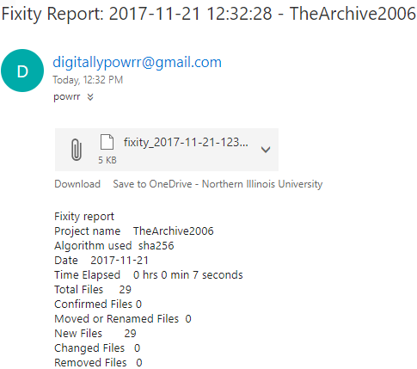
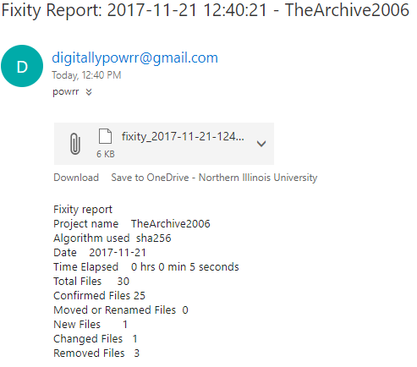
New Project
We Have a Problem
Since it’s a new project, Total Files and New Files are the same.
Confirmed Files is 0.
If the monitored files are unchanged
Total Files
and
Confirmed Files
will be the same.
But if there is a problem, Fixity will tell you.

Slide 39
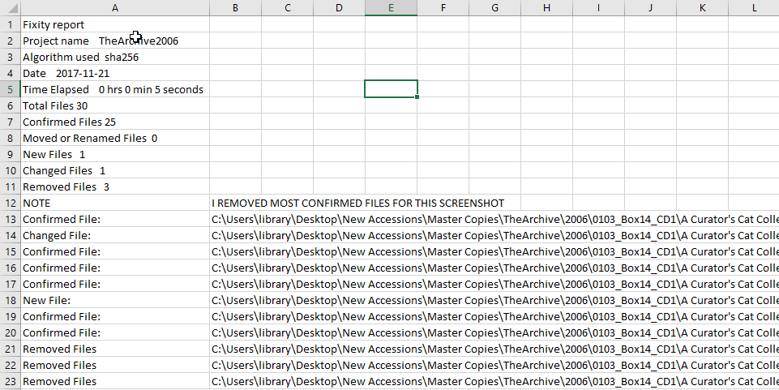
Fixity Report
Notes:
JAIME
NOTE: Fixity reports come as TSV (Tab Separated Value) files. When opening Fixity reports in spreadsheet applications it is important to open them by importing the .tsv file, identifying the delimiter as a Tab and treating all data as text (see FAQ for details)

Slide 40
We Walked The Workflow!!
Ingest
Processing
Access
Storage
Maintenance
Other
Spreadsheet DataAcessioner
DA: Metadata Transformer
AV Preserve’s Fixity
Bagger
Notes:
Case Study
Inventory
Triage with DataAccessioner
Visualizing the output with DataAccessioner: Metadata Transformer Tool
Bagging Your Materials in preparation for handoff
Monitoring long-term health with AVPreserve’s Fixity

Slide 41
Technology Module:
Walk The Workflow
QUESTIONS?
Notes:
Curriculum created by Jaime Schumacher and the POWRR team and is on your flash drives and the POWRR website

