Slide 1
Starting from Scratch: Digital Preservation from the Ground Up Lynne M. Thomas, co-PI Northern Illinois University | Navigating Cultural Change for Digital Preservation Meg Miner Illinois Wesleyan University

Slide 2
Where to begin?
We began by not getting an NEH digitization grant in 2008
This is our “holy crap” moment…and the beginning of our education process

Slide 3
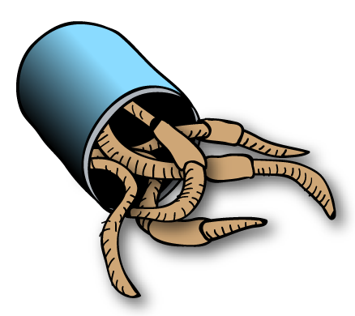
Cans of worms opened
Image source:Wikimedia Commons
It can’t just be us losing out on grant dollars… can it?
Do we even know what’s here? And how much of it there is? Where it is?
How on earth will we manage it?
And pay for it?

Slide 4
It’s so tempting to begin with tools…
But you can’t make good choices without good information and lots of campus wide buy-in
You will miss hugely important details based on not knowing different organizational practices outside your purview

Slide 5
So we started talking to people instead
Conversations are (mostly) free.
But not always successful at first
  On campus
  Consortially
Find your allies! Commiseration leads to team building.
Group IMLS grant application

Slide 6
Getting a grant really helped the conversation along
Campus attention
Money
Federally-mandated accountability
Outreach component to grant

Slide 7
An institutional records angle
Pre-grant conversations about records generally – Enron!
When the IR was obviously not going to be enough
A tragedy and an opportunity – the Great Crash of 2009

Slide 8
Benefits of making your move
Further records discussions with staff
  IT staff make great allies!
Working with faculty
  Leverage with campus students and administrators
  Scouts for issues that arise on committees and in their disciplines
Advice and priorities

Slide 9
Partnering Challenges
Ways the grant is different for partner institutions vs. “lead”
Different collection types
Different administration setups
Staffing, money, and IT setups
Different missions

Slide 10

Actions & Findings

Slide 11
What do you do with a funded grant?
We educate ourselves, our faculty, and our administrators
Survey!
Self-study/case study!
Tool evaluation
Sample policies to share
Workshops, webinars, and conferences, oh my
White paper (overview)

Slide 12
Figure out what you know
Begin with the library. Then the campus.
How much data?
What kinds of formats?
Will we keep all of it? Where?
Do we have a plan? A policy? A plan for a policy?

Slide 13
…and what you don’t
Just how much digital stuff in need of saving is there on our campuses?
Does campus IT?
How about our Administrators?
Do our faculty even know that this is a thing?

Slide 14


Where do people keep their data?

Slide 15

Where do people keep their data?

Slide 16
Where do people keep their data?

Slide 17
Aware of data protection policies?

Slide 18
Aware of data protection policies?

Slide 19
Restoration priorities?

Slide 20
Restoration priorities?

Slide 21
Restoration priorities?

Slide 22
Roadblocks
IRB
“We can’t even afford test tubes”
“You'll need a virtual machine for that”
“You don’t have access to that server”
“All that’s on the internet, it’ll always be there…”
Getting around them will cause cultural change for all of us!

Slide 23
Figure out what you have
Begin SOMEWHERE. ANYWHERE. But BEGIN.
An excel spreadsheet is a perfectly reasonable place to start.
Get your own house in order.
You already have many of the skills you need (i.e. selection, curation, description)

Slide 24
Embrace “good enough”
Most of us will not be TRAC certified. And that is okay.
It’s cheaper to implement good enough digital preservation than to not have it and lose out on grant dollars or your institution’s own history
You routinely make choices for paper; why not digital?

Slide 25
Inspire action institutionally
Raise awareness for individual researchers
Impress on all contacts that this isn’t a “project” – think programmatically!
We cannot and should not try to keep everything (cultural/personal habits)
We will not have an enduring historical record if Web pages are the default IR

Slide 26
Additional current incentives on our campuses
IL Senate Bill 1900
FASTR (federal bill)
Data Management Plan requirements from federal funding agencies
New University President at NIU July 1, 2013

Slide 27
Education is key
This can’t be done alone or by hiring in one person who “knows new tech”
Collaboration means more stakeholders = better chances of success and funding
This is already acquisitions, processing, and description, just in a different format.

Slide 28
More on education
Educating communities can never stop
  one-on-one with everyone
  sitting in on relevant committees (invited or not)
  give presentations of any size, anywhere, to any group
Use the right message with the right group

Slide 29
Tilting at Windmills
We surveyed our individual campuses
We looked at 50+tools so you don’t have to.
Right now, we are testing a limited subset of tools to see how they work together.
We’re going to tell you what’s easiest to use and how well it works out of the box.
Testing generally by end users, to identify roadblocks.

Slide 30
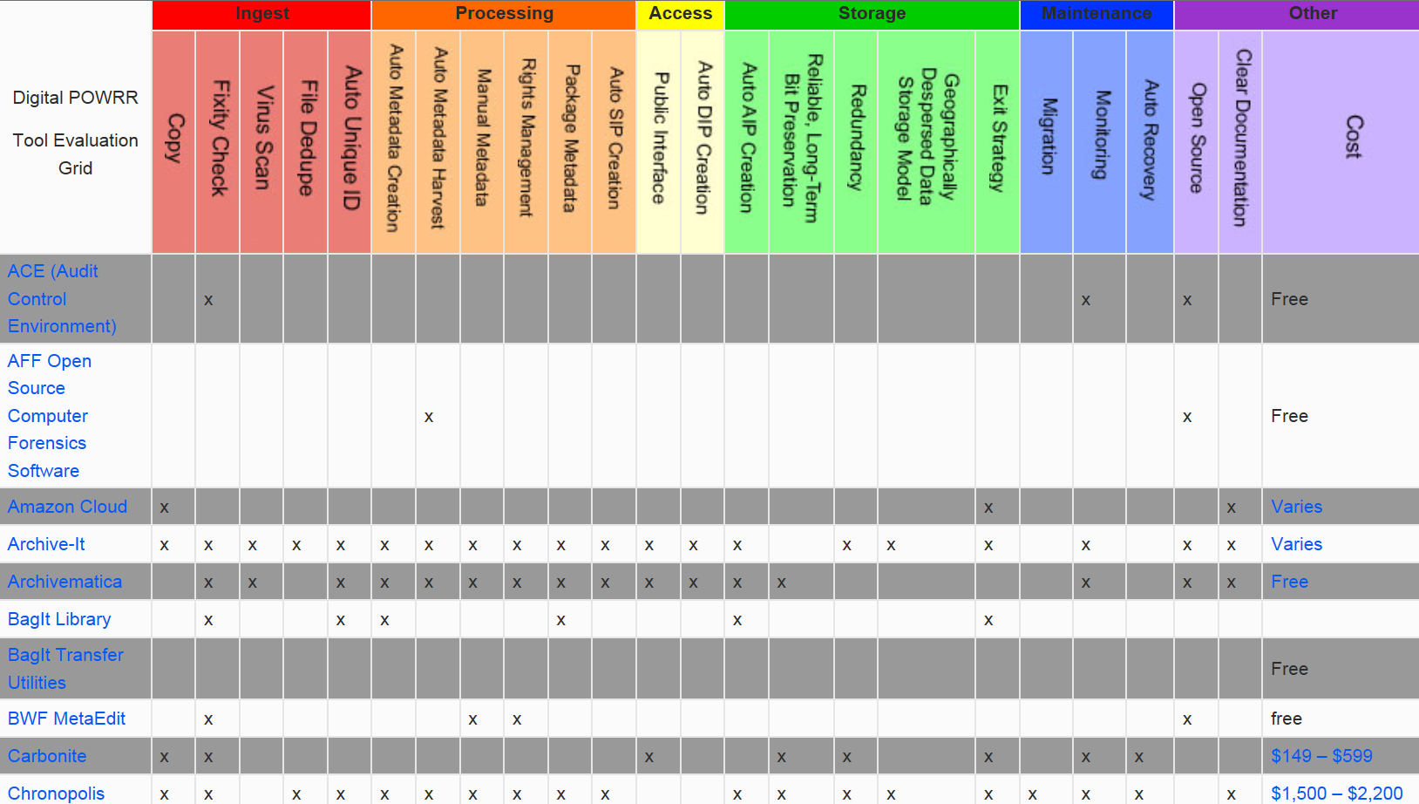
Tool grid!
Notes:
Based on OAIS reference model

Slide 31
Tools 101
Open source (“free”) vs proprietary ($$)
Testing: Archivematica, Curator’s Workbench, DuraCloud, Internet Archive, and MetaArchive
Don’t forget storage costs.
Tool grid!
http://digitalpowrr.niu.edu/tool-grid/

Slide 32
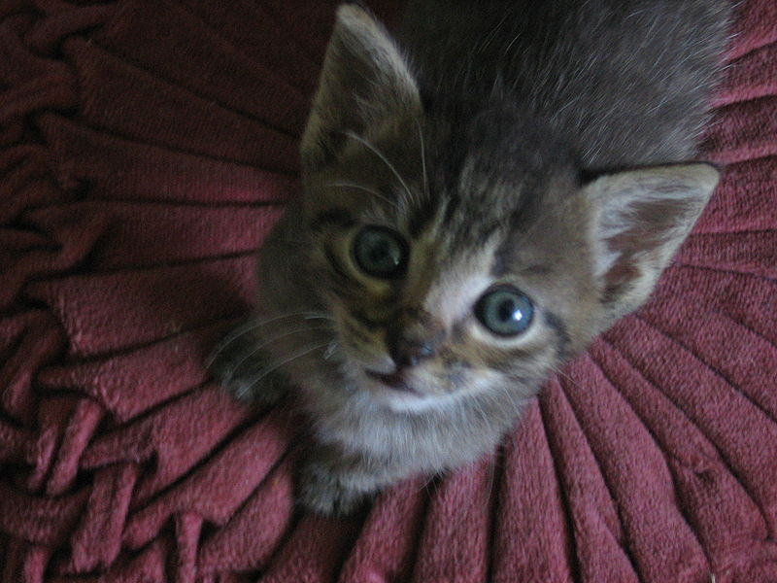
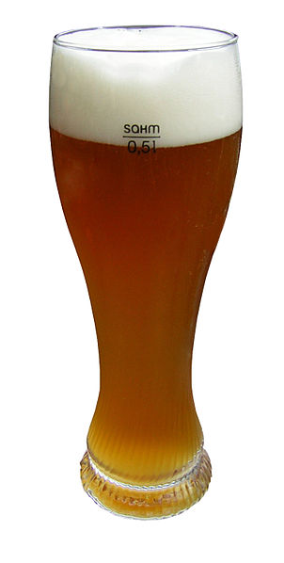
A note about the word “free”
NOT

Slide 33
Grant period “aha” moments
Explosion in theory and practice from 2008-present
Resources everywhere – good and bad news
We do not have technology problems
DP is not library/archive problem
Why we should all be grateful to the NSA

Slide 34
What’s next?
White paper via IMLS (Spring 2014)
Digital POWRR Wiki http://powrr-wiki.lib.niu.edu/index.php/Main_Page
Workshops, tools, and more!
Tool selection, policy writing, collaborative DP plans, and implementation

Slide 35
http://digitalpowrr.niu.edu
Questions?

