Slide 1
Digital Asset Registers
Notes:
NDSA 4-Step Model - Step 2: Know your data

Slide 2
This sessions answers:
Digital Asset Register
What is a digital asset register?
Why should we create one?
How do we create one?
What information should be collected?
How do we get that information?
What happens to a digital asset register after it is created?

Slide 3
What is a Digital Asset Register?
Notes:
What is a digital asset register? How does it relate to a verifiable manifest?
A Digital Asset Register:
-Recorded in a document or database
-Log of all digital collections
-Includes details about collections, even some data collection from ‘verifiable manifest’
-Includes information about preservation risks
A digital asset register is a document or database where collections managers or those responsible for digital preservation systematically record all digital content. A digital asset register will contain some data collected from the verifiable manifest. A verifiable manifest is about file types and the size of data and is used mainly by digital preservation practitioners. A digital asset register organises data (or metadata) about collections in a way more easily understood by others, particularly management and practitioners in other parts of the institution. In other words, they contain more information about items in the collection than a verifiable manifest. Some institutions make their digital asset registers available internally to all staff who have responsibility or partial responsibility for one or more items in the register. This way, individuals with more direct knowledge of a particular collection, or part of a particular collection, can provide updated information if something should change. For instance, if more items are added to a collection or if copyright permissions have changed.

Slide 4
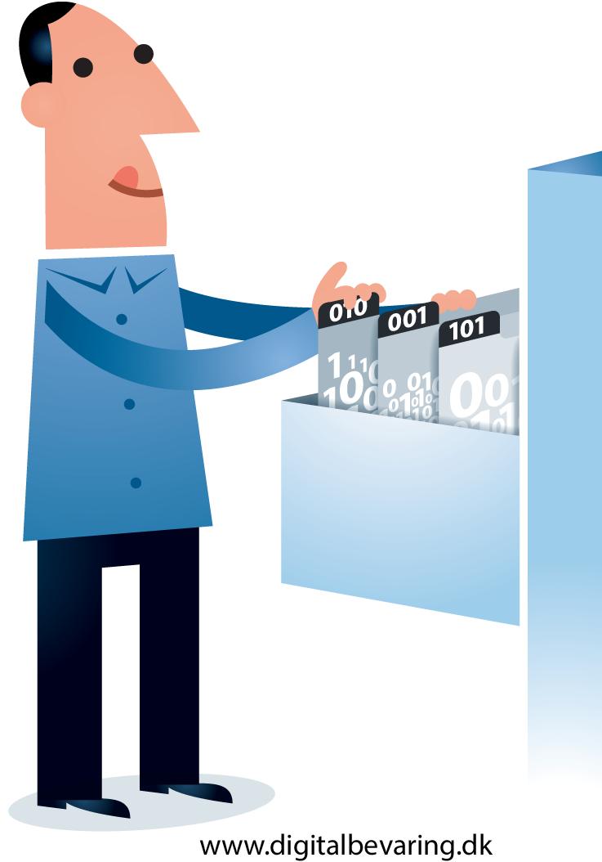
Why should we create a Digital Assets Register?
gathers information about digital content in one place
logs preservation risks
coordinates digital preservation actions
supports negotiations with management
promotes best practice in management of digital content
provides basic finding aid in absence of other discovery methods
retains valuable knowledge

Slide 5
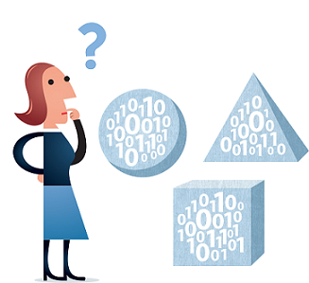
How do we create a Digital Assets Register?
Organise assets into
logical groups
Groups:
Type of material (e.g. file format, os, size)
Special requirements
Same owner or manager
Etc.
*Useful for digital preservation practitioner, not other users
Illustration by Jørgen Stamp digitalbevaring.dk CC BY 2.5 Denmark

Slide 6
What information should be collected for a Digital Asset Register?
Name of collection or content
Person or department of responsibility
Size of collection
File formats
Retention policy
e.g. How long does this content need to be preserved? Why?
Ownership, rights, and data protection issues
Associated risks and impact
e.g. software or hardware dependencies
Estimated value of content
e.g. How easy would it take to retrieve this content? How long to re-create it?
Notes:
What information should be included in a digital asset register?
A digital asset register is a document (or database) maintained by the role or roles within an institution responsible for digital preservation. Because the digital asset register should contain more information useful for the management of these assets, it does not need to detail this information for each individual item in a collection down to the file, unless a particular file is especially important, large, or unusual. In table form, for instance, a digital asset register may contain a row for each collection, or for each subset of a collection, with a column for each category of information required. In a simple database, it might have an entry for every collection or subset of a collection.
The information recorded in a digital asset register will depend on the needs of an organisation and the nature of their collections. Generally, a digital asset register would include:
-Name of Collection / Content
-Person / Role / Dept. responsible for this content
-Size of collection and file formats it contains
-Retention policy (e.g. How long does this content need to be preserved? Why?)
-Ownership, rights, and data protection issues
-Associated risks and impact, including software / hardware / other dependencies
-Estimated value of content (e.g. How easy would it take to retrieve this content? How long to re-create it?)
This may include posing questions about information you do not have about your collection(s) that you may need to follow-up on.

Slide 7
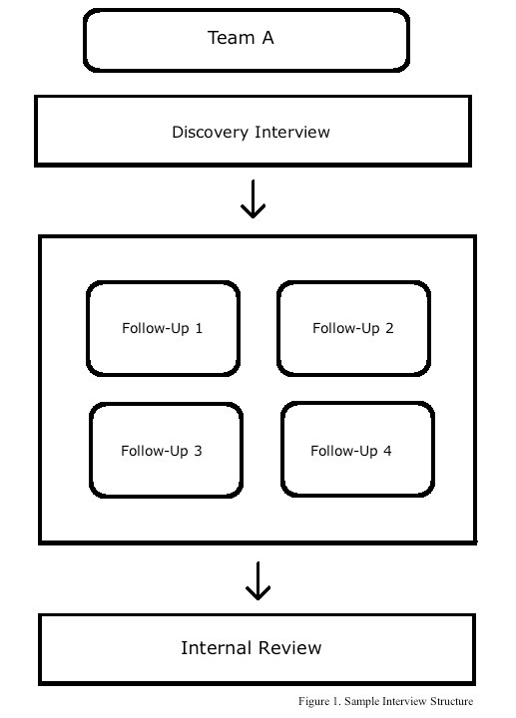
How do we get the information for a Digital Assets Register?
Approaches:
Finding aids and catalogues
Metadata already captured about collections
Shared drives
Interviews with staff members
Survey to all staff members
A combination of all of the above
Notes:
Your approach to collecting information for your Digital Asset Register will depend on the size of your organisation, the amount of time you have, and your priorities for digital preservation. On a very basic level, finding aids and catalogues will give a summary of information needed to compile a Digital Asset Register. If your organisation keeps a relatively organised shared drive, you can find deeper information about digital collections and other digital contents through organisational documentation. It’s important to note that finding aids and documents on shared drives are ALSO digital materials that need preserving – it’s important to work closely with corporate management to ensure organisational records are also registered and preserved to standard. To obtain any information missing from your digital asset register after these approaches, an organisation-wide survey can help fill in the gaps. A survey may also be an opportunity to raise awareness about digital preservation as well as gain insight into unpredicted risks or other issues with digital assets across your institution.
If you come from a medium to large-sized organisation, and/or you have time and resources to develop a more detailed Digital Asset Register, performing interviews with staff across the library will provide a very rich and thorough method for collecting the information you need and potentially discovering information you didn’t think to ask about. This process can be very time-consuming, working around your own schedule and the schedules of other staff can be difficult. It’s also important to use a standardised set of questions so that the interview responses will fit your Digital Asset Register uniformly. That said, you may need to adapt your questions slightly for different members of staff. It’s a work in progress – don’t worry if it’s not perfect the first time. If you’re doing it right, you will have to update the Register within 6 months to a year anyway.
Some third-party services provide a Digital Asset Register as part of their service, but because a Register is such a primary tool for managing collections, it’s smart for an institution to create and maintain their own based on institutional needs and policies.

Slide 8
What happens to a Digital Asset Register after it is created?
It’s not over…
Share across the organisation
Share with management
Create more granular entries
Create update schedule
Update
Notes:
Once we have it, what do we do with it?
Make your Digital Asset Register an active document or database that you update as you further progress digital preservation at your institution. You may need to break down original entries into more granular items, especially if items within a group have different preservation requirements than other items at that level. It is best to start with a higher overview and drill down after the register is established.
Make other colleagues aware of the register, especially if they are responsible for all or part of a collection or subset of a collection. They may want to use the register for reference or add new information to it as a collection grows or evolves. Use the register as evidence in requests for funding or budgeting for further action.

Slide 9
More Resources
Digital Preservation Handbook, ‘Getting Started’, http://www.dpconline.org/advice/preservationhandbook/getting-started
Digital Curation Centre, ‘Data Audit Framework Methodology’, http://www.dataaudit.eu/ DAF_Methodology.pdf
Digital Curation Centre, ‘Digital Asset Framework Implementation Guide’, http://www.data-audit.eu/docs/DAF_Implementation_Guide.pdf
The National Archives, ‘Stage 2: Define your digital continuity requirements’, http://www.nationalarchives.gov.uk/ information-management/manage-information/policy-process/digital-continuity/step-by-step-guidance/step-2
Notes:
The good news is, there is a lot of information about this topic available. The bad news is, there is a LOT of information about this topic available. Don’t get overwhelmed – essentially, a Digital Asset Register is a pragmatic tool aimed to help you do your job. Make it work for you and don’t collect more information than you need to practice effect management and preservation of your digital materials.

Slide 10
Exercise #2 Start creating your own Digital Assets Register
Choose the categories of information you want to know about your digital assets.
Consider how you will collect this information. What kinds of questions do you need to ask to get the information you need for your register?
Use the templates provided in your packs for ideas.
Notes:
In groups of 2 or 3.

