Slide 1
Technology Module: Tech Skills 201 Extracting Files Command Line Virtual Machines
This POWRR Institute is generously funded by the
Martin Kong
Notes:
Curriculum created by Martin Kong

Slide 2
Expected Outcomes
Learn how to extract files that are stored in compressed or archive file formats so that they can then be processed in the digital preservation workflow.
Learn how to navigate a command line interface and where command line might be used in some of the digital preservation tools.
Learn what a virtual machine is and how virtual machines fit into the digital preservation workflow.

Slide 3
Tech Skills 201
Extracting files from a compressed or storage archive file

Slide 4
What Are Compressed or Storage Archive Files?
On Windows the .zip file format indicates that the file is compressed.
It is compressed to save storage space and make transferring files faster.
Can also be used on a Mac or Linux.
On Linux the .tar file format indicates that the file is “tape archive” utilized for storing data, and not for compression.
They can be compressed after being created, but they become .tgz or .gz.
Are just containers for other files, like a folder.
Windows cannot handle the extraction of .tar file extension files without the assistance of a third party program such as 7-zip.
Can also be used on a Mac.
Notes:
The zip format is used to compress files to save storage space and thus make transferring them faster (especially over the Internet). It is mainly a Windows format but can be used on Linux and Mac as well.
The tar format is actually a storage archive for the storage of data and is not a compression format. Tar is short for tape archive. Tar files can be further compressed, but then the file extensions become .tgz or .gz. Tar files are just containers for files, similar to a folder. It is important to note that Windows cannot handle tar files natively without the assistance of a third party extraction program such as 7-zip.

Slide 5
Compressed or Storage Archive Files…continued
On Mac, the .dmg file format is a Mac OS X Disc Image file, which represents a digital reconstruction of a physical disc.
DMG files are intended for Mac and are often used to store compressed software installers instead of having to use a physical disc.
The Mac operating system is able to handle the decompression and/or extraction of .zip, .tar, and .dmg files natively.
No need for third party software.
Simply double-click on the file to extract it.
Notes:
On Mac, the dmg file format is a digital reconstruction of a physical disc, similar to a digital copy of a software installation CD. It is mainly used to transfer software installers instead of sending a disk.
Since the Mac OS is able to handle the extraction or decompression of zip, tar and dmg files natively. Simply double clicking will open them. As such, we will not be covering the extraction process of compressed or storage archives on a Mac OS.

Slide 6
Extracting Files…..
….from a compressed archive on Windows (.zip or .tar)
Windows will natively handle the extraction of zip files.
The Windows operating system does not natively handle extracting tar archive files.
In order to open a tar file in Windows, a program such as 7-zip www.7-zip.org will have to be installed. (screenshots of these steps on the next slide)
Browse to where the file is located using Windows Explorer.
Right-click on the tar file and choose the 7-zip submenu and choose “Extract Files…”
This will load the 7-zip program’s extraction subprogram window
Choose the directory that you want to extract the files to.
Click OK when you are ready.
The files are now extracted and can be located in the directory you chose.
Notes:
Windows will handle the extraction of zip files natively.
Windows does not handle extracting tar archive files on its own. In order to open a tar file in Windows, an extraction program such as the open-source 7-zip will have to be installed. The following extraction instructions assume that 7-zip has been installed already.
There are screenshots of this process on the next page.
Browse to where the tar file is located using Windows Explorer
Right click on the file to bring up the 7-zip submenu and choose “Extract Files…”
Once the 7-zip extraction subprogram window has opened, choose the directory that you want to extract the files to
Click Ok when you are done.
The files are extracted and can be found where you put them.

Slide 7
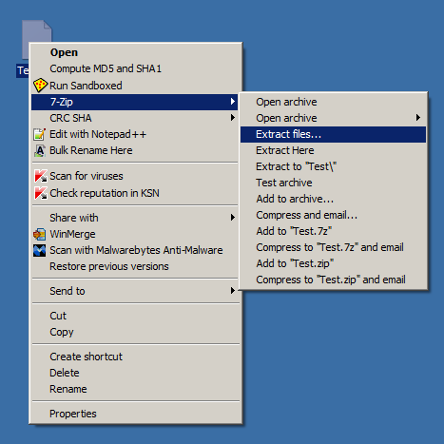
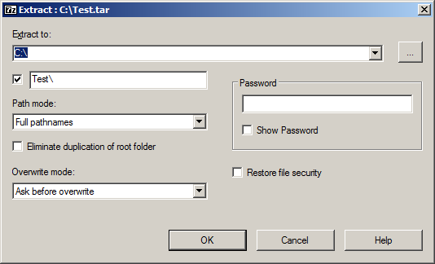
Extracting Files from a Compressed Archive

Slide 8
Where are compressed or archive files…
….found in digital preservation?
Compressed or archive files can be found in a multitude of places.
The program installers for various digital preservation programs and tools are compressed
They are compressed to save space and reduce time of travel over the Internet.
Must be uncompressed or unpacked before the programs can be installed.
Digital files from donors may also be compressed due to space constraints.
These files will have to be extracted prior to being ingested into the digital preservation workflow.
Notes:
Where are compressed files or archive files found in digital preservation?
They can be found in many places.
1) many of the software installers for the digital preservation tools such as Data Accessioner, or FITS, etc. are compressed before being sent over the Internet.
2) digital files from donors could also contain compressed or archive files. These will have to be unpacked prior to being ingested into the digital preservation workflow.

Slide 9
Tech Skills 201
Navigating a command line interface

Slide 10
What Is The Command Line?
It is different than using a Graphical User Interface (GUI), where you:
Utilize a mouse (or touchscreen) to point and left-or-right click to:
run programs
do work such as web browsing.
The command line is simply another method of interfacing/interacting with a computer.
Before the 1980’s and 1990’s:
GUI did not yet exist
Command line was the primary method of interacting with computers.
It is textual based
It involves (almost exclusively) the use of the keyboard to
type commands in order to run programs;
copy, move, rename, or delete files;
navigate or browse for files
Notes:
Most people today commonly use a Graphical User Interface when working with a computer. A person works with a GUI on a computer by using a mouse to point and left click or right click to run programs or to browse the web. Touchscreens can also be used to interact with a GUI.
However, in the 1980’s and 1990’s, before GUIs existed, command line was primarily the method for people to interact with computers. It is a textual based interface involving mostly the use of the keyboard to type commands into the prompt to run programs, copy, move, rename or delete files, navigate or browse for files.
Windows does not handle extracting tar archive files on its own. In order to open a tar file in Windows, an extraction program such as the open-source 7-zip will have to be installed. The following extraction instructions assume that 7-zip has been installed already.
There are screenshots of this process on the next page.
Browse to where the tar file is located using Windows Explorer
Right click on the file to bring up the 7-zip submenu and choose “Extract Files…”
Once the 7-zip extraction subprogram window has opened, choose the directory that you want to extract the files to
Click Ok when you are done.
The files are extracted and can be found where you put them.

Slide 11
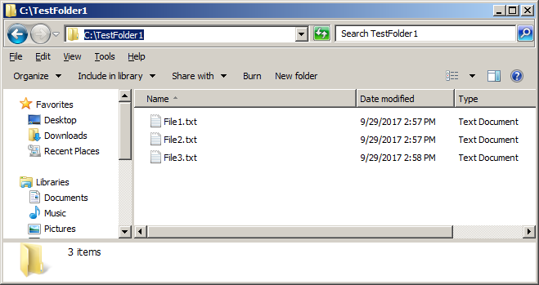
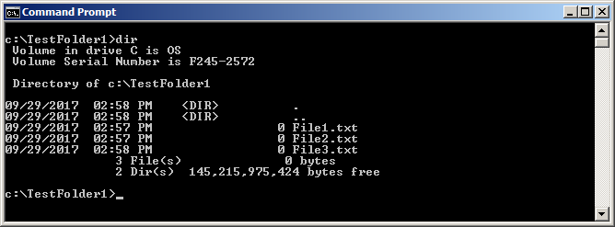
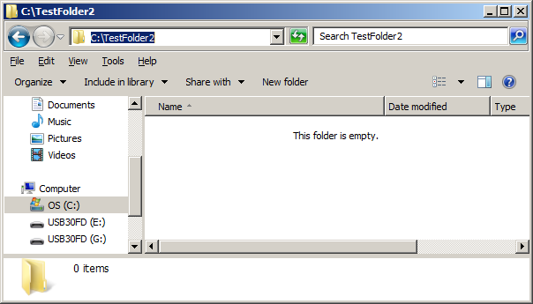
GUI vs. Command Line
Notes:
On the left screenshots, you can see that the top left screenshot is of a GUI interface, where TestFolder1 has 3 files in it. The bottom left screenshot is of another GUI interface where TestFolder2 is empty.
On the right screenshots, you can see that the top right screenshot shows a command line interface where it is a listing of the files in the folder, TestFolder1. The right bottom screenshot is a command line listing of the lack of files in the folder TestFolder2.
As you can see from the screenshots above, a command line interface looks different than a GUI interface, but can provide similar information.

Slide 12
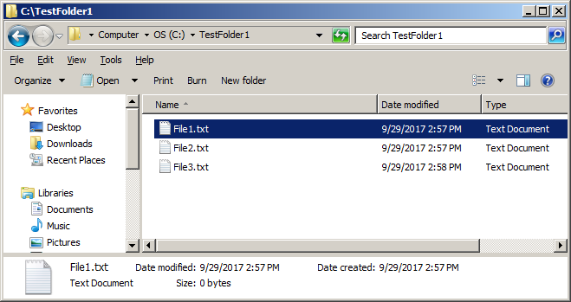
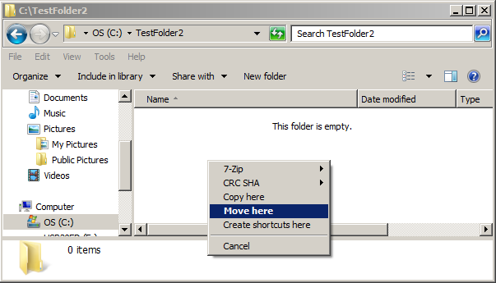
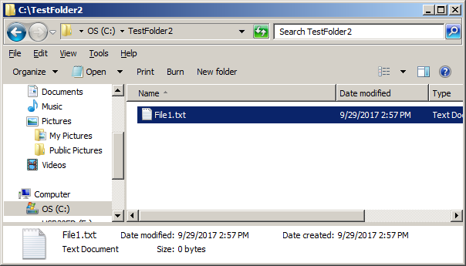
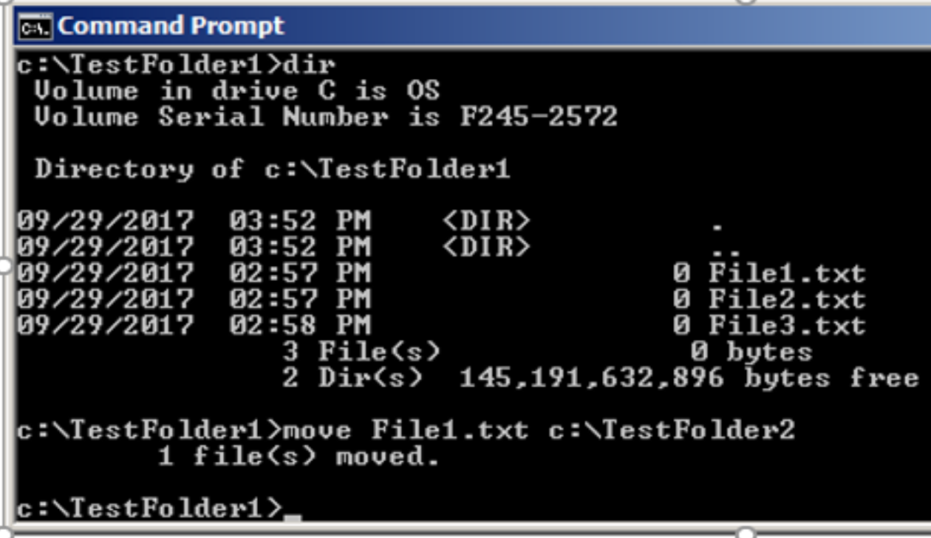
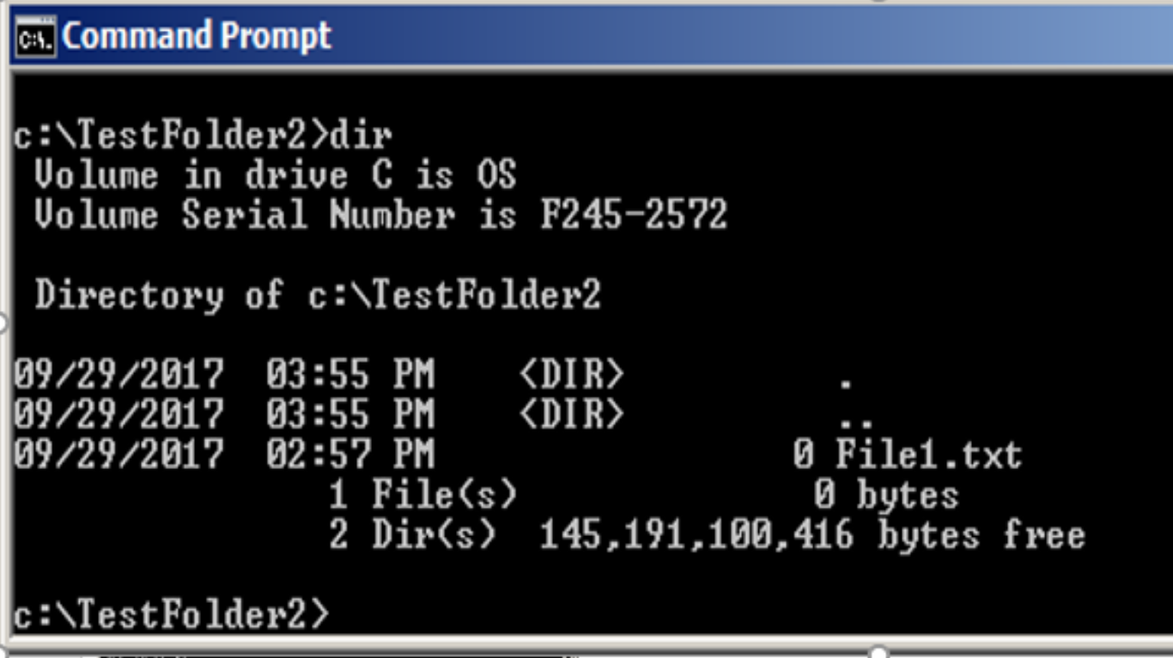
Moving Files in GUI vs. Command Line
Notes:
As you can see on this slide, the first two top screenshots simulate the moving of a file from TestFolder1 to TestFolder2 by right click and dragging File1.txt from TestFolder1 into TestFolder2. The right-click context menu will pop-up and Move Here can be chosen. The third/top right screenshot shows File1.txt now residing in TestFolder2.
The bottom left screenshot illustrates the use of the command line to move File1.txt from TestFolder1 into TestFolder2. The right bottom screenshot illustrates that File1.txt is now located in TestFolder2.

Slide 13
How Does The Command Line Work?
Command line is available for use in Mac, Windows, and Unix/Linux computers. However, we will focus on the command line for Linux computers in the following slides.
Sample prompt after login:
jsmith@computername:~$
The user issues instructions to the system, usually in the form of consecutive lines of textual commands in order to perform an action or actions.
Unlike using a GUI, with a command line, the user is not generally presented with visual commands that can be chosen from.
No right-click menu options to choose commands from.
You are only presented with a blinking cursor
You have to know in advance what it is that you would like to do with a particular file, folder, etc.
For example, in Unix/Linux, if you wanted to rename a file originally called “FILE1.txt” and give it a new name “FILE2.txt”, you would type the following into the command line: mv FILE1.txt FILE2.txt
Notes:
While the command line is available for use in Mac, Windows, Unix/Linux computers, we will be focusing on the command line for Linux in the following slides.
When you first log into a Linux system that has a command line interface, most times you will be presented immediately with a command prompt that shows your username on the computer that you are logged into followed by a squiggly character and the dollar sign or hash symbol
Commands are given to the computer by typing text.
With command line you don’t have visual commands or options to choose from that you would have in a GUI:
For example, if you used a mouse to right click a file in a GUI, you would get a list of options and/or choices to choose from, i.e. copy, paste, delete, etc. If you used a mouse to right click on a folder in a GUI instead of a file, you would get different available action options.
In the command line interface, you are not presented with any of those choices. Instead, you are only presented with a blinking cursor and you have to know in advance what it is that you would like to do with a particular file, folder, etc.

Slide 14
Tips About The Command Line
In Linux, all file or folder/directory names are case sensitive.
/home/jsmith/Docs is a different directory than /home/jsmith/docs
Linux-like emulators are available online
Use to practice your Linux commands as you learn without risk of damage to a real Linux system.
https://autellinux.wordpress.com/2013/09/04/online-simulator-in-linux-practice-linux-commands/
http://www.masswerk.at/jsuix/
This particular emulator seems to work well.
Notes:
Please note that in Linux (unlike Windows), all file or folder/directory names typed into the command line are case sensitive. The folder path /home/jsmith/Docs is a different directory than /home/jsmith/docs (the uppercase versus lowercase D)
There are Linux-like emulators available online that you can use to practice your Linux commands as you learn without risk of damage to a real Linux system.
A list of emulators can be found on this wordpress site. The second link I have listed has an emulator that mimics Linux very closely.

Slide 15
Command Line….Additional Notes
Depending on if you are an administrator or not, you may not have full privileges to browse certain directories in Linux.
You may be able to navigate to a specific directory but not execute any of the files located in that directory or are not allowed to make changes to the files found there.
On the other hand, you could have full permissions to make changes to everything in a directory.
In some instances, you don't have permissions to browse above a certain directory other than your home directory i.e. /home/yourusername
Notes:
Some additional notes about the command line.
Depending on your administrative privileges on the system, you may not have the ability to navigate to, see, or make changes to the files in directories/folders above a specific directory such as your home directory.

Slide 16
Where Is The Command Line…..
….in the digital preservation workflow?
Understanding how to use the command line is important for running some of the software tools that are available for use in the digital preservation workflow.
For example, we will be working through an activity that illustrates how to run the File Information Tool Set (FITS)
FITS is a tool that is used to identify, validate and extract technical metadata from digital files.
FITS can handle a multitude of different file types.
Notes:
Where is the command line in the digital preservation workflow?
Understanding how to use the command line is very important as some of the open source software tools that are available for digital preservation, utilize the command line very heavily. An example is the FITS tool. It is a command line based tool that can extract metadata and identify file types from a multitude of different files formats.
Windows does not handle extracting tar archive files on its own. In order to open a tar file in Windows, an extraction program such as the open-source 7-zip will have to be installed. The following extraction instructions assume that 7-zip has been installed already.
There are screenshots of this process on the next page.
Browse to where the tar file is located using Windows Explorer
Right click on the file to bring up the 7-zip submenu and choose “Extract Files…”
Once the 7-zip extraction subprogram window has opened, choose the directory that you want to extract the files to
Click Ok when you are done.
The files are extracted and can be found where you put them.

Slide 17
A Live Demonstration…..
….of basic LINUX command line commands.
We will be using an online Linux-like emulator for the following demonstration of some basic Linux command line commands
In your packets is a Linux Command Line Cheat Sheet that you can use to obtain additional information or follow along if you would like to do so.
Notes:
Please refer to your Linux Command Line Cheat Sheet for further information about the commands being utilized in today’s demo.
We will be demonstrating how to use the command line via the Linux-like emulator found at http://www.masswerk.at/jsuix/.
Login as jsmith

Slide 18
Hands-on Command Line Activity!
Now that we have seen some basic Linux command line commands, we will demonstrate and work together through an activity where you will run the FITS tool.
FITS is used to identify file types for digital files, validates, and extracts technical metadata for digital files.
FITS can be run from the Windows command line
FITS will be run against a very small sample set of different files/file types
We will view the output produced by the program
Notes:
Now that we have reviewed some basic Linux commands, it is time to work on an activity where you get to practice working with the command line. It will be within the Windows command line and it will be with the FITS tool from Harvard. FITS is a tool that can be used on digital files to identify file types, validate them, and also extract technical metadata.

Slide 19
Tech Skills 201
Virtual Machines
Stress-free Experimentation

Slide 20
Sound Familiar?
“I want to kick the tires on this website software, but there’s no demo and I don’t have a server to test on.”
“Install Linux? UGH.”
“I hear this BitCurator thing is all the rage, but it runs on Linux and we only have Windows here.”
“I want to learn how to do things on the command line, but I’m scared I’ll mess up the server if I do.”
TIP: Never let anyone tell you to type “rm -rf”
Notes:
Here are some scenarios where Virtual Machines might come in handy.
For the last statement, if you are working in a Linux command, never let anyone tell you to type rm –rf. This command deletes everything that it can find, including files on your harddrive and also files on connected removable media devices (USB flash drives, USB external harddrives). The dangerous part is that it does it without prompting you to confirm. It will literally wipe the entire system and connected devices of all files.

Slide 21
Virtual Machines For The Win!!!!

Slide 22
What’s a VM?
A computer within a computer
Can run a completely different operating system
For example, the “host” OS can be Windows and the “guest” OS Linux, or vice versa
Can run server software on a desktop/laptop computer
Can create “snapshots” of guest VMs: if something goes wrong, you can go back to a known-good state and try again.
Can also destroy a misbehaving guest VM instantly and set up another fast
Many popular server OSes have special downloads just for popular VM software; you don’t even have to do most of the installation work!
Notes:
Here is what a Virtual Machine is…
It is essentially running a computer operating system within another computer operating system. For example, your laptop or desktop’s Windows 10 OS is the host. The virtual machine would run inside of a program such as VirtualBox and allow you to run another copy of Windows (perhaps XP or Windows 7 for backwards compatibility). You can also use a VM to run Linux on a Windows host machine.
What is very useful with VMs is that they allow you to take “snapshots” or saved states of an operating system running inside of the virtual machine, so that you could try out the installation of software or run a program and then if it crashes, revert back to the earlier saved snapshot without much effort.

Slide 23
VM Software: Hypervisor
Popular: VirtualBox and VMWare
VirtualBox is open source. VMWare has a free version called VMWare Player that’s usually good enough.
Both are fine. It’s personal preference.
Cloud VM services available inexpensively (not free!)
DigitalOcean.com is probably the easiest to use.
Handy for places with strict rules about installing software on staff computers, or very low-powered computers
Notes:
There are many different available VM software hypervisors. A hypervisor is software, firmware, or hardware that creates and runs virtual machines. In this case, VirtualBox and VMWare are software hypervisors.
There are Cloud VM services available, but they are not free. DigitalOcean is a subscription based VM service where you can obtain a Virtual Machine for use over the internet.

Slide 24
Installing a Guest OS
If you’re lucky, there will be pre-installed VMs for your hypervisor of choice.
If you’re not as lucky, there will be an “ISO” (CD image) to install from.
This is a little tricky, but once you get the hang of it you’ll be fine. VirtualBox tends to be a bit easier than VMWare.
BitCurator comes as an ISO.
As soon as you have a working install, shut it down and take a snapshot!
That way you can always return to it if something goes wrong.
Notes:
Once you have a chosen hypervisor software installed (VirtualBox or VMWare, etc.) on your host OS, then it is possible that there is already a pre-installed “snapshot” or image that is downloadable and available for use for the OS of your choice. For example, if you wanted to run Ubuntu Linux on a Windows host machine running VirtualBox, there may already be an Ubuntu Virtual Box image that is available for download. That way you won’t have to install Ubunu Linux from scratch. If there is not an image available, then you will have to install the OS yourself inside of VirtualBox.
Once the OS is fully installed and ready for us inside of the VM, make sure to take a snapshot so you can go back. It is like having a backup that you can go back to multiple times.

Slide 25
Virtual Machines in Digital Preservation
Virtual Machines can be useful in Digital Preservation
If you don’t have access to another physical computer and you want to run or test digital preservation software that runs in another OS type such as Linux.
BitCurator
Archivematica
You don’t want to install or are restricted from installing software directly on your actual computer.
IT approval or assistance may still be needed to install the virtual machine software or hypervisor on your local machine.
Once VM software is installed, then you can run as many virtual machines as needed.
Notes:
BitCurator can be run as a native Linux environment or as a virtual machine.
Archivematica can be test installed as a virtual machine, to test out its functionality and see if the workflow and processing of materials will meet your institution’s needs.
VirtualBox or Vmware would still have to be approved by your local IT department if there are restrictions. However, once that is installed, then you can create and utilize many different VMs for the various digital preservation applications that you want to run such as Archivematica or BitCurator.

Slide 26
Please Standby….
At the end of this session, if time allows, a demonstration will be given of a virtual machine running the Linux operating system.
Linux will be running INSIDE of the Virtual Machine.
Notes:
At the end of this session, if time allows, we will be demonstrating how a Virtual Machine works by running a Linux operating system inside of the program Virtual Box. Virtual Box will be running on top of the Windows operating system.

Slide 27
Technology Module: Tech Skills 201 Extracting Files Command Line Virtual Machines
QUESTIONS?
Notes:
Curriculum created by Martin and is on your flash drives and the POWRR website

