Slide 1
From Theory to Action
A pragmatic approach to
digital preservation strategies and tools
A Digital POWRR Workshop
http://digitalpowrr.niu.edu/

Slide 2
Logistics/Housekeeping
Basic Logistics
Handouts/Flash Drives
Assessment/Evaluation (today and in 3 months) YOUR FEEDBACK IS VITAL
- Pre-Test - Post-Test - Standard Workshop Evaluation - 3 Month Follow-up
First Up… The Day’s Schedule!

Slide 3
MORNING
AFTERNOON
Now – 9:45 Collect Pre-tests Expected Outcomes
Who we are & How we got here
Levels of Preservation (Activity)
9:45 – 10:15
Solution in Theory vs. Solution in Practice
10:15 → Break
10:30 – 11:00
Your Pre-Ingest Workflow
Accessioning a Collection (Demo)
11:00 – Noon
Tools that POWRR investigated
1:00 – 2:00
Solution in Action: Accessioning a Collection (Activity)
2:00 – 2:30
Assembling Your Team
Your 3-3-3 Action Plan (Activity)
2:30 → Break
2:45 – 3:30
Advocacy, Policy, Potential Solution Models
3:30 – 3:50
Questions
3:50 – 4:00
Post-Test
LUNCH!

Slide 4
Expected Outcomes
You will understand that different digital preservation tools/services can perform different functions within the digital curation lifecycle, and be able to explain how these tools/services can be used within your institution’s workflow.
You will practice the initial pre-ingest steps necessary to accession a digital collection, as described in the OCLC report “Walk this Way,” and gain the skills necessary to repeat this process at your institution.
You will gain hands on experience with a basic digital preservation tool and understand how it can be used within your institution’s workflow.
You will take away resources that help align communication and advocacy, policymaking, and tool selection/implementation.
You will create a 3-3-3 Action Plan to implement in the following 3 months that will move you closer to your digital preservation goals.

Slide 5
Who we are….and how we got here….
Defining Moments → Found Some Friends
Applied for an Implementation Grant → Received a “Figure It Out” Grant
We’ve learned a lot…and are a lot like you!
Proud to be works-in-progress:

Slide 6
Activity Time! 20 Minutes
NDSA Levels of Preservation
Where can my institution place its Bingo chips?
We’ll go first
Small Groups – Where do you think you fit in? (10 minutes)
All Together – Poll of who is where!
NDSA: National Digital Stewardship Alliance

Slide 7
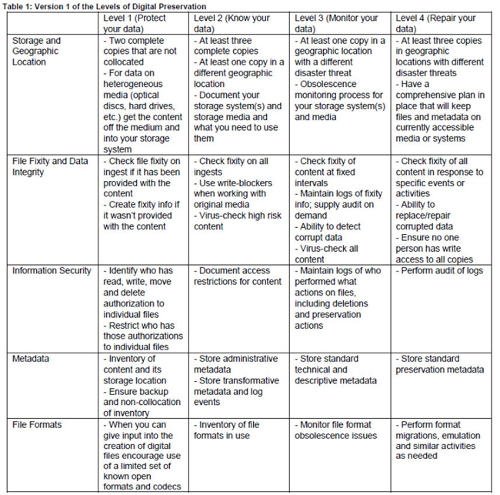
http://www.digitalpreservation.gov/ndsa/activities/levels.html

Slide 8
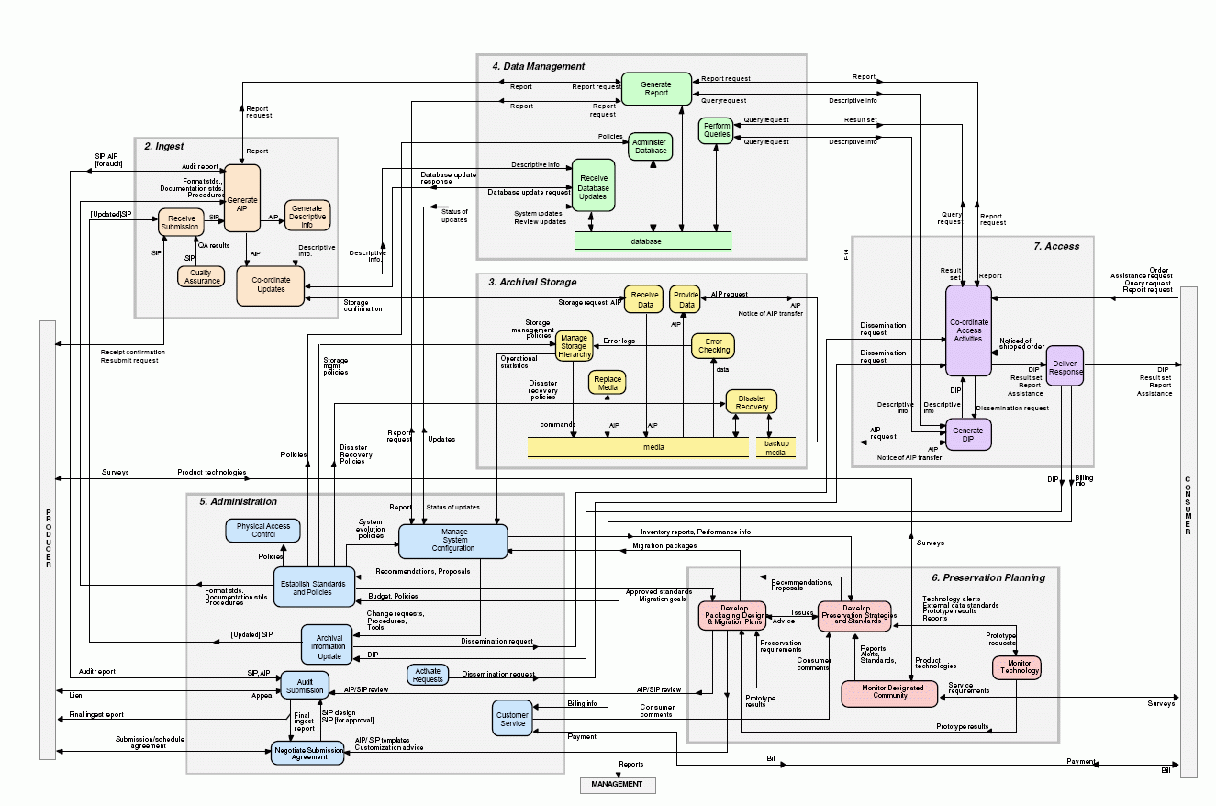
So……How do we get from here to there?
Solution in Theory
Solution in Practice
vs.
Scary OAIS Spaghetti Monster
Notes:
!

Slide 9
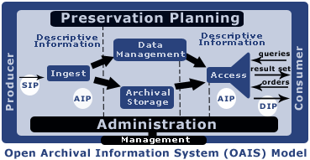
Solution in Theory (riiiiiight)
OAIS (Open Archival Information Systems) and other scary schematic models
TRAC Certification (Trustworthy Repositories Audit & Certification)
TDR ISO 16363 (Trustworthy Digital Repository ISO Standard)
Complex Curation Lifecycles that don’t look a thing like your workflow
…and other things you don’t need to worry about when you just WANT TO GET STARTED and DO SOMETHING!
SIPs, AIPs, DIPs, Oh my!
A Note: These are all valuable things that benefit the field of digital preservation greatly…. We just don’t want you to become overwhelmed by them and grind to a halt before you take your first steps…like we did!!

Slide 10
Solution in Practice AKA Good Enough DP for real people!!
Our take on what you need to consider when thinking about your digital stuff…..
Getting it
And a few other odds & ends…
Letting people use it …or not!
Understanding it
&
Documenting it
Taking care of it

Slide 11
Our take on some things that need to happen or be considered along the way to this “Digital Preservation” thing….

Slide 12
Solution in Practice AKA Good Enough DP for real people!!
Some things to keep in mind…..
Not all tools and services are created equal. - Some tools/services do specific tasks (microservices). - Some tools/services combine multiple microservices (you guessed it….macroservices!).
Starting small is good enough! - Starting with a simple microservice tool will get you closer to your goals AND you can use them NOW! - Baby steps still move you forward….. See “Walk This Way”.
Knowing what you have is crucial. - Write. It. Down. And maintain it. - We’ll show you an easy way to do this in a bit!

Slide 13
Let’s Talk about Macroservices….
And there are back-end storage/preservation services like…..
There are front-end/processing tools like…..
MetaArchive DuraCloud Amazon Glacier
Internet Archive
Archivematica Curator’s Workbench
Data Accessioner
There are even some services that will pretty much do it all like….
Preservica Dspace Direct (uses DuraCloud)
Archivematica + DuraCloud
Note: Yes, there are also CMS’s, IR software, and Forensics tools….ugh. However, these are outside the scope of this workshop!
AND you have to figure out what works best with what!!! But we have done some of that so you don’t have to!

Slide 14
Clarification: Preservation vs. Access
Long term access (Preservation)
Short term access
Purpose: ensure long-term access
Focus: current & future users
Relies on proven (reliable) technologies to preserve digital objects across generations of technology
Accumulates metadata over the life cycle to trace preserved content
Preservation systems create new versions of digital objects for access to deliver as needs change over time
Purpose: provide content to users now
Focus: current
Relies on cutting edge technologies to provide best and fastest access at a point in time
Selects metadata needed to use and understand content
Access systems deliver objects with user-oriented services

Slide 15
BREAK TIME! Back by 10:30, please
Next up: Your Pre-Ingest Workflow

Slide 16
Everyone’s favorite donor question:
Hey, do you want this
jump drive for your collection/archive?
Demo: Accessioning a digital collection

Slide 17
Don’t Panic - Your Pre-Ingest Workflow aka Wrangling your digital stuff before you can get it into a shiny system
NOTE: This is only ONE way to do this… Everyone’s workflow is a little different!
Hang tight for a demo
and some hands-on
practice of this!
Starting from scratch:
Begin an Inventory Spreadsheet
Run accessioning tools (creates basic preservation metadata files in XML for you!)
- Move everything to a stable carrier (like a network drive)
Make an Access Copy from your Master Copy
Continue populating Inventory Spreadsheet (if needed)
OPTIONAL: Keep original media
Most of these will cost you more time than money
Document what you do pre-ingest. For future you.
Remember: Good enough is just fine. For now.

Slide 18
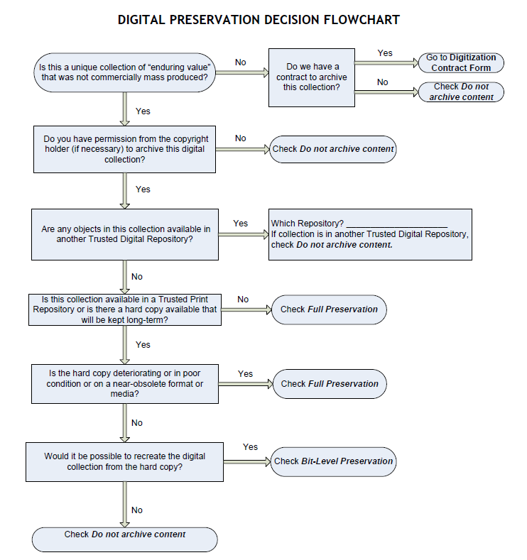
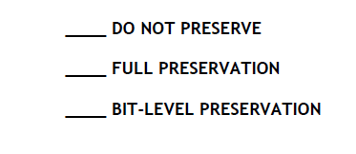
Courtesy of: Tawnya Keller, Digital Preservation Archivist
University of Utah

Slide 19
Pre-Ingest Inventory Spreadsheet Categories
These suggestions follow the recommended DPOE step “Identify” as locally defined by curator/archivist. Example at: http://www.carli.illinois.edu/sites/files/digital_collections/documentation/digipres_identify.pdf
Category (digitization project; born digital; university archives)
Title and Description
Date(s) (date range of what’s IN there or date of creation if born digital)
Location (CD, Jump drive, server location?)
Extent (quantity: 48 journal issues; 106 images; 2 TB of video)
Format (file formats: PDF, .Jpeg, Animated GIF, Wordstar2.0 file)
This is YOUR inventory… YOU get to decide if it needs additional fields, if some can be deleted, etc. You are the boss of this!
FILL OUT WHAT YOU CAN AS YOU WOULD WITH ANY NORMAL ACCESSION
DPOE is a Library of Congress Digital Preservation and Outreach Program http://www.digitalpreservation.gov/education/

Slide 21
Data Accessioner

Slide 22
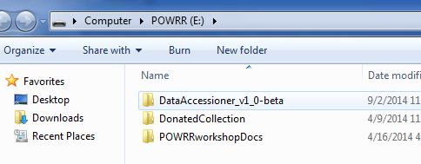
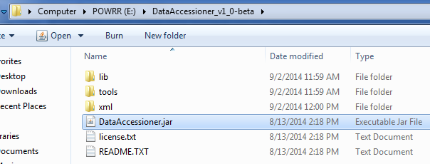
1. Insert flash drive and open the explorer window Data Accessioner Donated Collection Folder Other stuff…..
2. Navigate to DataAccessioner.jar and open it

Slide 23
Switch to live Data Accessioner demo

Slide 24
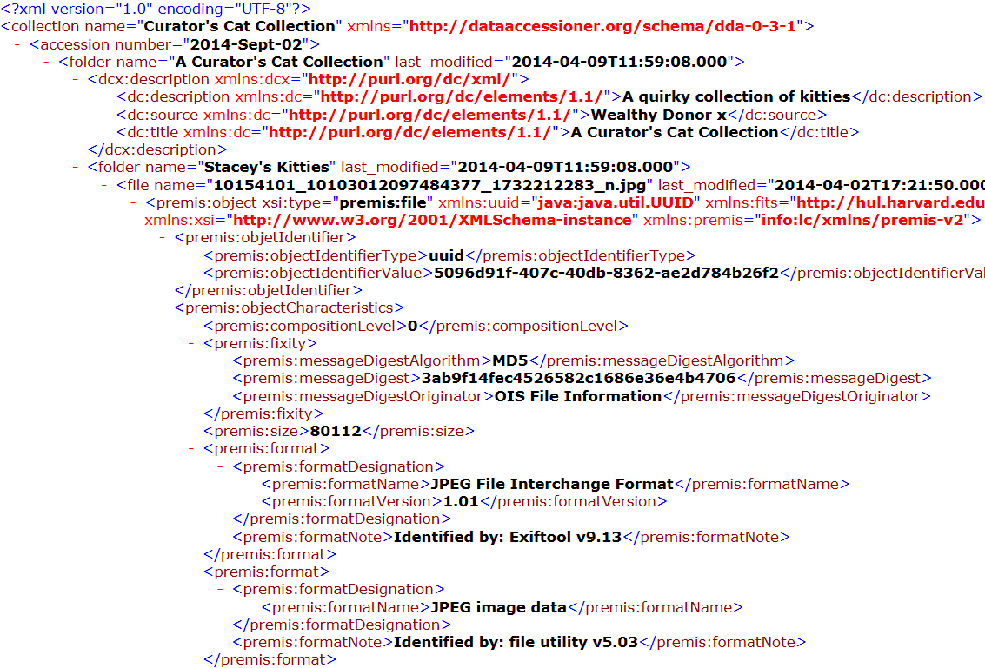
XML Output
Basic descriptive and Dublin Core metadata that you created
Fixity/Checksum: MD5
Extracted metadata: tree hierarchy of your accession (folder names, file names, last modified, size, and more!)
Identifying Information (Exiftool)
Identifying Information (file utility)

Slide 25
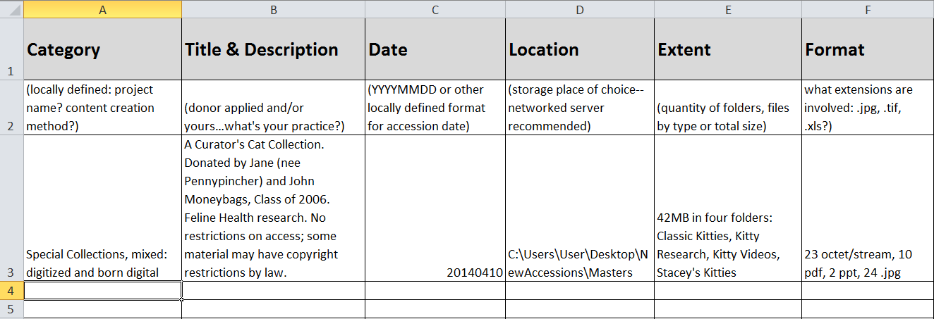

Slide 26
Congratulations!
You just did the first few steps in the digital curation lifecycle.
Well, we did it. Your turn comes after lunch!
But first….. Macroservices! WOO!

Slide 27
Macroservices: Doing it all! Sort of.
Using simple tools, like Data Accesioner, is what you can do while you are petitioning your institution for a more robust solution like…
Archivematica
Curator’s Workbench
DuraCloud
MetaArchive
Preservica
Internet Archive
Please Keep In Mind…
This is NOT exhaustive
Software changes quickly!
Based on availability at time of testing and our perceived needs

Slide 28
Remember this?
Most tools and services only perform some of the functions in a digital curation lifecycle.
*Tools/Services in RED were tested in-depth by POWRR
Back-end * Storage * Preservation
Front-end * Processing
MetaArchive DuraCloud Amazon Glacier
Internet Archive
Archivematica Curator’s Workbench Data Accessioner
Preservica Dspace Direct (uses DuraCloud)
Archivematica + DuraCloud
But there are very few services that will pretty much do it all.

Slide 29
Front-end/Processing: Curator’s Workbench

Slide 30
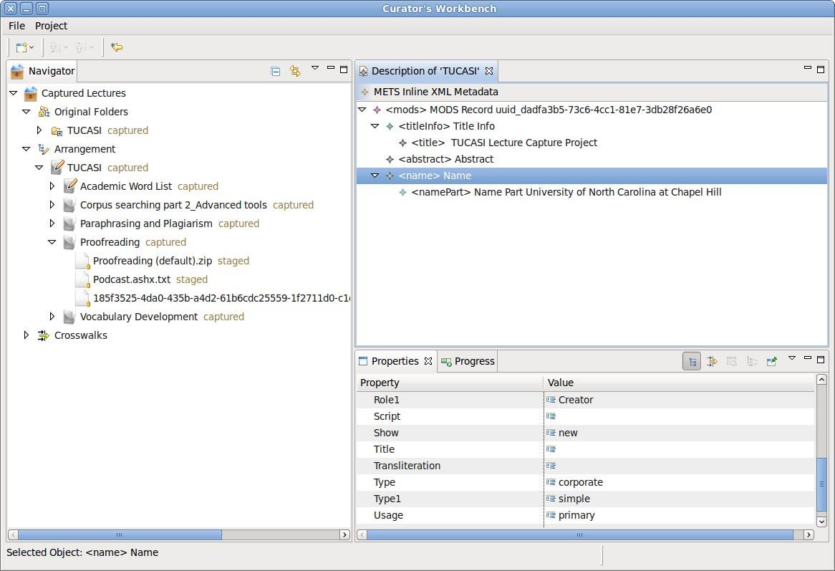
Front-end/Processing: Curator’s Workbench
Requires expertise in MODS & direct metadata entry
Project partners couldn’t make it fit their workflows
The update process is slow
What we just demo’ed (DA) does a good enough version of this

Slide 31
Front-end/Processing: Archivematica

Slide 32
Front-end/Processing: Archivematica
Open source/free software
Requires IT support and administration (Virtual Machine, Ubuntu Server, etc.)
Microservices run by themselves
Shows all the steps for AIP, SIP, DIP
Capability to upload own metadata
Errors stop everything
Great Google users group support
Integrates with Content DM & DSpace
Bundled with ICA-AToM (archival content management system like ARCHON)
Hosted version now available
File transfers not intuitive
Slower processing, but that could be due to the fact that we are used to desktop-based applications

Slide 33
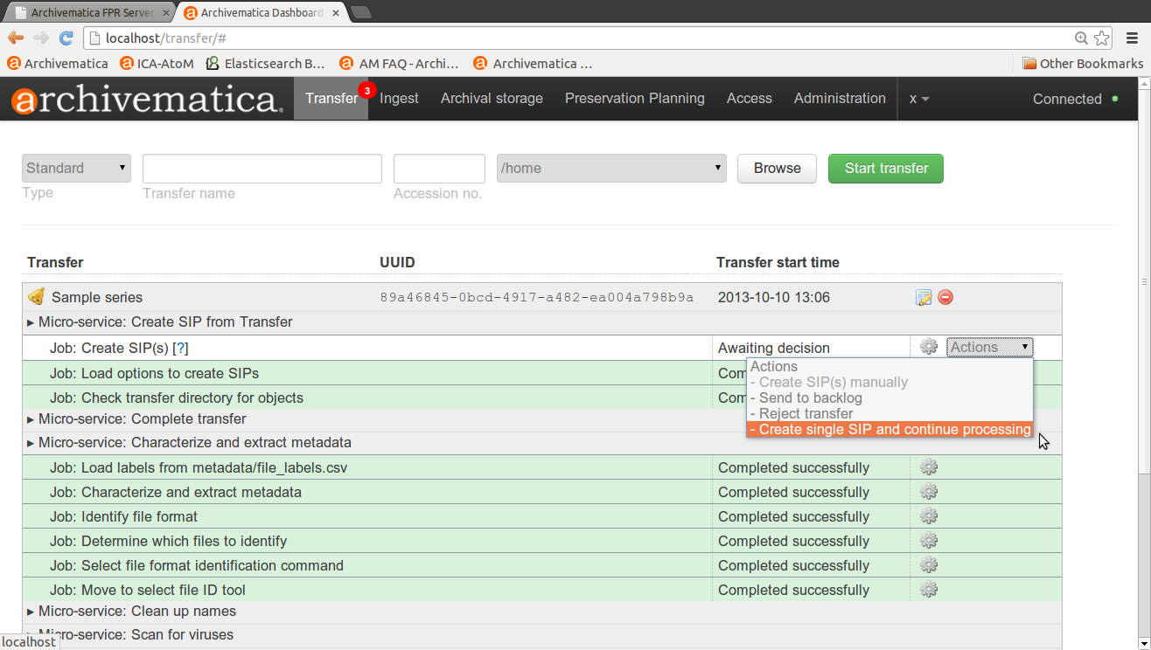
Archivematica: Transfer Collection

Slide 34
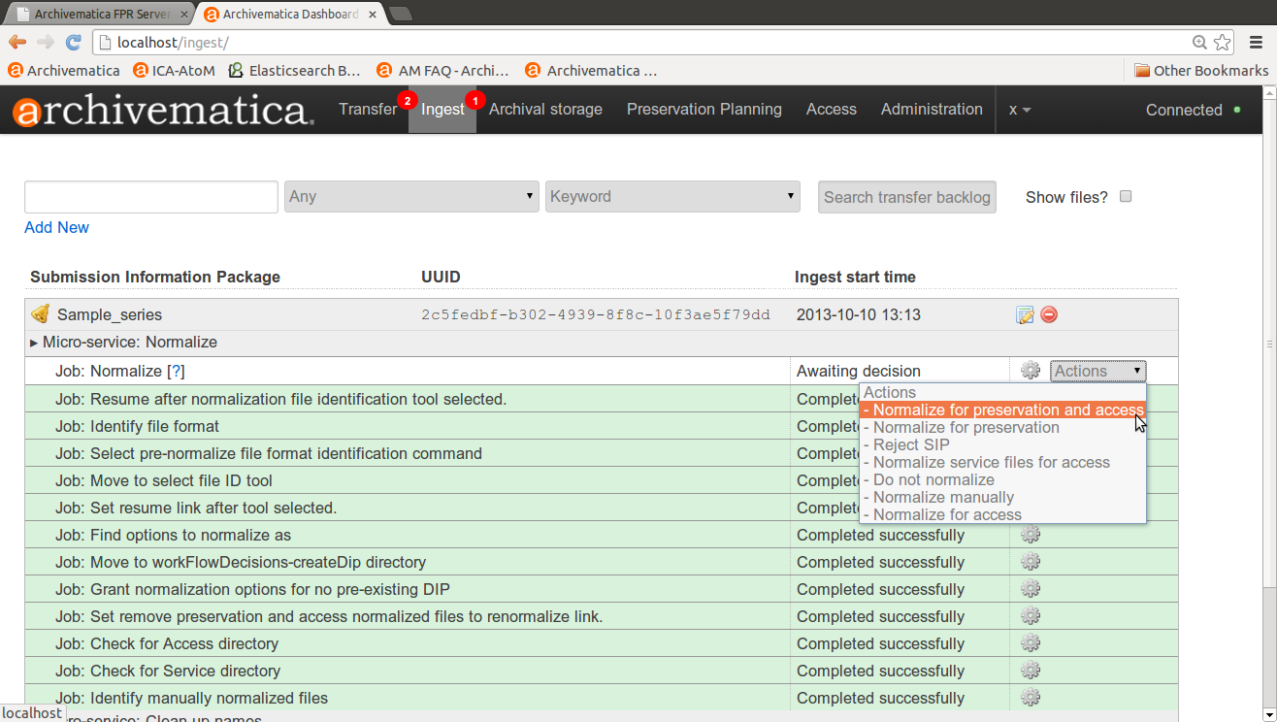
Archivematica: Normalization On Ingest

Slide 35
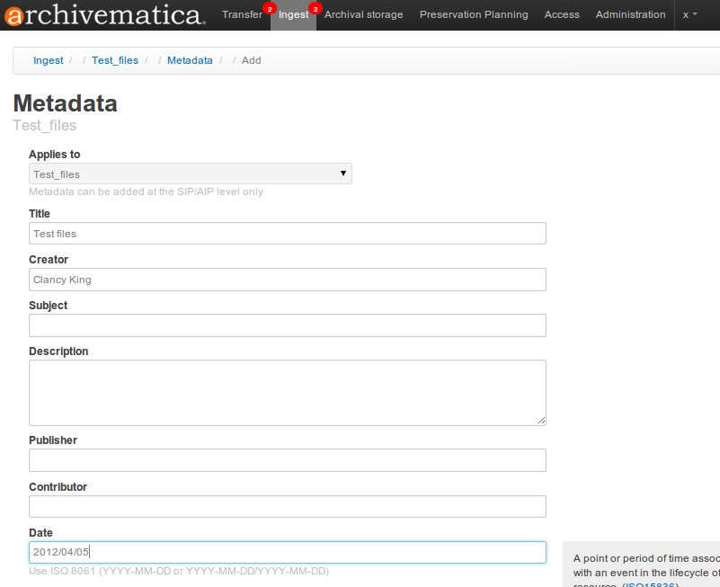
Archivematica: Add Metadata

Slide 36
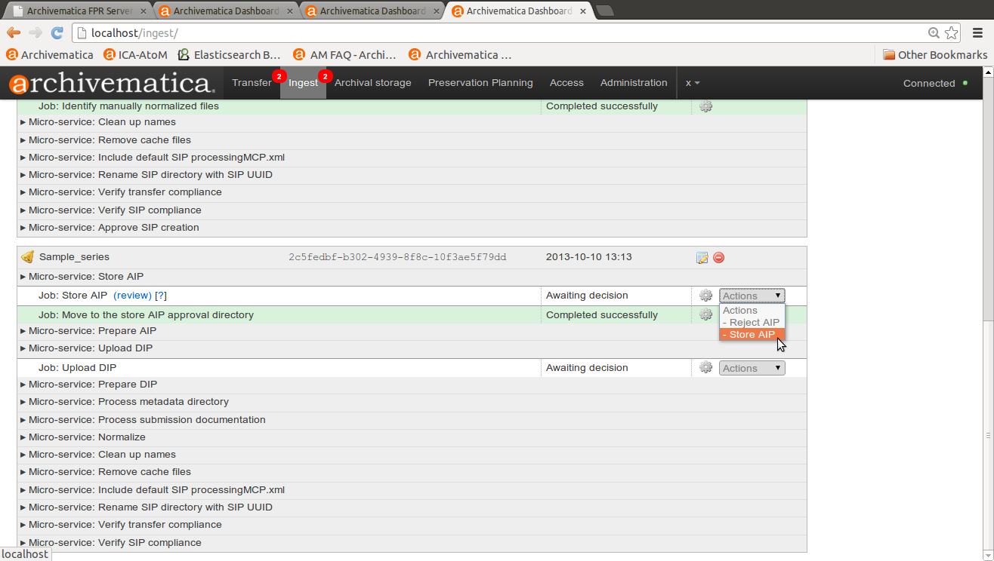
Archivematica: Add AIP to Storage

Slide 37
Back-end/Preservation: DuraCloud

Slide 38
Back-end/Preservation: DuraCloud
Nonprofit; Open Pricing; Community buy-in
Cloud storage/preservation solution
Different storage provider options
Hosted service (requires little to no IT support on your end!)
Some microservices available (like health checks that verify checksums
Different options/methods for uploading content (bulk, single item, etc.)
Intuitive uploads and file management
Easy exit strategy
Easy integration with DSpace
New: Integrated with hosted version of Dspace
Media streaming based on Amazon’s Cloud service
Responsive customer service with very good documentation
Affordable; Scalable; Easy to get started

Slide 39
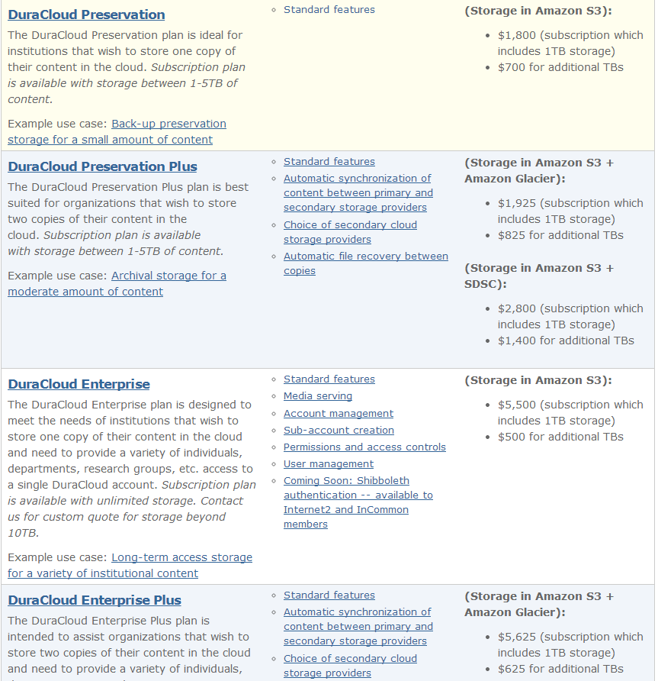
DuraCloud.org
Head to the website for…
Open Pricing
Free Trial
Lots of webinars and tutorials
Learn more about the new DSpace Direct… a hosted version of the DSpace Institutional Repository software that is integrated with DuraCloud for preservation

Slide 40
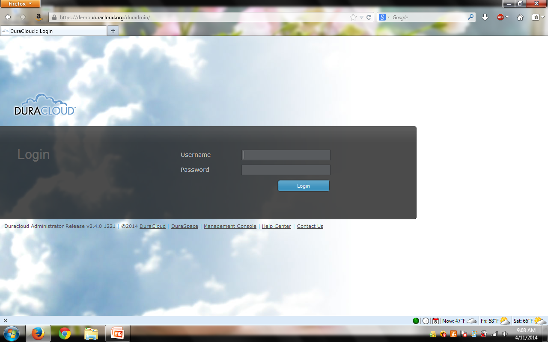

Slide 41
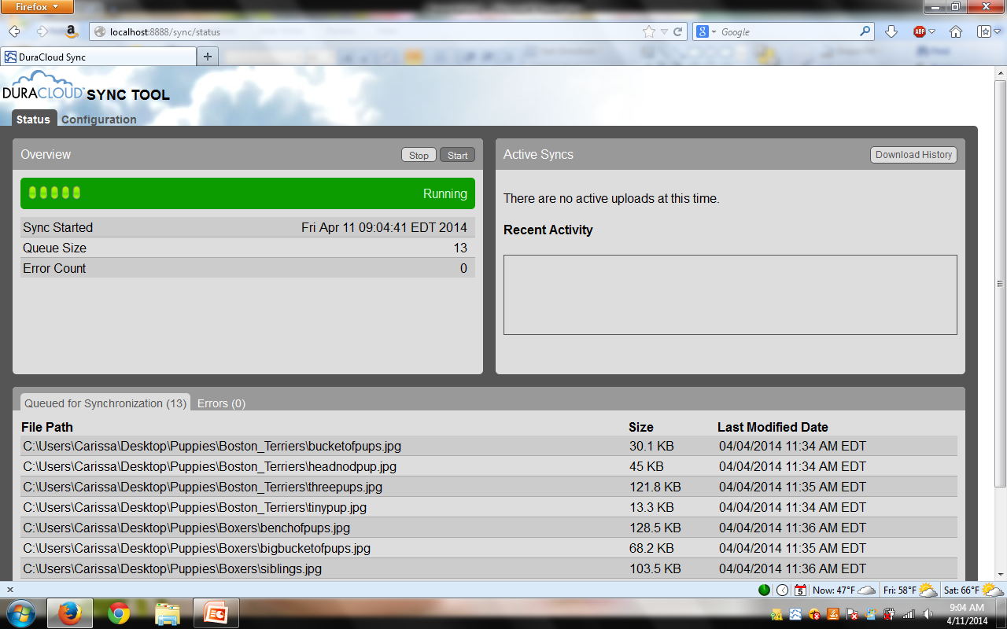

Slide 42
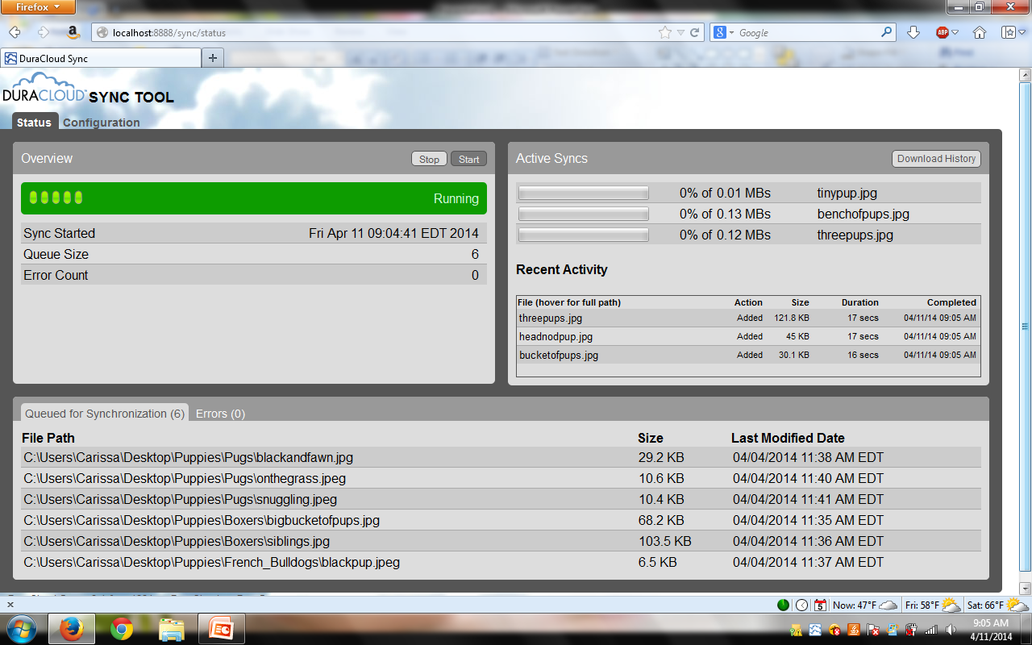

Slide 43
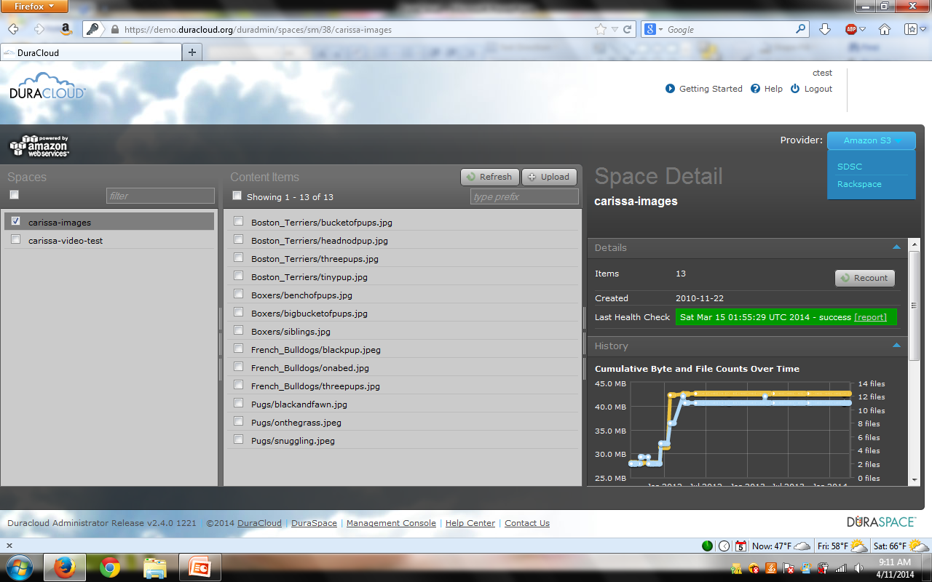

Slide 44
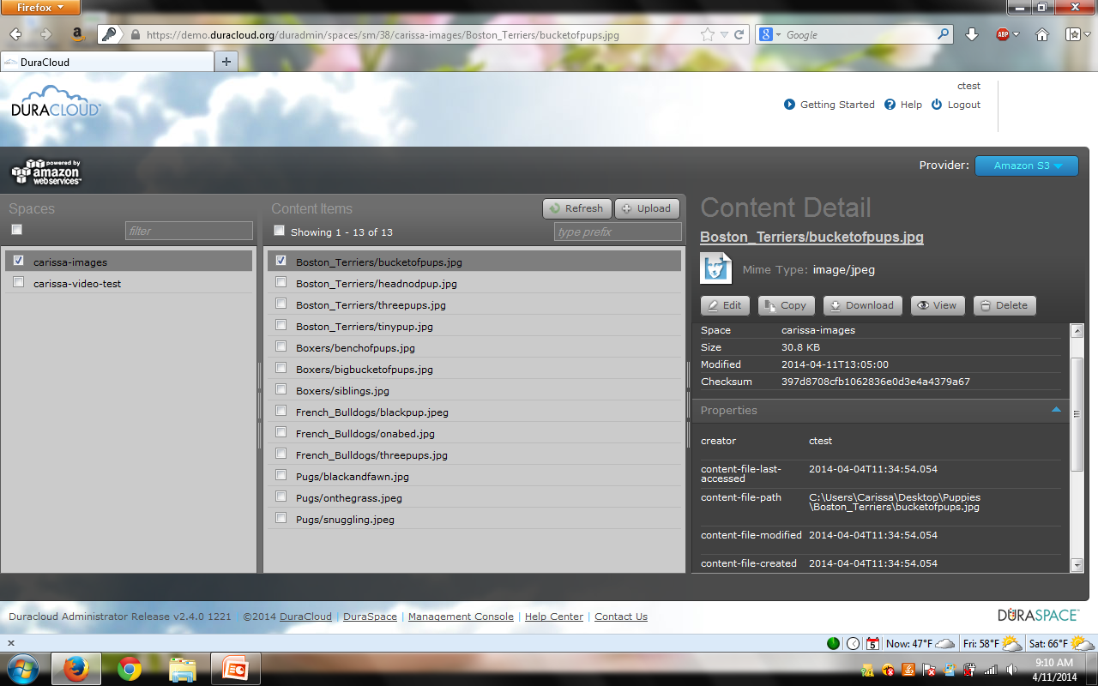

Slide 45
Back-end/Preservation: MetaArchive

Slide 46
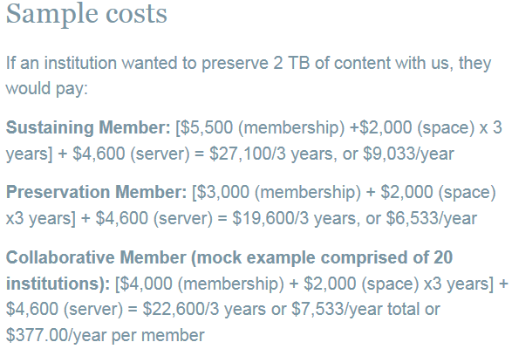
Back-end/Preservation: MetaArchive
Nonprofit; Open Pricing
Instant community in the Cooperative! - All the cool kids are doing it!
Helpful and responsive customer service
Private LOCKSS network
Dark Archive
Requires dedicated IT administration
Most memberships require attending meetings
Assumes pre-processing work is done
Rules for minimum processing requirements (ie file naming conventions)
http://www.metaarchive.org/costs
What we tested

Slide 47
Back-end/Preservation: MetaArchive
Very simplified version of how it works:
Collaborative Membership Model
1)
Partners prepare their content for preservation and package it.
→We used the BagIt specification, and Bagger helped us with this
MetaArchive
Tech Help
2)
Lead Institution prepares a staging server, sets appropriate access protocols and assists Partners with technical help.
AIPs
Lead Institution Staging Server LOCKSS Server
3)
Partners FTP their AIP’s (Bags) to the staging server at the Lead Institution.
→ We used Filezilla
AIPs via FTP
Tech Help
4)
MetaArchive harvests the AIP’s from the Lead Institution's staging server and pushes it into their LOCKSS network.
Partner 1
Partner n
One other thing: The Lead Institution also has a dedicated server that runs the LOCKKS software, is hooked into the MetaArchive network of servers across the globe, and is actively preserving the content of other Members.
Partner 2

Slide 48
Front-end & Back-end: Preservica

Slide 49
Front-end & Back-end: Preservica
All encompassing: - Ingest - Processing - End-User Access - Preservation - Migration
Aligned with OAIS reference model
Hosted Service (Requires little IT support on your end)
Very user friendly
Intuitive workflows
Exit strategy available (batch export)
Ability to harvest via web crawls
Solid customer support
Different training options available for institutions with smaller budgets
Currently uses only Amazon cloud storage - new options forthcoming
Proprietary, vendor-based

Slide 50
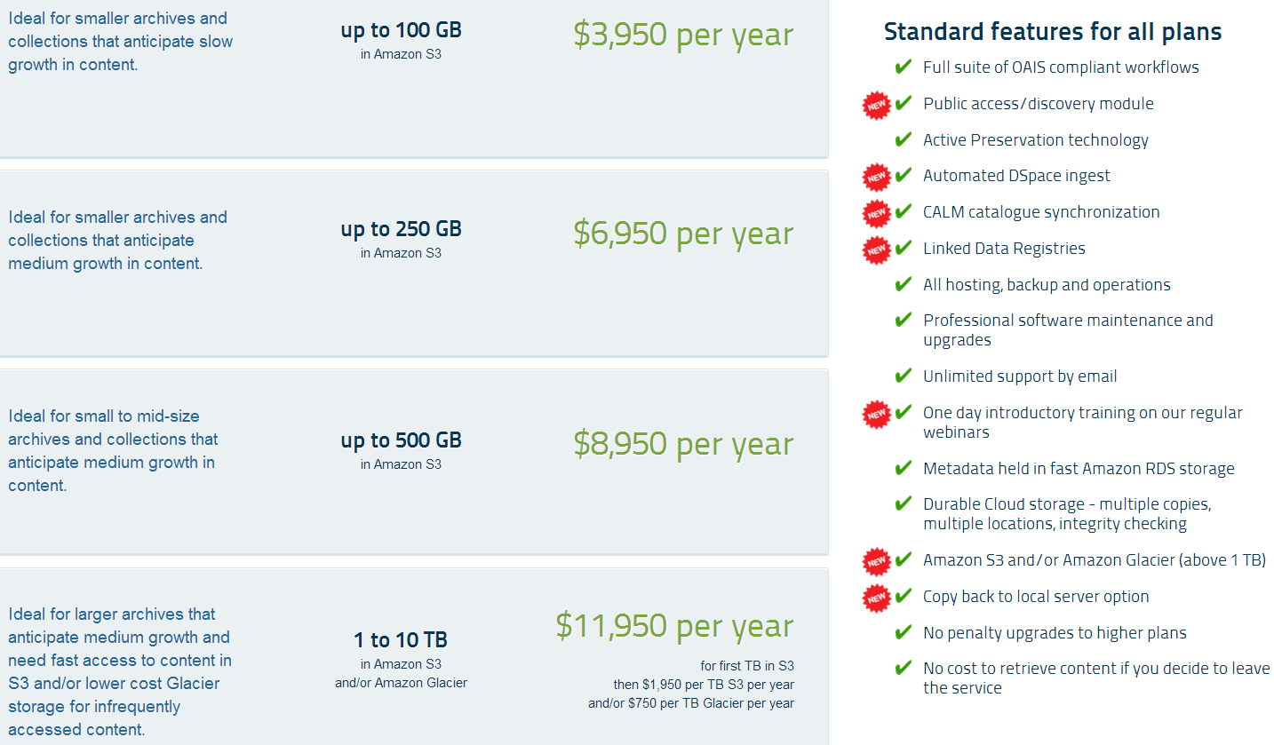

Slide 52
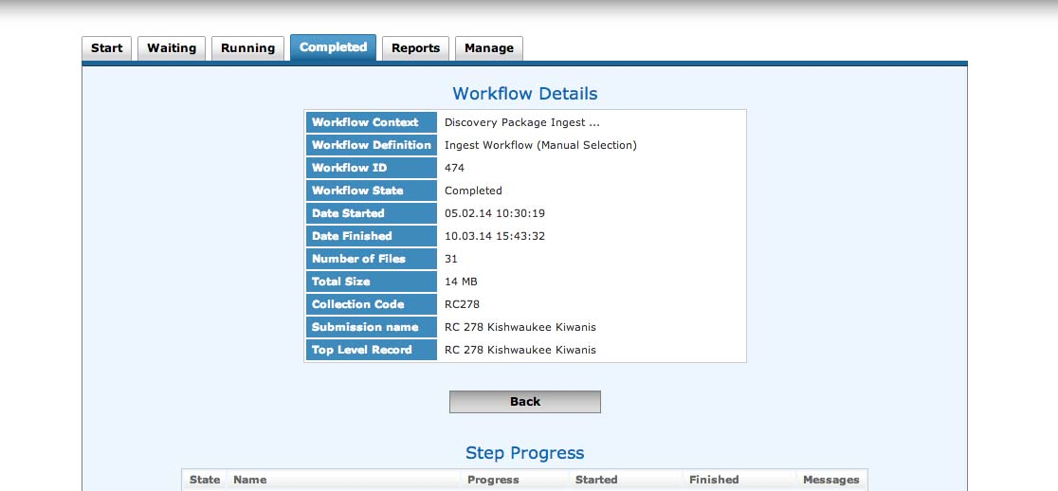
INGEST

Slide 53
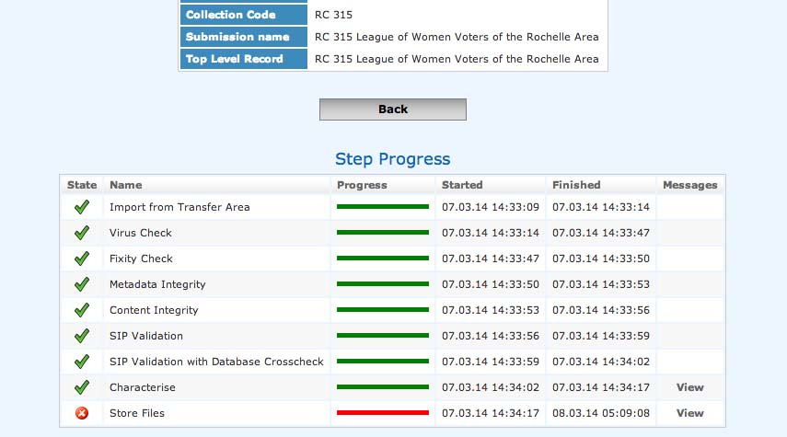

Slide 54
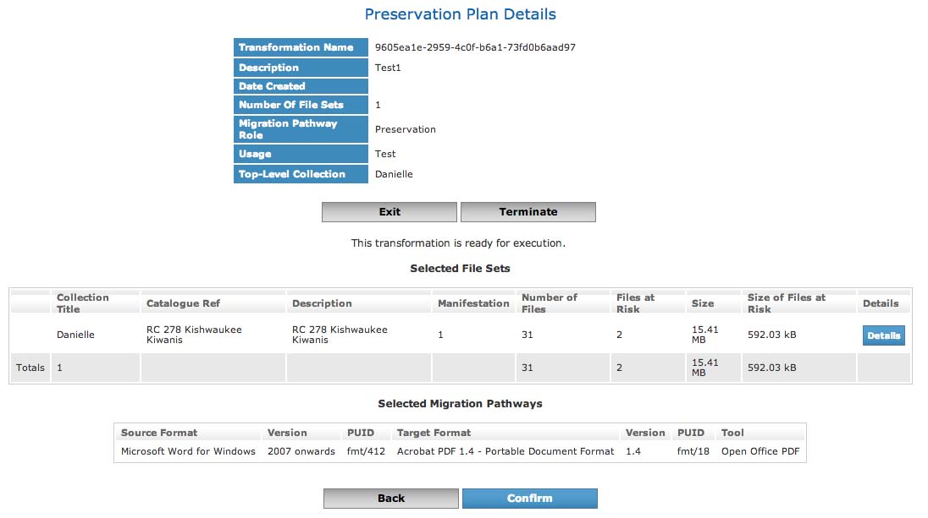

Slide 55
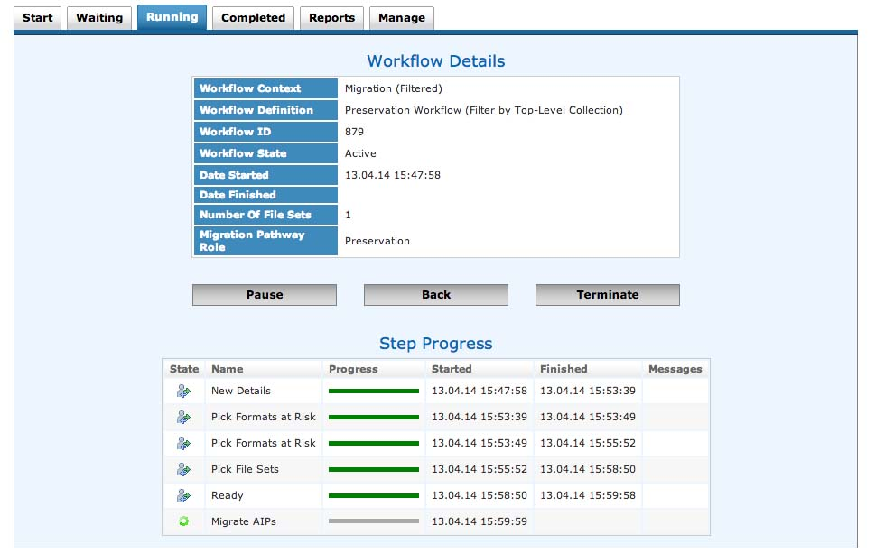

Slide 56
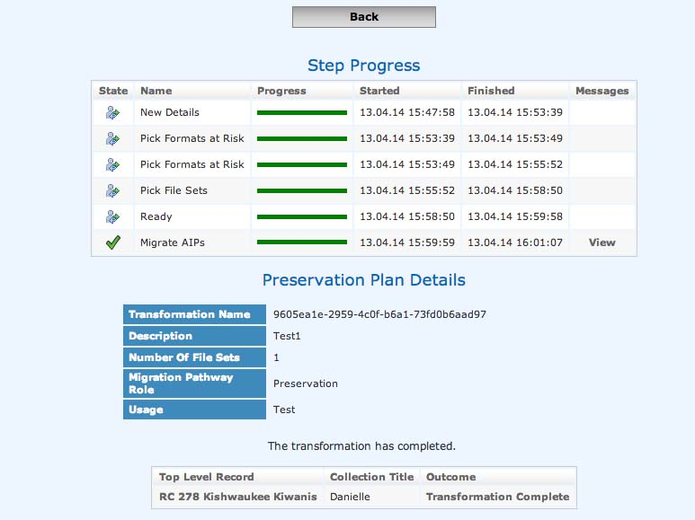

Slide 57
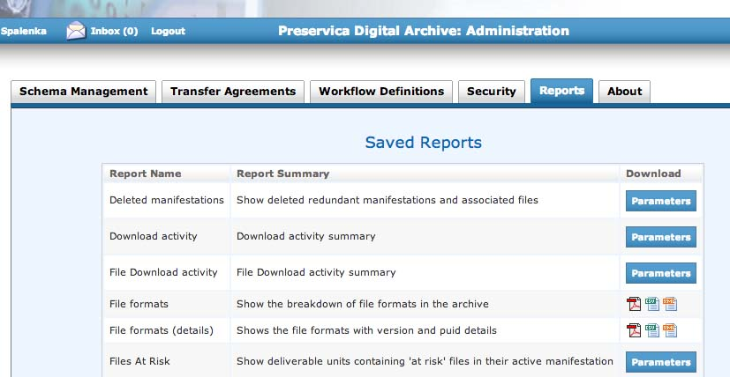

Slide 58
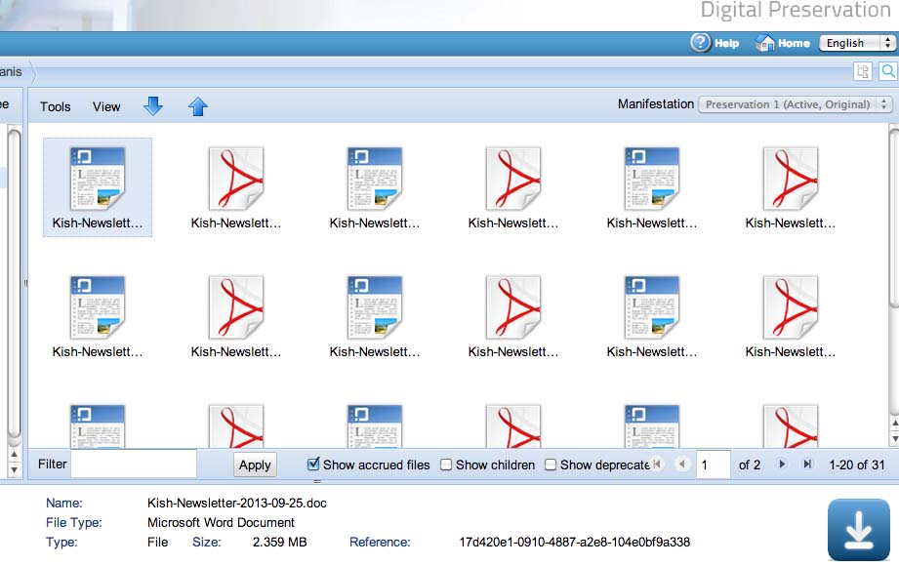

Slide 59
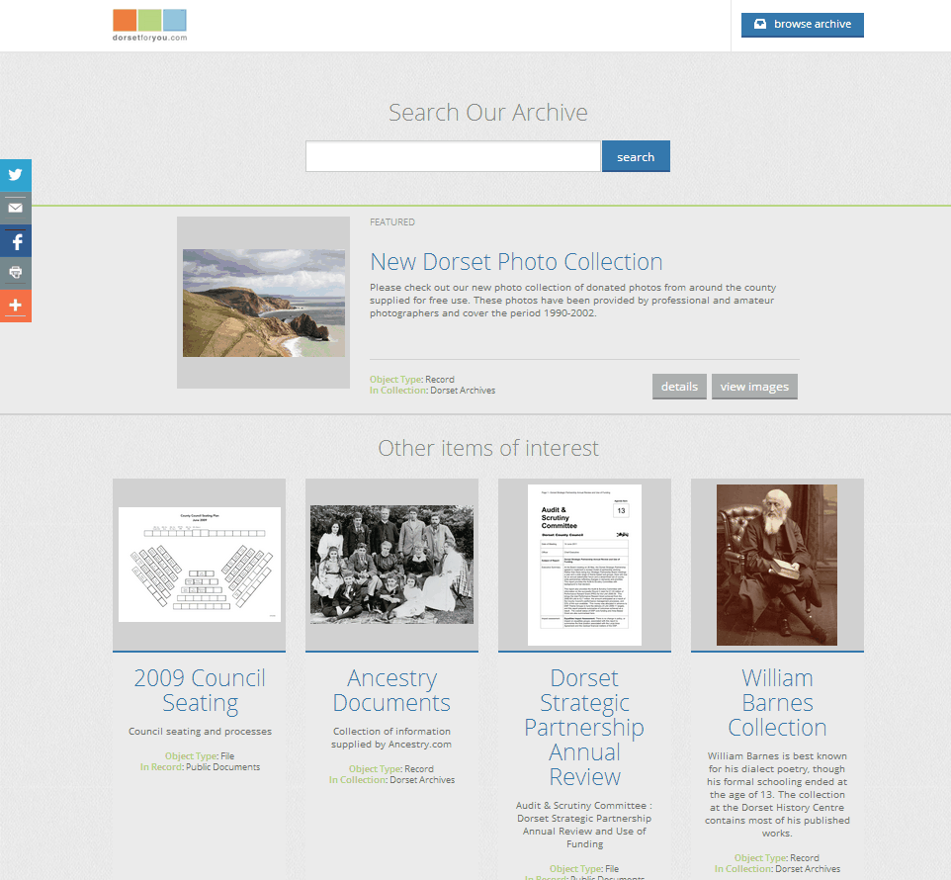

Slide 60
Front-end & Back-end: Internet Archive

Slide 61
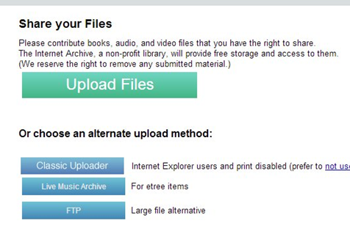
Internet Archive
Only intended for materials in the public domain (available to everyone).
Geographically distributed copies.
No frills (and no charge!) service.
Handles books best, but can accommodate manuscripts, audio, video, and images.
Is especially suited for small (VERY small institutions with limited (or no) other alternatives.
Does offer a more traditional preservation product through its Archive-It service.

Slide 62
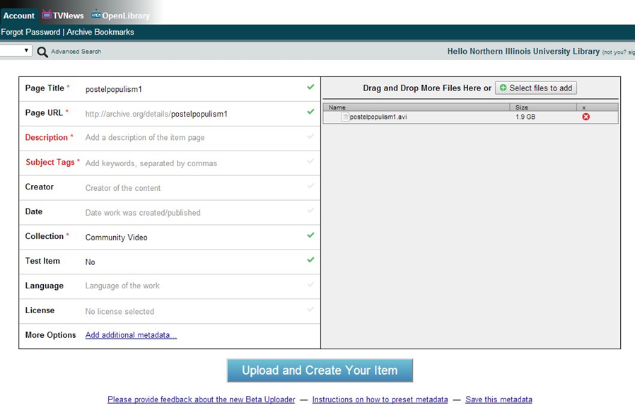

Slide 63
LUNCH

Slide 64
Activity: Accessioning a Digital Collection 1 - 2pm
1. Insert flash drive and open the explorer window Data Accessioner Donated Collection Folder Digital Collections Inventory file Other stuff…..
2. Navigate to DataAccessioner.jar and open it

Slide 65
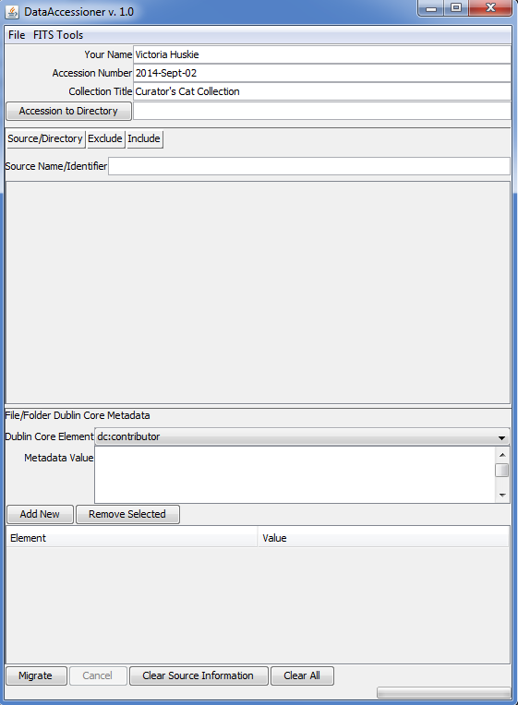
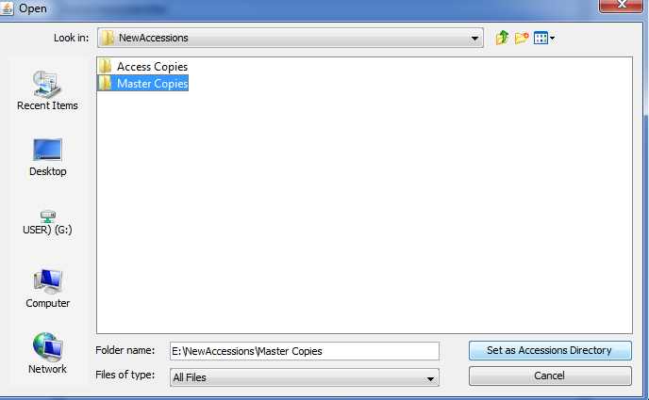
Create your accession directory: Where you want the collection to go live Preferably a stable media like your network drive
In your POWRR drive, open the NewAccessions folder and select the Master Copies folder

Slide 66
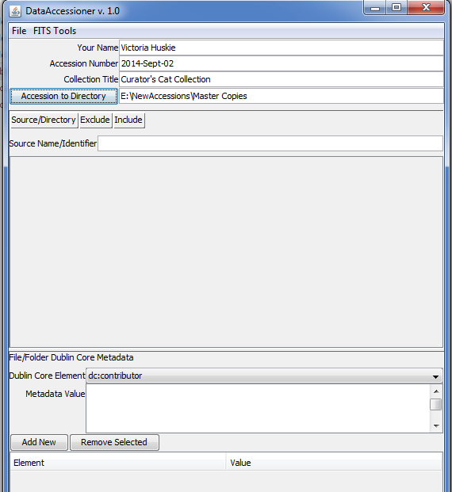
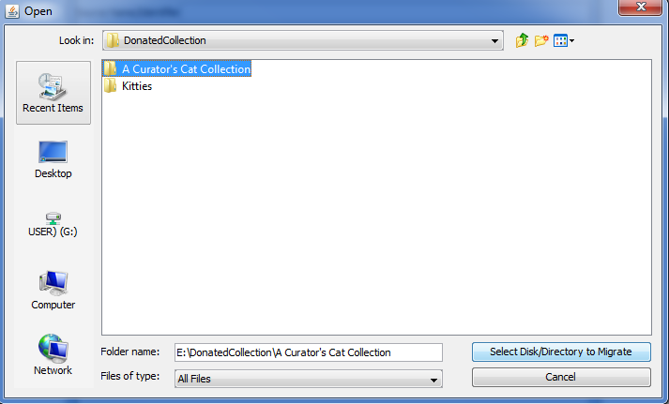
Select the collection you are accessioning

Slide 67
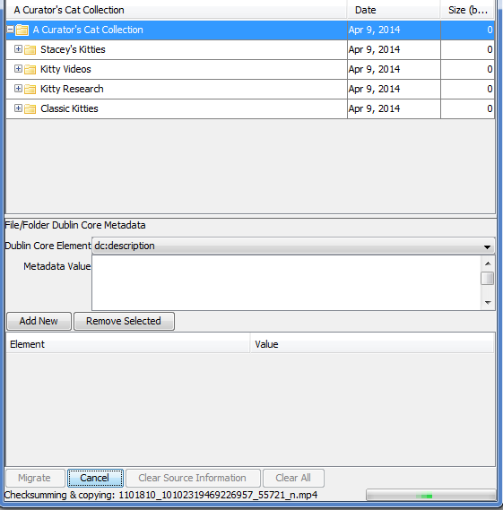
Populate descriptive metadata and migrate your collection
Select which element you want to add metadata to
Add the Dublin Core Metadata goes here
You will be able to see the progress bar move at the bottom.
Hit the “Migrate” button to begin the migration process.

Slide 68
What did you create?
New copy of your migrated collection.
Located in the
Directory that
you specified
XML Metadata file
You. Are. AWESOME.

Slide 69
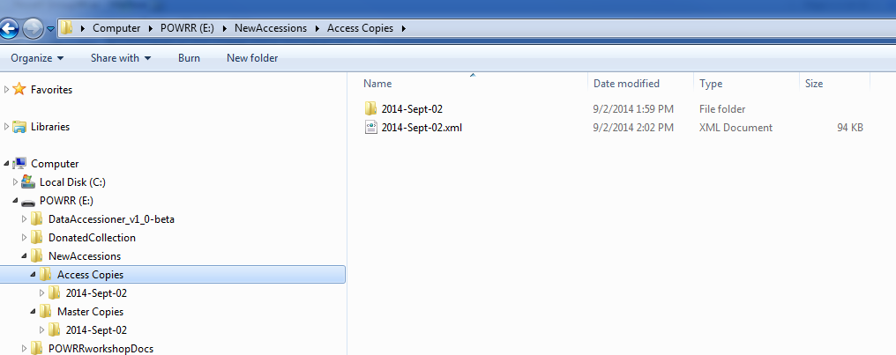
Not quite finished…
Make a copy of the Master, place in the Access Copies folder, and don’t touch the Master Copy again unless a new derivative is needed or until you move it into a preservation system!!

Slide 70
Not quite finished…
And finally…update your Inventory to reflect the location of the Access Copy. Note addition of XML file after processing.

Slide 71
CONGRATULATIONS!
We call this “Digital Preservation in Your Office”
There are things that need to happen outside of your office as well….

Slide 72
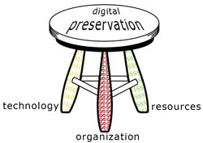
Outside Your Office
Digital Preservation is not sustainable by just using a tool or selecting a service. Sustainability takes funding and people.
You cannot do this alone. You will need to talk to other people… because you are not the only boss of this.
Successful Digital Preservation programs take a team of people at multiple administrative levels.
Three-Legged Stool of Digital Preservation
Anne R. Kenney
Nancy McGovern
Digital Preservation Management Workshop
http://www.dpworkshop.org/

Slide 73
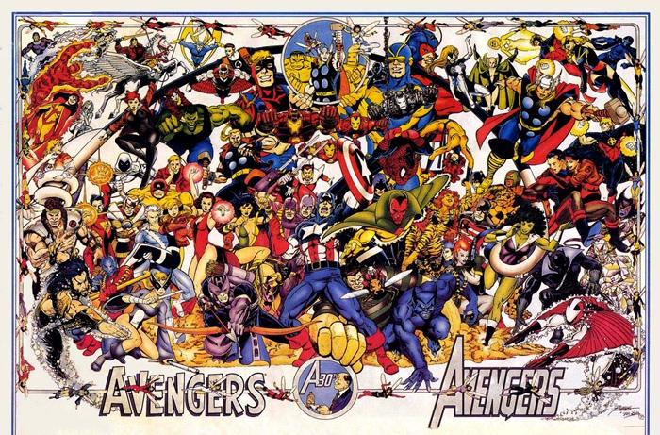
Assemble Your Team!
Image: Flickr Commons

Slide 74
Outside Your Office Group Activity: 3-3-3 Action Plan
Create a list of all roles in an organization that should play a part in some aspect of digital preservation

Slide 75
3-3-3 Action Plan: Build Your Team
Now let’s move from roles to people….
On your 3-3-3 Action Plan handout, list 3 individuals at your institution in these roles that you already have a working relationship with.
Which of these folks are you willing to contact in the next 2 weeks? …in the following month? …in the following 3 months?
After bringing these colleagues on board, what are 3 concrete, small steps that you can take together to move your burgeoning DP program forward?
~Conversations/Meetings ~Inventory what you already have
~Enhance the metadata of the records you already have
~Look at how current policies address digital materials (ex. collection development)
~Tool investigation: Dig a little deeper on tools that piqued your interest today
~Look at other institutions’ DP policies with an eye to crafting your own
~Engage in some outreach/education activities…host a Brown Bag!
~Download DDA and play with it some more! ~Read the POWRR white paper

Slide 76
Now Let’s Assess...
How will you know if your 3 activities succeeded?
Added people to team?
Number of people newly educated?
Number of items added to inventory?
Number of tools investigated?
Number of DP policies looked at?
Revised standing policies?

Slide 77
BREAK TIME! Back by 2:45, please
Next Steps:
Advocacy, Policy, and Potential Solution Models

Slide 78
Next Steps: Advocacy
Advocacy is valuable because you’re educating people about why digital preservation is also THEIR problem.
- Our one-pagers may help you frame why digital preservation is important to different jobs/function.
- The risks of doing nothing are a lot greater than they may think.
Good policies incorporate multiple viewpoints.
Other people at your institutions will bring up issues – and possible solutions – you may have missed.
You will discover many things that you don’t directly control that still directly affect your work. This will lead you to more people to add to your team.
Notes:
!

Slide 79
Next Steps: Towards a Policy
You have started assembling your team….now what?
We found a gap analysis really helpful:
Where are you now?
Where would you ideally like to be?
What is keeping your institution from moving in that direction?
What are some interim steps you can take to move in the right direction?

Slide 80
We also found that Gap Analyses can be challenging…
Next Steps: Towards a Policy
Be brutally honest. It’s the only way to move forward.
Look closely at risk: What is the cost of doing nothing?
Documenting what you know will tell you what you don’t know.
Feel free to look at our case studies and see how it worked. Our wiki has the case studies of all 5 of the POWRR partner institutions. http://powrr-wiki.lib.niu.edu/index.php/Main_Page

Slide 81
Next Steps: Towards a Policy
Policy is where the ideal leads to actual workflows within your organization.
We’ve collected links to resources on our website for getting started. http://digitalpowrr.niu.edu/digital-preservation-101/
Iterative is TOTALLY OKAY.
Begin with how you would LIKE your workflow to run: tool selection may come out of that.
Does it work with your already existing policies?
It’s better to have a draft policy ready if resources show up than random resources with no policy.
DOCUMENT what you do….future you will be deeply grateful.

Slide 82
Next Steps: Potential Solution Models

Slide 83
How to Decide? Results May Vary…
Things to consider:
How many staff members will be actively engaged in the digital curation lifecycle? Are they tech-savvy?
How robust and supportive is your technical/systems group? Do you even have one? How about some developers/programmers…have any of those on staff?
Is your institution already using archival management software or an Institutional Repository (like ARCHON/ArchivesSpace, BePress, Fedora etc.)? You’ll want to select tools/services that work well with what you have.
Do you have digital collections unique to your institution that are irreplaceable? Consider organizing collections along the lines of those that warrant more robust preservation services than others. For example: 1 TB (High Value) → MetaArchive (gold standard) 3 TB (Medium Value) → Amazon Glacier (cheapest storage with fixity checking) Rest (Replaceable) → Tape Drive Backups In other words: One tool/service will not be your only solution.

Slide 84
How to Decide? Results May Vary…
Remember: Smaller institutions with less resources may also have unique advantages like….
You only need to convince the person one level above you to get what you need.
It doesn’t take years to set up an account with something like DuraCloud.
Want to install a simple open source tool? Go for it!
Less red tape for getting things done
Fewer levels to push requests for additional resources through
Self-administered workstations (aka no IT administrative lock downs)
Personnel-heavy operating model (usually has smaller cash flow)
Higher cash flows and less data (like small, private institution)
This is ideal for running a *free* robust tool that requires a developer and server administrator like Archivematica.
You can purchase a reasonably-priced, hosted soup-to-nuts solution.

Slide 85
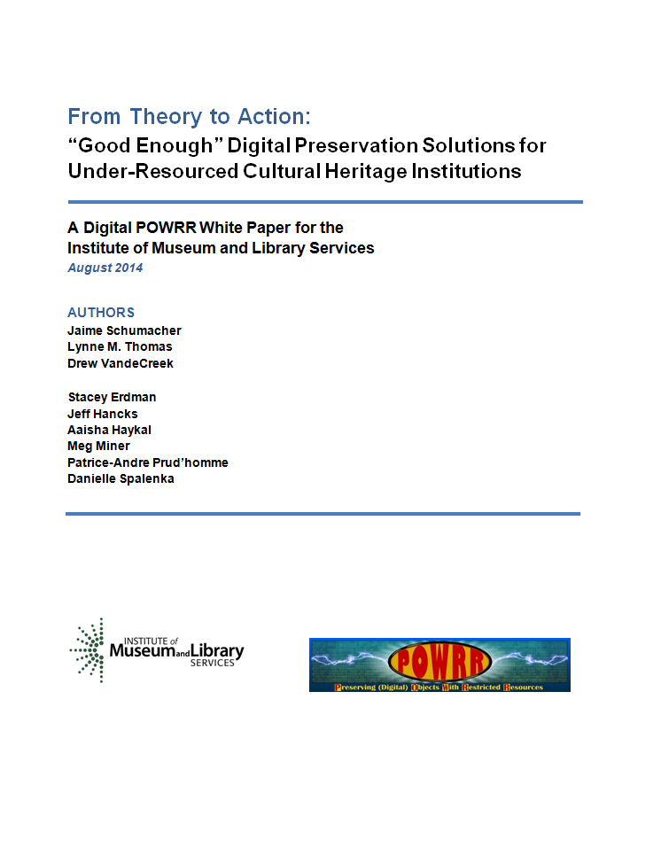
Next Steps: Potential Solution Models
POWRR White Paper available at:
http://commons.lib.niu.edu/handle/10843/13610

Slide 86
Wrapping Up
Our Final Thoughts & Your Questions
I survived the POWRR workshop! Now what? https://digitalPOWRR.niu.edu/survived-powrr-wkshp/
We’re here to help. Seriously.
YOU CAN DO THIS. Really. But not alone. So bring some friends.
“If you want to go fast…go alone. If you want to go far…go together.” — African Proverb
Remember: Baby steps still move you forward!

Slide 87
Evaluation Time! (10 minutes)
Post-Test
Workshop evaluation…tells us about pace, style of presenting, etc.
In 3 Months…
Emailing you a brief survey around your 3-3-3 Action Plan
There may be a phone call too (if we don’t hear back from you or if we need further details)
Please note: The IMLS requires us to do these things…and it helps to make sure these workshops are delivering outcomes that bring tangible results to our peers!

Slide 88
Thank You for Coming!
Please Return:
Jump Drives
Contact Info Section of 3-3-3 Action Plan (bottom)
Pre & Post Tests
Workshop Evaluation

Slide 89
POWRR Project Team Members Contact us…we are here to help!
Northern Illinois University Lynne M. Thomas Curator, RBSC lmthomas@niu.edu 815.753.0255
Drew VandeCreek Director Digital Scholarship drew@niu.edu 815.753.7179
Jaime Schumacher Digital POWRR Director jschumacher@niu.edu 815.753.0576
Stacey Erdman Digital Collections Curator serdman@niu.edu 815.753.1004
*Danielle Spalenka Regional Hist Cntr Curator dspalenka@niu.edu 815.753.9394
Matthew Short Metadata Librarian mshort@niu.edu 815.753.9868
Nathan Books Technical Associate nbooks@niu.edu 815.753.9653
Chicago State University Aaisha Haykal University Archivist ahaykal@csu.edu 773.995.3843
Martin Kong Systems Librarian mkong@csu.edu 773.995.3908
Illinois State University Patrice-Andre Prud’homme Digital Collections Head ppprudh@ilstu.edu 309.438.5385
Illinois Wesleyan University Meg Miner University Archivist mminer@iwu.edu 309.556.1538
Western Illinois University Jeff Hancks Director, Archives and Special Collections jl-hancks@wiu.edu 309.298.2717

