Slide 1
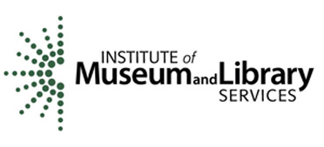
Welcome to the POWRR Institute!
@digitalPOWRR
This Institute is generously funded by the

Slide 2
Welcome to the POWRR Institute!
Logistics
Cohort Model & Instructor Introductions
POWRR Plan
Agenda Review
POWRR Approach to the Digital Curation and Preservation Lifecycle
@digitalPOWRR

Slide 3
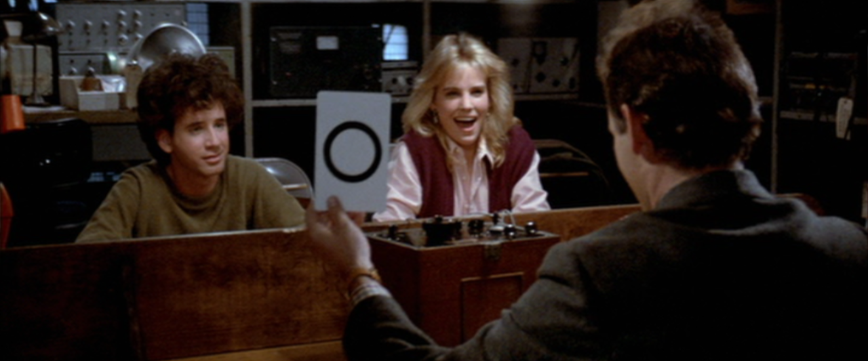
But first…..
Murray, B., Aykroyd, D., Weaver, S., Ramis, H., Moranis, R., Columbia Pictures Industries., & RCA/Columbia Pictures Home Video (Firm). (1984). Ghostbusters
Notes:
You are our inaugural group of POWRR cohorts…thank you! We have poured ourselves into developing the Institute for you. We have lived and breathed it for the past 6 months and longer, in some cases. We need YOUR help to make this Institute better. We really need to hear from you on things like:
Were the pre-Institute communications helpful?
What do you think of the cohort model?
Are the materials understandable?
How did the tech work?
What would you do differently?
Etc.

Slide 4
Logistics
Wi-Fi username is “NIUguest” – no password needed
Accessibility
Facilities
Breaks & Noms
Evaluations
Technology
Notes:
Talk about the tech distribution:
Cohort 1’s laptops should have been wrangled first thing in the morning
Cohort 2 – During Morning Break
Cohort 3 & 4 – During Lunch
Cohort 5 – Afternoon Break
EVALUATIONS – cards available for quickies and final eval at the end
WE WILL BE FOLLOWING UP WITH YOU IN 6 MONTHS

Slide 5
Cohorts & Instructors
Jaime Schumacher Martin Kong
Dorothea Salo
Lynne Thomas
Drew VandeCreek
Stacey Erdman
Illustrations by Jørgen Stamp digitalbevaring.dk CC BY 2.5 Denmark
Notes:
Stacey talks about the cohort model

Slide 6
Your POWRR Plan
Document the current state of your digital preservation activities
Define your organization’s needs and set goals accordingly
Determine what particular challenges and advantages will guide your decisions
Document the knowledge acquired during the POWRR Institute
Capture a pilot solution model(s) and proposed workflow
Create an action plan with goals and activities defined at 3, 6 and 12 months
Notes:
THEY NEED TO START THINKING ABOUT WHAT MATERIALS THEY HAVE IN THEIR BACKLOG (for instance) THAT THEY WANT TO SELECT FOR A PILOT. THIS IS WHAT WE WILL BE CONSULTING TOWARDS AND DEVELOPING A PLAN OF ACTION. THIS IS ALSO HOW WE ARE GOING TO TACKLE ASSESSMENT…THEY ARE GOING TO RATE WHERE THEY ARE WITH THAT “COLLECTION” ON THE NDSA LEVELS TODAY/TOMORROW, AND THEN AGAIN WHEN WE FOLLOW UP WITH THEM IN 6 MONTHS.
The POWRR Plan is a customized document for each member of an Institute’s cohort and is the primary deliverable for each event. You will take it back to your institution with you and use it to inform your development of a digital preservation workflow there. The POWRR Plan is a cloud-based document (Google Doc), divided into four sections, which will be initiated once a participant is accepted into an Institute. Some sections will be populated from the participant’s initial application, with more details added post-acceptance. The purpose of the POWRR Plan is to guide POWRR Institute participants as they:
-Document the current state of their digital preservation activities
-Define their organization’s needs and set goals accordingly
-Determine what particular challenges and advantages will guide their decisions
-Document the knowledge acquired during the POWRR Institute
-Capture their organization’s potential solution model(s) and proposed workflow
-Create an action plan with goals and activities defined at 3, 6 and 12 months

Slide 7
We’re gonna do WHAT???
Group Sessions
Now
Technology
Guest Speaker
Cohort Stuff
Sharing Circles
Discussion
Individual Consultations
Modules
Case Study
Walk The Workflow
Storage 101
Choose Your Own Adventure
Tech Skills 201
PROUD
Web Archiving Archivematica
Notes:
Have them get out the agenda

Slide 8
QUESTIONS?
@digitalPOWRR
Notes:
Talk about the tech distribution

Slide 9
The POWRR Approach to the Digital Curation & Preservation Lifecycle
@digitalPOWRR

Slide 10
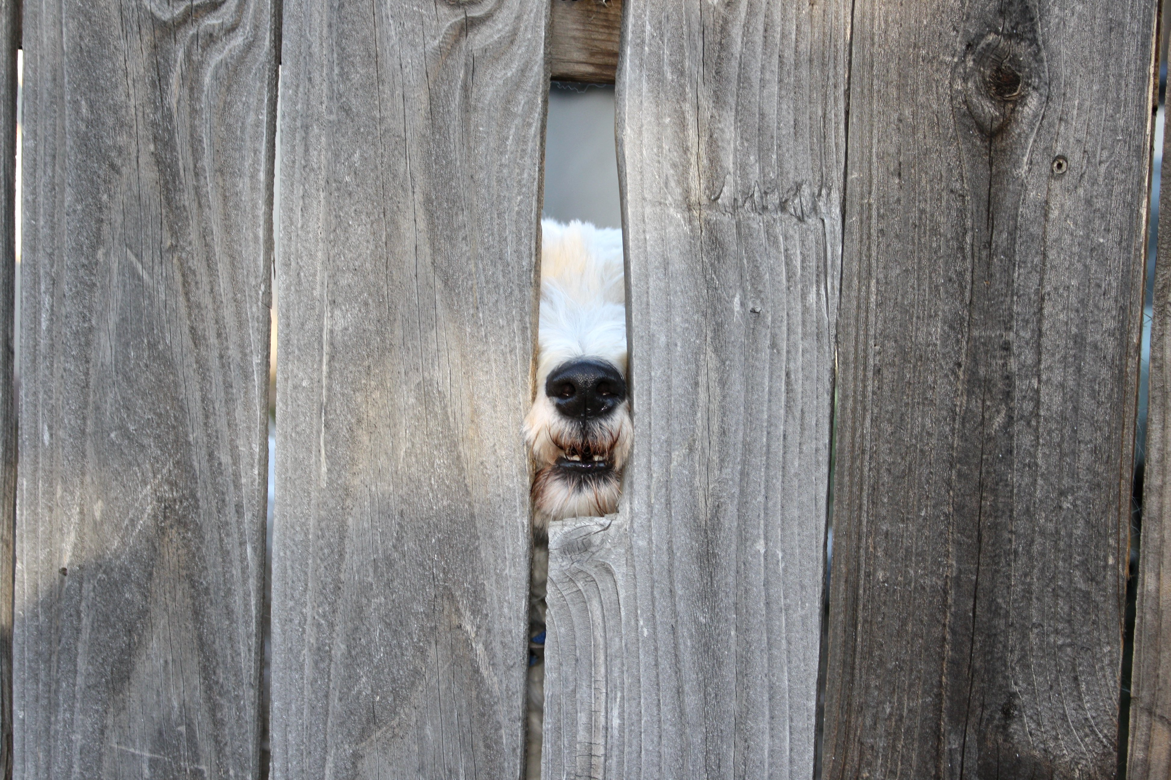
What We Discovered…
…it is NOT a lack of tools, services, and solution models preventing folks from making progress

Slide 11
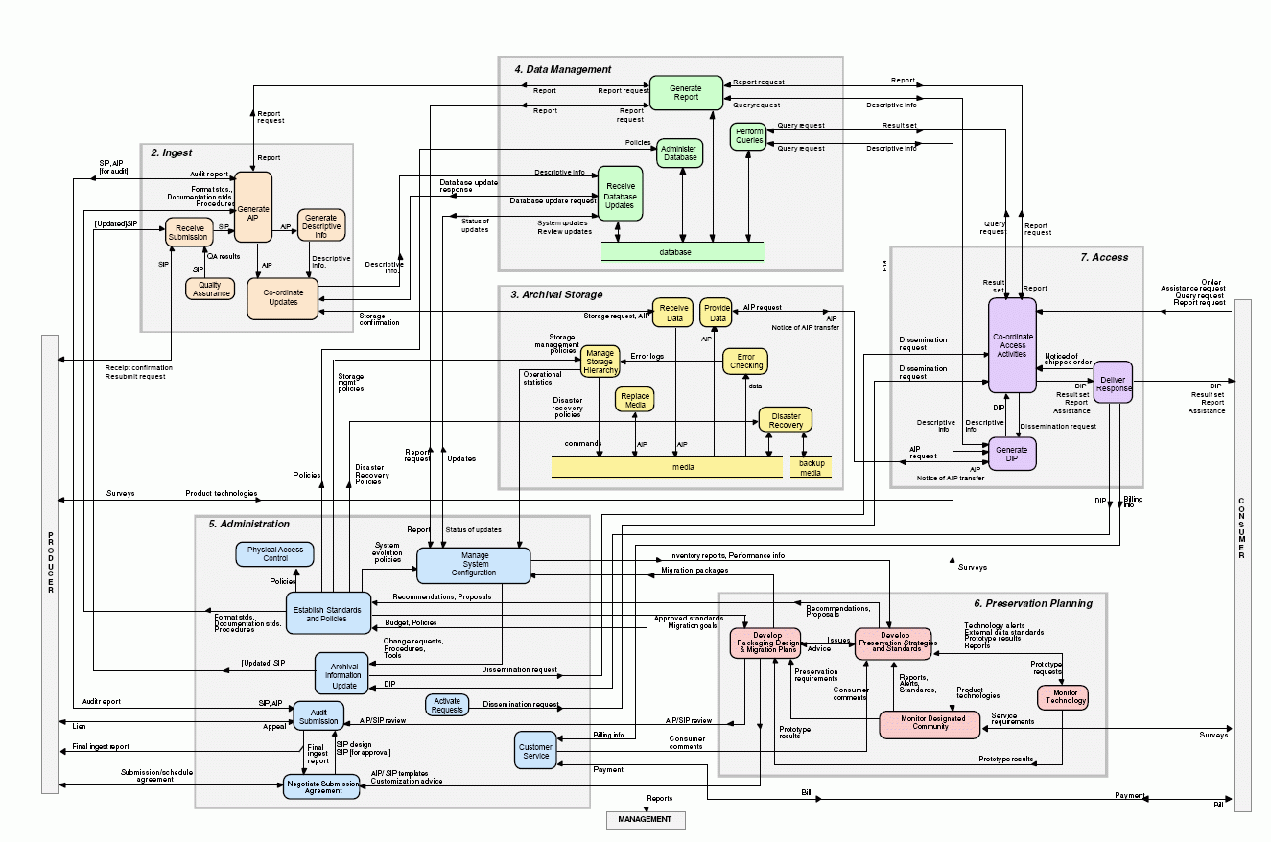
Scary OAIS Spaghetti Monster
Notes:
Analysis Paralysis – Google Search!
Isolation – everyone else has it figured out
Uncertainty – can’t even see what all we have (opaque backlog)
Misconceptions- one size fits all for your collections, FREE tools!, we need to get this all figured out before making the first step (see analysis paralysis!)
No money – for training/travel or a slick vendor-based solution
Technology Barriers – Lack of robust infrastructure to lack of IT department to personally being less savvy with technology
If you Google digital preservation, you may come across this!
OAIS (Open Archival Information Systems) and other schematic models
HEY THERE IS NO STEP 1!!!!!
A Note: These are all valuable things that benefit the field of digital preservation greatly…. We just don’t want you to become overwhelmed by them and grind to a halt before you take your first steps…like we did
TRAC Certification (Trustworthy Repositories Audit & Certification)
TDR ISO 16363 (Trustworthy Digital Repository ISO Standard)
Curation Lifecycles that don’t look a thing like our current workflows
In just over 10 years, there are 6 repositories that have been able to become certified!!! (Chronopolis Report; Hathitrust Report; Portico Report; Scholars Portal; CLOCKKS, which received the highest score of any org, and now Canadiana.org) OAIS was conceived in 1996 and accepted as an ISO standard in 2002.

Slide 12
The POWRR Approach
What you need to consider when thinking about your digital stuff…
….looks a LOT like the same things you consider for your physical materials.
Ingest
Processing
Access
Storage
Maintenance
Other
Getting it
And a few other odds & ends…
Letting people use it …or not!
Understanding it
&
Documenting it
Taking care of it
Notes:
For folks who are not rocket scientists
Understanding the world in which we need to operate -> comapre to physical process
Books, journals, documents, weird objects, pages within
Paper types, permissions (can we make it available to patrons? Can they copy it?)
Cataloging
Finding Aids
Metadata
Boxes
Shelving
Space issues
Handling

Slide 13
The POWRR Approach
Pragmatic
Realistic
Incremental
Notes:
Pragmatic – Yes, in order to get anywhere with this we will need to develop a basic understanding of scary things like AIPs SIPs DIPSs, Open Source Software, Cloud Storage, Checksums….but we are going to approach these topics pragmatically. You’ll see….
Realistic – We do not set our goals and measure our progress by schematics we don’t understand, or by checklists that few can ever hope to achieve. We take a look around us to see what’s actually keeping us from making progress (and it’s never about what they say it’s about!), we make note of the advantages we have, we find our sweet spots, and we jump in with potential solution, often working ass-backwards from how we were trained to approach things in our profession (research, plan, research some more, form a committee, write some policies, and so on)
Incremental – We are not so concerned with the “big picture” at this point. We want to triage what we have now, and what we are getting in the immediate future, so that we can begin to understand what our workflows may look like. We measure our progress in small steps, using things like the tool I’m about to show you, knowing that in a year or 2 we’ll have a better feel for this thing called digital preservation and will begin to develop a more refined, long-term approach.

Slide 14
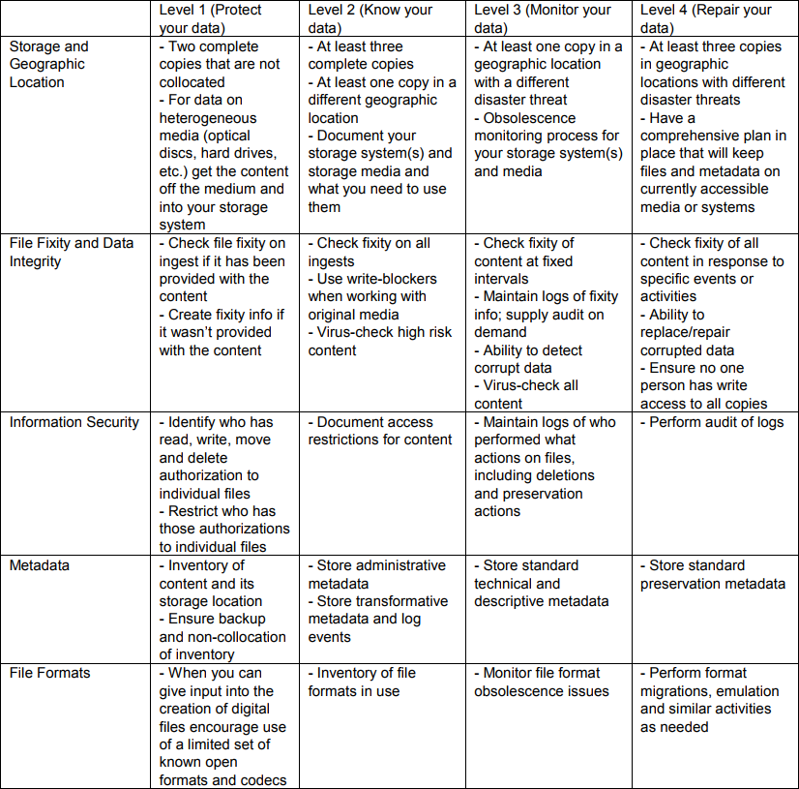
http://ndsa.org/activities/levels-of-digital-preservation/
Notes:
This epitomizes the incremental approach!!!
“In any of these areas, are folks at a level 4? Level 3? Level 0.5?”

Slide 15
The POWRR Approach
Not all tools and services are created equal. Don’t overthink it…especially tools. Choices of tools are not forever.
Focus on workflows! Today’s hot new tools are tomorrow’s orphans.
You will likely have different workflows for different sets of materials:
Backlog
Digitization Output
Born-digital Acquisitions
~ Start with the least scary project and approach it as a pilot ~
Notes:
Don’t overthink it…especially tools. Choices of tools are not forever. They serve what you need now, selected with an eye to later.
You don’t have to pick the tools/services that will do ALL of the steps from the get go.
- Some tools/services do specific tasks (microservices). - Some tools/services combine multiple microservices (you guessed it….macroservices!).
Start with a step or two. And it doesn’t even have to be with a fancy schmancy tool!
Starting with a simple microservice tool will get you closer to your goals AND you can use them NOW! - Baby steps still move you forward….. See “Walk This Way”.
Focus on workflows! Today’s hot new tools are tomorrow’s orphans:
IRONICALLY, your first pilot workflow will be determined in part by the tools you select. The idea is to TRY SOMETHING and then make adjustments to/refine your workflow as necessary, and then find the tool or service that fits the refined workflow well enough.
Would it be easier to start with an inventory of your backlog?
Or would it be easier to start piloting a workflow for digital materials you need to actively collect and preserve? (scans of theses? Organizational newletters? Images from an event?)
You will likely be handling your backlog and your acquisitions going forward *very* differently…that’s ok!

Slide 16
The Spectrum of Tools & Services
There are back-end storage/ preservation tools & services like…..
There are front-end/processing tools like…..
MetaArchive DuraCloud Amazon Glacier
Fixity
Internet Archive
Archivematica Data Accessioner
BitCurator
There are even some services that will pretty much do it all like….
Preservica Dspace Direct ArchivesDIRECT
Technical skill available + Amount of annual funding devoted to DP = Range of tools to consider
Notes:
Having a basic knowledge of DP…they should already know the difference between storage and preservation. But it may come up as a question anyway.
Explain what we mean by processing and backend. Define difference between DP and IR….interoperability will be important as you make longer-term decisions
Talking point: Front-end means the initial steps in the Dig Curation lifecycle, and not the “Access” part of things. Perhaps we can make it clearer by clarifying what it archivist/curator facing and what would be end-user facing (access/DIP/etc.)
Most of these are Open Source or FREE tools.

Slide 17
Discover Your Advantages
Quickly set up accounts/pilots with hosted services.
You only need to convince the person one level above you to get what you need.
Less red tape
Fewer levels between you and decision-makers
Self-administered workstations
Personnel-heavy operating model
Higher cash flows and less digital materials
Want to install a simple open source tool? Go for it!
Ideal for running a *free* robust tool that may require a developer and server administrator.
You can purchase a reasonably-priced, hosted soup-to-nuts solution.
Notes:
Smaller institutions with fewer resources likely have unique advantages…. We are small but mighty! This is where we find our sweet spot!
(aka no IT administrative lock downs)
No budget, personnel heavy - Ideal for running a *free* robust tool that may require a developer and server administrator like Archivematica or bitcurator
(like small, private institution)

Slide 18
The POWRR Approach

Slide 19
Sharing Circles
Intros: Name, Institution, Position
Dig In: What brought you to the POWRR Institute?
What are the biggest challenges you’ve faced thus far?
Just let it all out!
Discuss: How can we make the most out of this opportunity?
What are some of the “sweet spots” we may have?
What do we think will be served at lunch?
Rules of Engagement: Each participant will not exceed 5 minutes “digging in”
No interrupting… jot down your thoughts and share during the discussion Be an active listener
Break: 10:15 – 10:30
Notes:
ADVISORS NEED TO BE TIMEKEEPERS

