Slide 1
Making a Case for
Digital Preservation

Slide 2
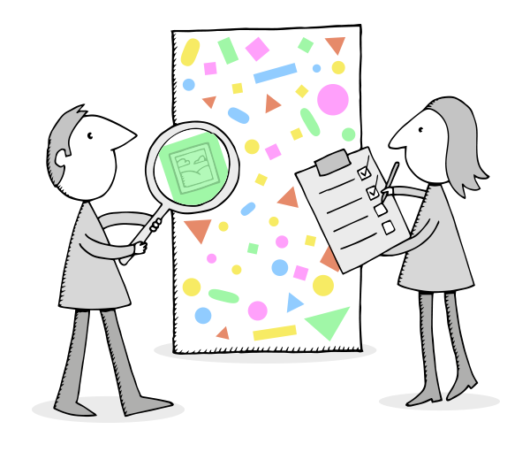
In This Session
Why do we do digital preservation?
Building a business case
Some tools to help with:
Risks
Benefits
Costs
Business case best practice
Illustration: Digital Preservation Business Case Toolkit http://wiki.dpconline.org/

Slide 3
Part One:
Why Do Digital Preservation?

Slide 4
Why Preserve?
‘’The answer will not to be found in the bits and bytes that you look after: it will be found at the place where those bits and bytes impact on the health and purpose of the organisation and its capacity to deliver meaningful services in the real world.
William Kilbride, 2015

Slide 5
We Do Preservation Because We Want:
1. Transparency
Data Protection, Freedom of Information…
2. Safety
Detection, disaster, recovery, audit…
3. Knowledge
Scientific value, access to heritage…
4. Wealth
Efficient business, management of IP…
5. Health
Research, safe innovation …
6. Environmental improvement
Evidence-based policy development…
1. Legal compliance
Sarbanes-Oxley, Data Protection…
2. Regulatory compliance
Power generation, aviation...
3. Legal protection
Patents, mis-selling, detection…
4. Unanticipated exploitation
Petro-chemical, pharmaceuticals….
5. Business continuity
Product recall, disaster recovery…
6. Business value
The right information to the right people at the right time in a format they can use…

Slide 6
Digital preservation is not just about ‘the bits’:
Digital preservation is not just about ‘access’:
Digital preservation is not just about ‘………’:
it’s about
people and opportunity
Make the case here!

Slide 7
Part Two:
Developing a Business Case?

Slide 8
Is Digital Preservation Expensive?
No!
But it is an unfunded mandate
Don’t throw money at it
Get the mandate properly incorporated

Slide 9
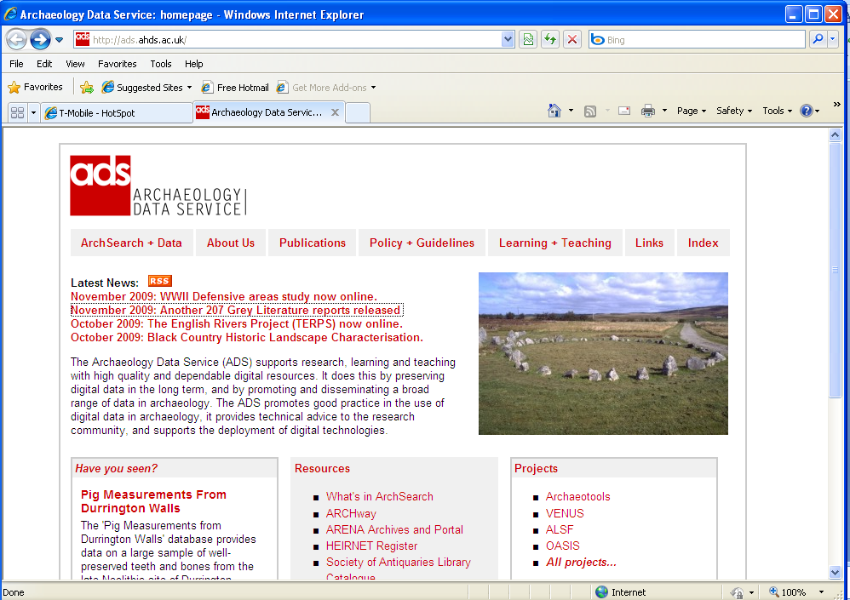
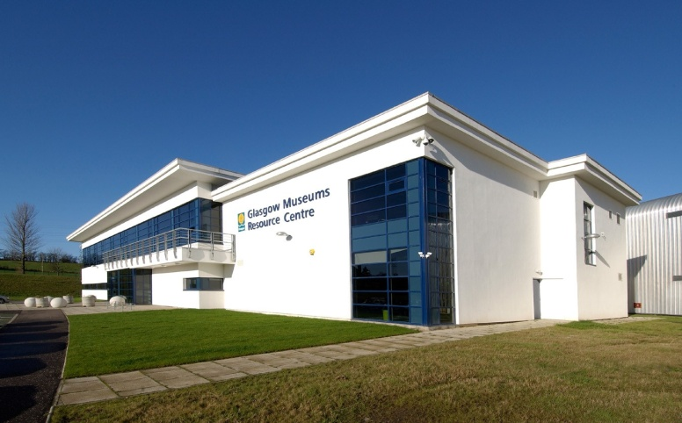
A Comparison…..
Setup:
Tens of thousands?
Setup:
Tens of millions?

Slide 10
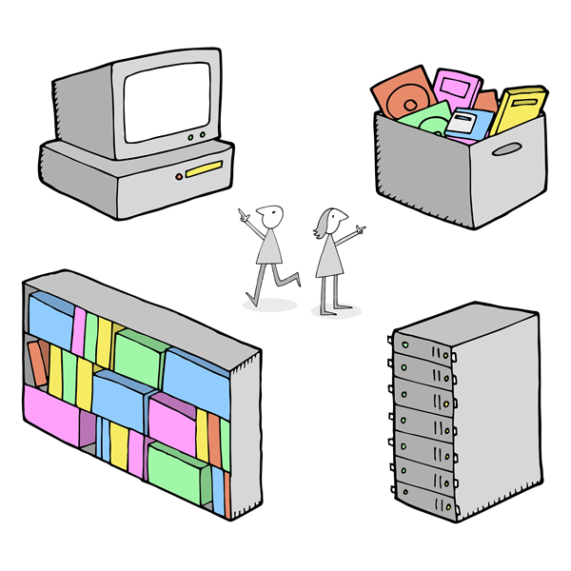
Business Cases
Key step in gaining (financial) support and resources for programme/project
Generally include sections on:
Objectives
Stakeholders
Financial Analysis
Benefits
Risks
Illustration: Digital Preservation Business Case Toolkit http://wiki.dpconline.org/
Notes:
Financial Analysis – Funding, Costs, Return on Investment

Slide 11
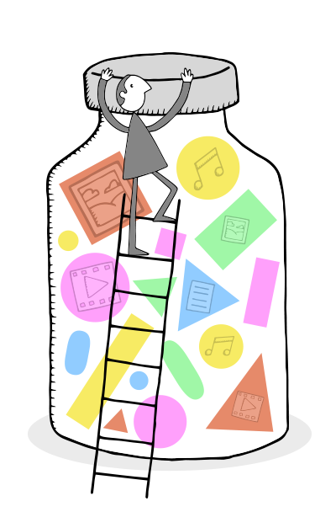
Developing a Business Case (1)
Preparation
Audit your organisation’s readiness
Assess where you are and what you need
Think hard about your audience
Work out your objectives
Illustration: Digital Preservation Business Case Toolkit http://wiki.dpconline.org/
Notes:
1) Preparation
Is the timing right?
Do the research:
Understand organisational issues: missions and strategy as well as requirements for business cases
2) Audit your organisation's readiness
Conduct a risk assessment at the organisational level.
Assess your Institutional readiness – maturity modelling
3) Assess where you are and what you need
Depending on the scope and granularity of your activity you may want to:
Audit your digital collections.
Assess your organisation for digital preservation risks in more detail.
Decide on the main focus of your business case
4) Think hard about your audience
Who are your key stakeholders?
Your business case must be carefully targeted at your intended audience.
Think about what language to use
5) Work out your objectives for your digital preservation activity
Describe what you want to achieve with the business case and what kind of activity you need to reach that goal.
Define your scope.
Provide a brief plan of what will happen and when.
Identify costs and describe the resources needed (eg. for staff/infrastructure).

Slide 12
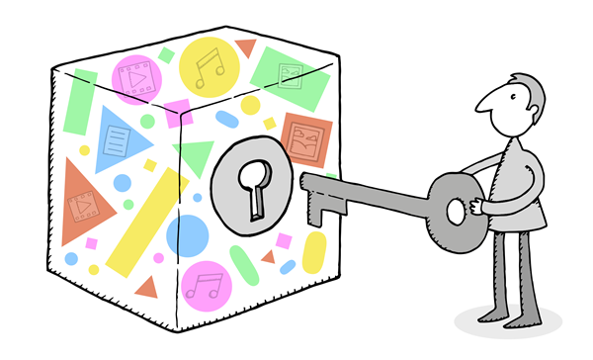
Developing a Business Case (2)
Identify Benefits
Prepare content for the business case template
Validate and refine
Deliver your business with maximum impact
Share!
Illustration: Digital Preservation Business Case Toolkit http://wiki.dpconline.org/
Notes:
6) Benefits
Get a generic list of digital preservation benefits as well as making a list of benefits for your digital content/collection.
Map those benefits to your organisation's strategy (prioritise benefits/work out what will appeal to your sponsor).
7) What else is required in your organisation's business case template?
Benefits, risks and costs are core - what else do you need to cover in your organisation's business case template?
Cost benefit analysis or options appraisal.
Further detail about what you want to do (implementation plan / project plan).
Return on investment
Where funding will come from
8) Validate and refine your business case
Think about what else you need to do to ensure that your business case is complete.
Review your business case carefully, and seek advice and comment from others.
Identify weaknesses in your business case.
Compare and contrast your case with others in order to identify missing detail or areas for improvement (see Case Studies).
9) Deliver your business case with maximum impact
Find out how your business case will be evaluated and consider ways to increase it's chances of success.
Who is you main sponsor/advocate?
Create an Elevator Pitch, so you have the right language ready to make your case to potential advocates in your organisation.
Persistence may well be required.
You may need to re-submit your case at a later date and/or adapt it to the feedback you get on delivering it first time around.
10) Share
Consider removing sensitive details from your business case, and then sharing it here for others to learn from.

Slide 13
Part Three:
Some Tools to Help….

Slide 14
Risks: DRAMBORA
http://www.repositoryaudit.eu/

Slide 15
Identifying Benefits: KRDS
http://www.beagrie.com/krds/

Slide 16
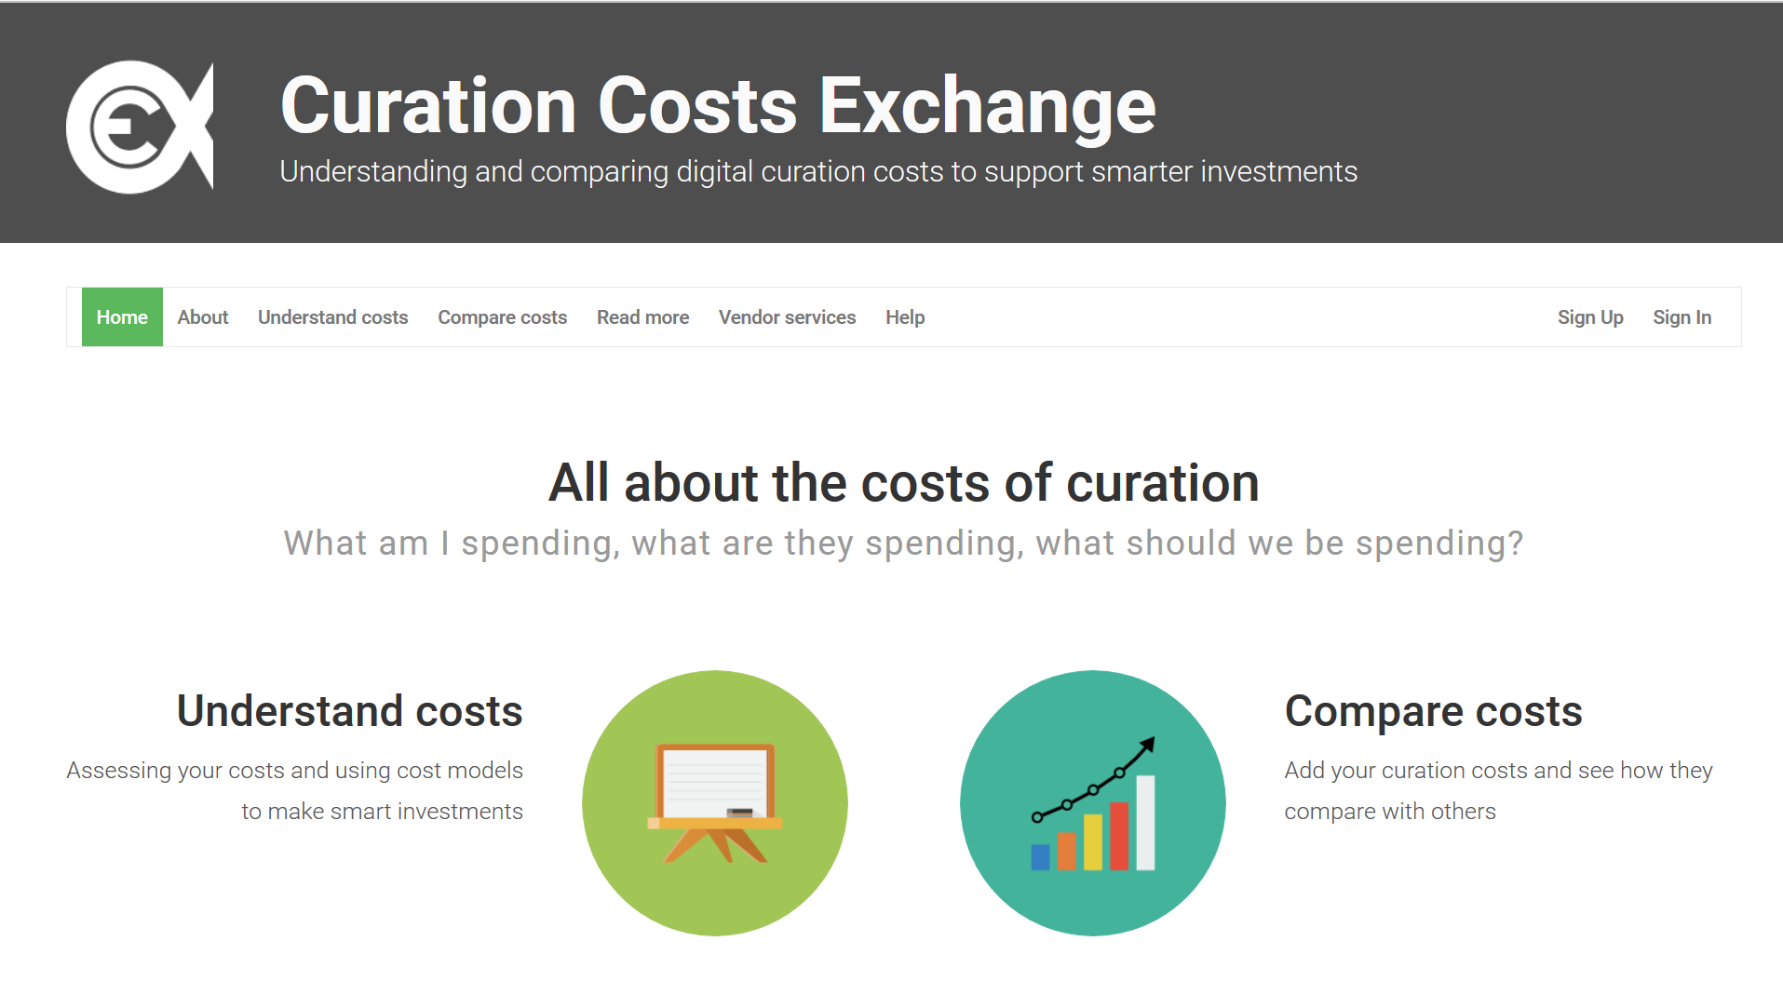
Curation Costs Exchange
http://www.curationexchange.org/

Slide 17
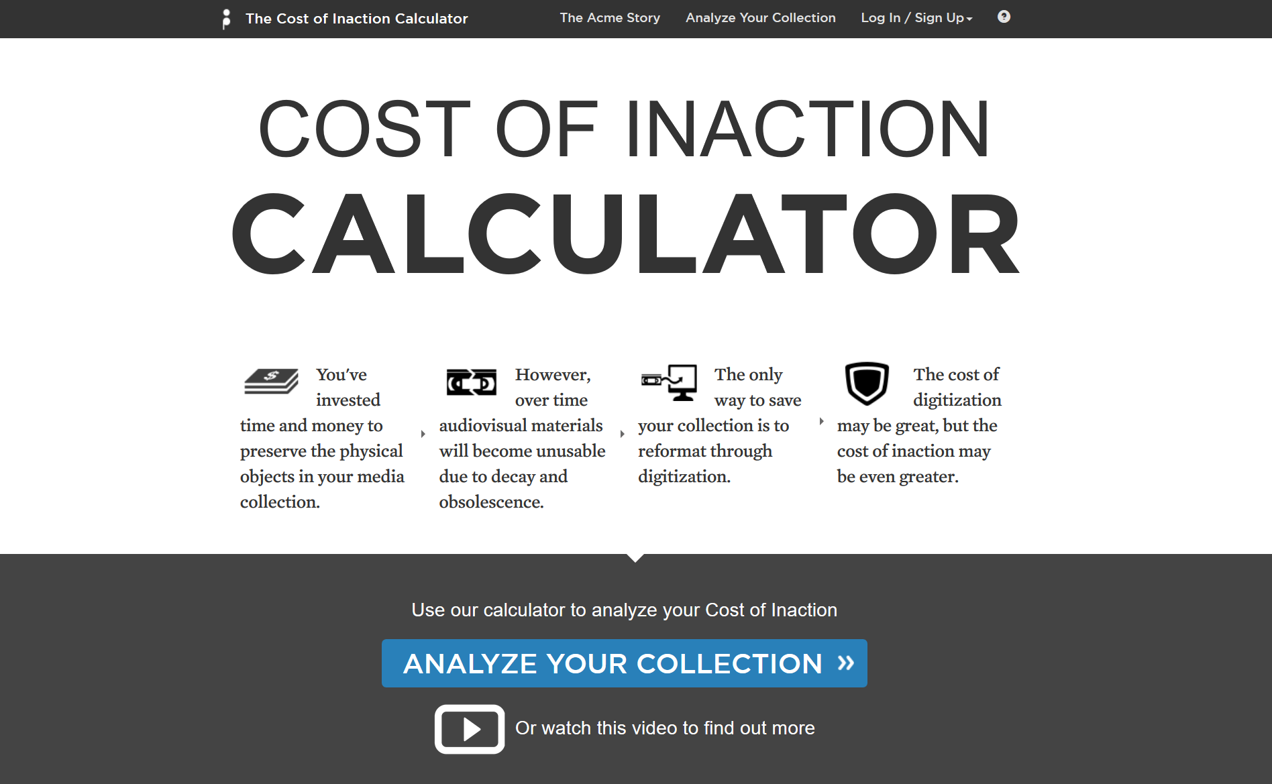
The Cost of Doing Nothing….
http://www.repositoryaudit.eu/

Slide 18
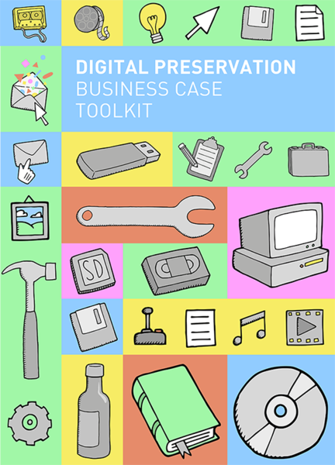
Business Case Toolkit
Step by Step Guide
Business Case Template
Common Questions
Case Studies
Additional Resources…..
http://wiki.dpconline.org/index.php?title=Digital_Preservation_Business_Case_Toolkit
Notes:
Case studies incl. example elevator pitches

Slide 19
Exercise: 2 Min. Elevator Pitch
Some questions to consider:
To whom you are pitching?
What is the value of the collection?
What problems do you face with the collection?
What work needs to happen?
How long it will take?
What benefits will flow from the work?
How does it relate to strategic objectives?
What will success look like?
2 minutes (approx. 200 words)

