Slide 1
Introduction to Digital Preservation

Slide 2
Traditional Media
Robust
Tangible
Independently understandable
Well-developed approaches to preservation
Experienced in assigning value
Notes:
Traditional objects are generally quite robust
They are tangible, we can hold them in our hands
Are generally independently understandable (if you speak the language they are written in…..)
We are quite experienced in understanding their worth and assigning value to such objects

Slide 3
Digital Information
Ephemeral
Proliferation
Rights
Privacy
Need tech to interpret
Obsolescence
Media
Formats
Software/Hardware
Documentation
New skills and solutions
How to estimate value?
But also new opportunities!
Notes:
Digital objects are ephemeral by their very nature
They very susceptible to obsolescence as they are entirely dependent on the media they are stored on, the accessibility of their file format and often require documentation to use and understand them
Managing issues such as rights can also be much more difficult, from protecting copyright to ensuring personal data is protected
They require us to gain new skills to care for them, or for us to work with new groups of colleagues with different skills groups (particularly IT specialists)
But they do also bring a whole host of new benefits, in particular the ability to make content accessible to users.

Slide 4
What’s the Problem?
Digital data (images, documents etc.) have value and create opportunities
...but...
Access depends on software, hardware and people
…and…
Technology and people change, creating barriers to reuse
...therefore...
We need to actively manage data to protect and create opportunities

Slide 5
Why We Preserve….
Legal and Regulatory Compliance
Increased Efficiency
New Revenue Streams
Improving Health
Protecting the Environment
Enabling Research
Documenting Cultural Heritage
Ensuring Transparency and Accountability

Slide 6
A Tale of Three Models
Three Legged Stool
DCC Life-Cycle Model
OAIS – Open Archive Information System
Notes:
Fancy words and acronym bingo….

Slide 7
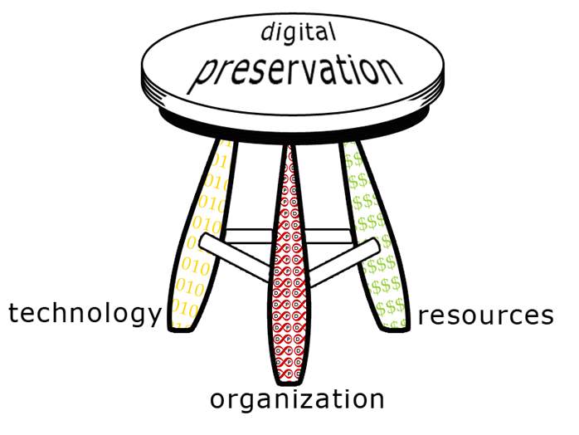
DP Models: Three Legged Stool
http://dpworkshop.org/dpm-eng/conclusion.html

Slide 8
More on the Three Legged Stool
Technology
Storage and Back-Up
Repository Systems
Tools
Security
Organisation
Policy
Strategy
Procedures
Risks and Benefits
Staffing
Resources
Business Planning
Cost modelling
Funding
Sustainability
Staff skills
Illustration by Jørgen Stamp digitalbevaring.dk CC BY 2.5 Denmark

Slide 9
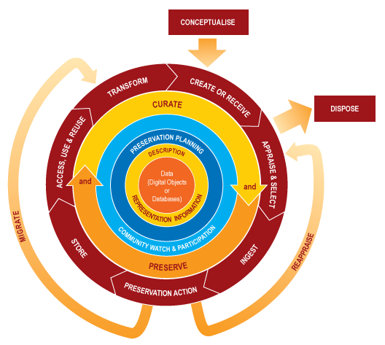
DP Models: DCC Life-Cycle
http://www.dcc.ac.uk/resources/curation-lifecycle-model

Slide 10
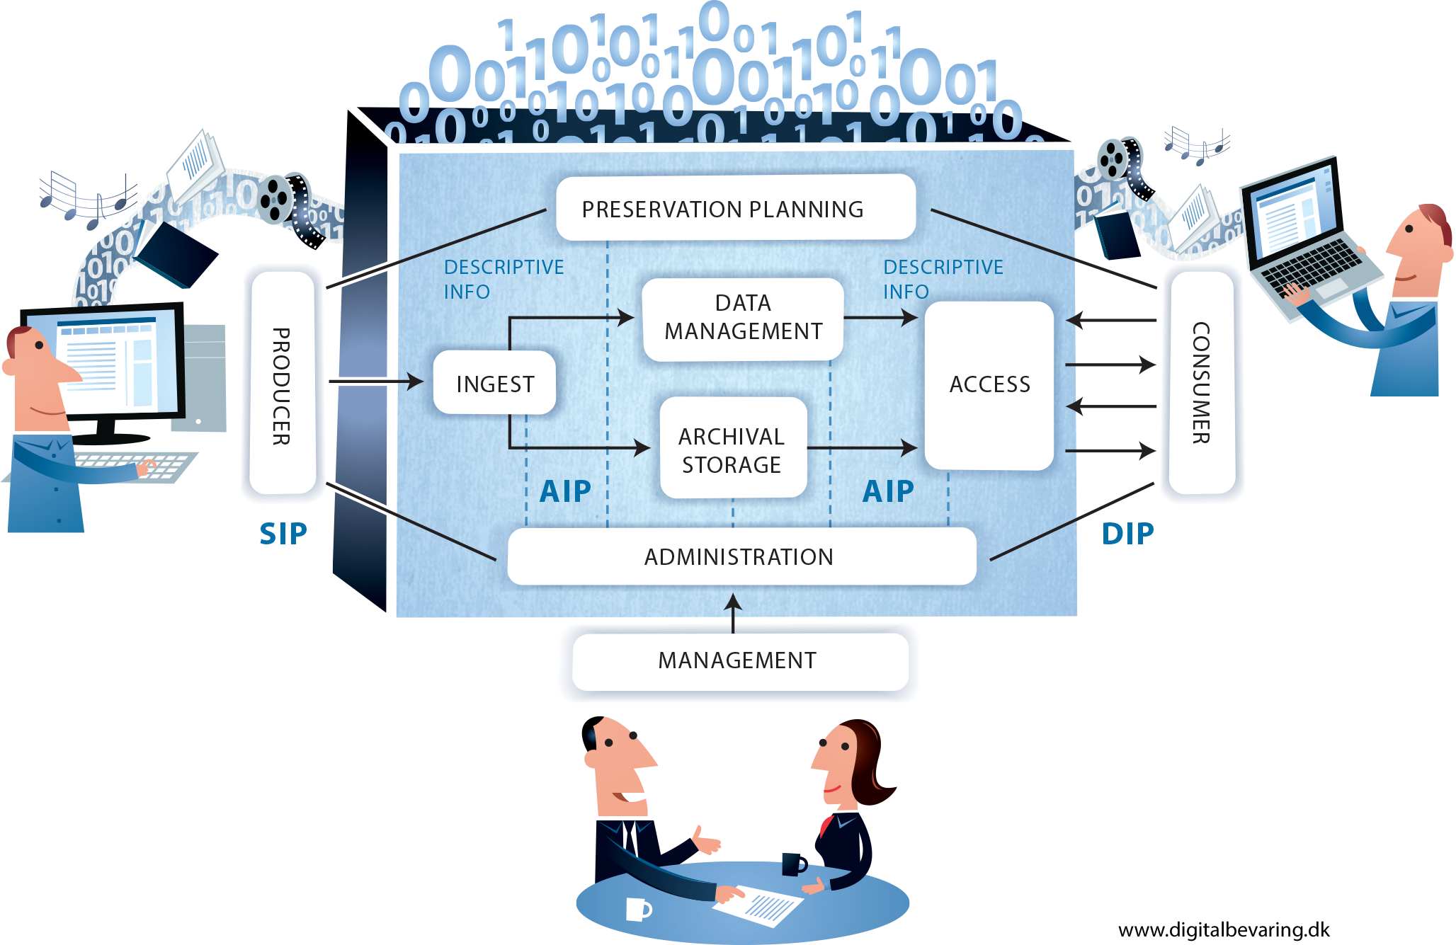
DP Models: OAIS
Notes:
While it is far from perfect the Open Archival Information System model is one of the keystones of Digital Preservation. In particular it provides much of the terminology used within the field. This diagram represents it’s functional model at the highest level. As well as the key functions of an OAIS that it shows (such as Ingest, Preservation and Access) it also includes various information packages. These information packages contain the digital material to be preserved along with its accompanying metadata and within OAIS these exist in 3 different forms across the lifecycle:
The Submission Information Package
The Archive Information Package
The Dissemination Information Package
To accompany this functional model the OAIS also describes an information model that lays out what types of metadata (specifically called Representation Information in OAIS) should be included in the information packages to facilitate preservation.
Full OAIS Standard: https://public.ccsds.org/pubs/650x0m2.pdf
Brian Lavoie’s Tech Watch Report on OAIS: http://dx.doi.org/10.7207/twr14-02

Slide 11
Where it starts getting really scary…

Slide 12
I’ve Always Been More Terrified Of…

Slide 13
Making Sense of the Information Model
Data Object
Representation Information
Information Object
Interpreted by
Yields
Film Reel
Projector
Movie
Interpreted by
Yields
Notes:
Representation information is perhaps the most difficult part of the information model to grasp. It can be useful to consider in relation an object like a reel of film. To show this onscreen a film projector is required. The projector fulfilling the role of the representation information. In the digital world representation information can be anything from the file format to detailed information about the file and the software and operating system environment in which to access it (in some cases perhaps even the software itself).

Slide 14
But still useful….
Notes:
This a diagram we produced at my previous place of work, the Royal Commission on the Ancient and Historical Monuments of Scotland. The aim was to start building what a digital preservation workflow might look like then carry-out a gap analysis comparing the current systems with the OAIS functional model. The black circles are people, systems or process that were in place and meeting standards, the tan circles are those which were in place but not sufficiently developed/meeting requirements and the white circles where things that did not currently exist. It provided a very useful, clear visual aid for presenting to managers as they could clearly see the large gaps in our current systems and processes.

Slide 15
Other Standards
Metadata – METS and PREMIS
Information Packages – E-ARK Project
Audit and Certification – Data Seal of Approval, ISO 16363…
Data Security
File Formats

Slide 16
Approaches to Preservation
Migration
Emulation
Hardware Preservation
Digital Archaeology
Virtualisation
etc.……
Illustration by Jørgen Stamp digitalbevaring.dk CC BY 2.5 Denmark

Slide 17
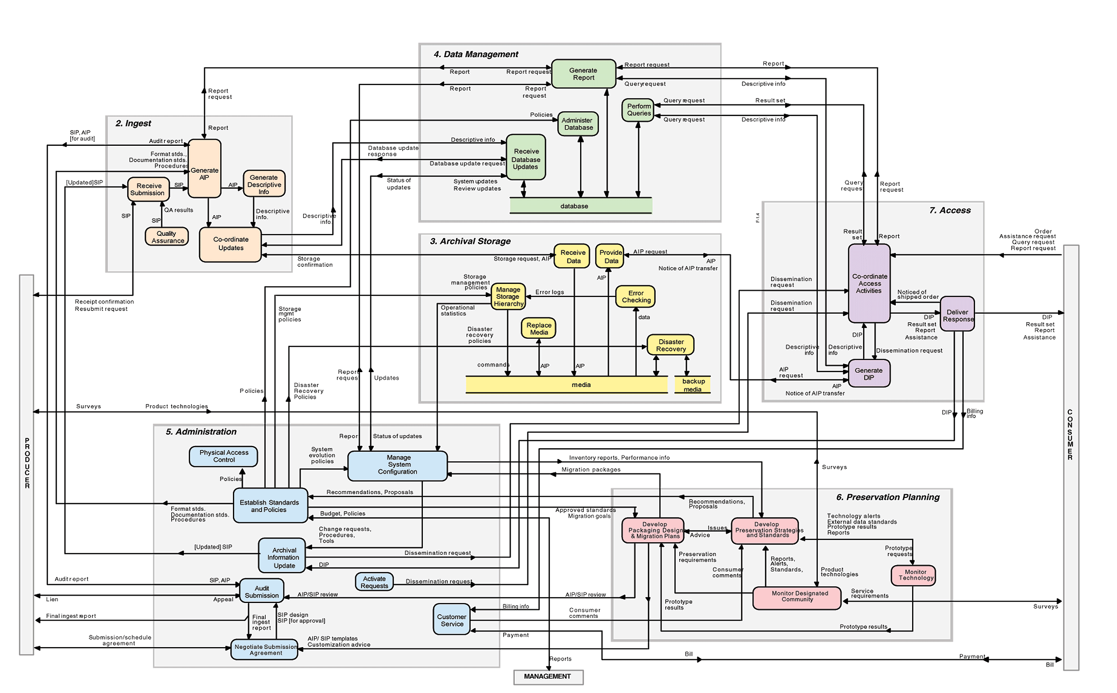
But ‘Don’t Panic’…..
You don’t need to understand or do all of this.
... and even if you do, it doesn’t all have to exist at the same time ...

Slide 18
Digital Preservation Handbook
Notes:
http://dpconline.org/handbook

