Slide 1
Practical Preservation
Workshop

Slide 2
What is Preservation Planning?
A practical process supported by the Plato software tool, for making preservation decisions?
A definition from the OAIS reference model, for planning activities within a digital repository?
Strategic organisational planning for preservation?
And more….

Slide 3
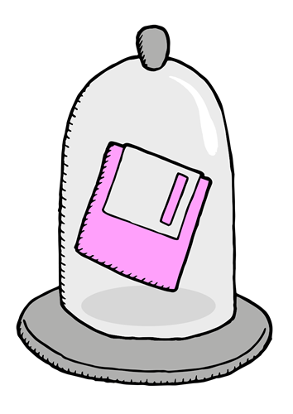
What is Preservation Planning?
... a series of actions to be taken … due to identified risks for a given set of digital objects along with responsibilities and conditions for implementation
It takes into account:
preservation policies,
legal obligations,
organisational and technical constraints,
user requirements
preservation goals
It describes:
the preservation context,
the evaluated preservation strategies
the resulting decisions for and reasons for the decisions

Slide 4
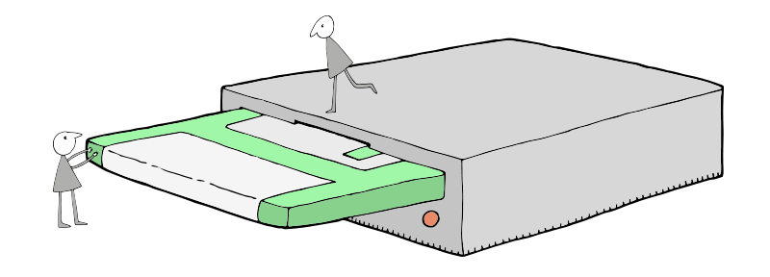
The Workshop
You’ve been given a hard drive! What do you do?
What have you got?
Understand characteristics of the files
Decide what to do
Consider aims, constraints, context & risks
Identify your options
Evaluate strategy
Preserve!

Slide 5
Part One:
What Have You Got?

Slide 6
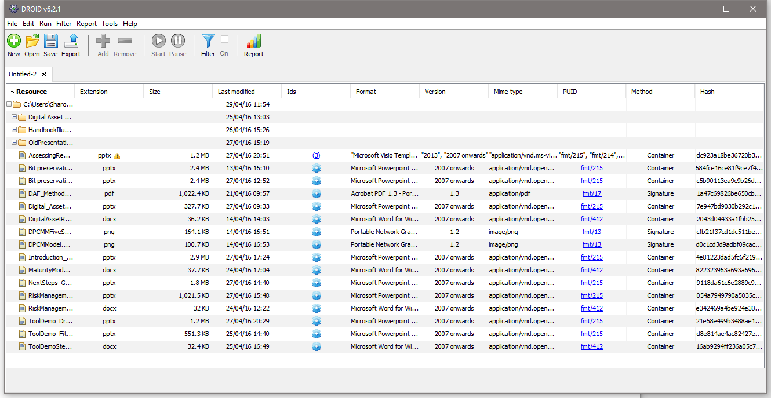
Basic Characterisation: DROID
Works with PRONOM file format registry
Analyses contents of folder(s)
Captures information such as:
File name, location, file size, last edited, format, version, PRONOM ID, checksum
Outputs raw data or a variety of reports

Slide 7
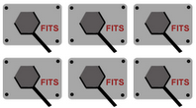
Delving Deeper: FITS
http://projects.iq.harvard.edu/fits
Wraps together a selection of open-source tools
Identifies, validates and extracts technical metadata
Command line operation
Consolidates info
into an XML file

Slide 8
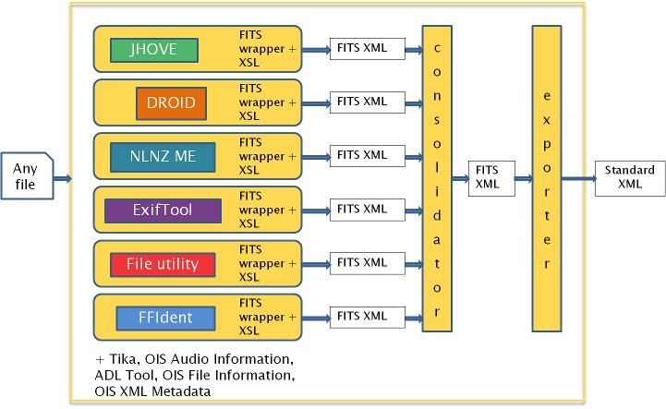
FITS – File Information Tool Set
FITS
Any
file
Metadata

Slide 9
A Brief Intro to XML
“a mark-up language that defines a set of rules for encoding documents in a format that is both human-readable and machine-readable….”
<book>
<title>Cold Comfort Farm</title>
<author>Stella Gibbons</author>
<publication edition=“1st”>
<date>8 September 1932</date>
<publisher>Longmans</publisher>
</publication>
</book>
Notes:
Attributes

Slide 10
Fits Output - Header
<?xml version="1.0" encoding="UTF-8"?>
<fits xmlns="http://hul.harvard.edu/ois/xml/ns/fits/fits_output" xmlns:xsi="http://www.w3.org/2001/XMLSchema-instance" xsi:schemaLocation="http://hul.harvard.edu/ois/xml/ns/fits/fits_output http://hul.harvard.edu/ois/xml/xsd/fits/fits_output.xsd" version="0.8.4" timestamp="27/10/16 15:09">
<identification>
<identity format="Portable Document Format" mimetype="application/pdf" toolname="FITS" toolversion="0.8.4">
<tool toolname="Jhove" toolversion="1.5" />
<tool toolname="file utility" toolversion="5.03" />
<tool toolname="Exiftool" toolversion="9.13" />
<tool toolname="NLNZ Metadata Extractor" toolversion="3.4GA" />
<tool toolname="ffident" toolversion="0.2" />
<tool toolname="Tika" toolversion="1.3" />
<version toolname="Jhove" toolversion="1.5">1.4</version>
</identity>
</identification>

Slide 11
FITS Output – File Info
<fileinfo>
<size toolname="Jhove" toolversion="1.5">6406168</size>
<creatingApplicationName toolname="Jhove" toolversion="1.5" status="CONFLICT">Adobe PDF Library 10.0.1; modified using iTextÃ‚Â® 5.3.1 Ã‚Â©2000-2012 1T3XT BVBA (AGPL-version)/Adobe InDesign CS6 (Windows)</creatingApplicationName>
<creatingApplicationName toolname="NLNZ Metadata Extractor" toolversion="3.4GA" status="CONFLICT">Adobe PDF Library 10.0.1; modified using iText 5.3.1 2000-2012 1T3XT BVBA (AGPL-version)/Adobe InDesign CS6 (Windows)</creatingApplicationName>
<creatingApplicationName toolname="Tika" toolversion="1.3" status="CONFLICT">Adobe PDF Library 10.0.1; modified using iTextÂ® 5.3.1 Â©2000-2012 1T3XT BVBA (AGPL-version)/Adobe InDesign CS6 (Windows)</creatingApplicationName>
<lastmodified toolname="Exiftool" toolversion="9.13" status="CONFLICT">2015:09:17 09:03:16+01:00</lastmodified>
<lastmodified toolname="Tika" toolversion="1.3" status="CONFLICT">2014-09-19T13:06:41Z</lastmodified>
<created toolname="Exiftool" toolversion="9.13" status="SINGLE_RESULT">2013:12:04 17:25:56+05:30</created>
<filepath toolname="OIS File Information" toolversion="0.2" status="SINGLE_RESULT">D:\Apps\fits-0.8.4\LargeScaleDataAnalytics_eBook.pdf</filepath>
<filename toolname="OIS File Information" toolversion="0.2" status="SINGLE_RESULT">LargeScaleDataAnalytics_eBook.pdf</filename>
<md5checksum toolname="OIS File Information" toolversion="0.2" status="SINGLE_RESULT">6e3d47cfdd7010adb6f0ffede28db303</md5checksum>
<fslastmodified toolname="OIS File Information" toolversion="0.2" status="SINGLE_RESULT">1442476996000</fslastmodified>
</fileinfo>

Slide 12
FITS Output – File Status
<filestatus>
<well-formed toolname="Jhove" toolversion="1.5" status="SINGLE_RESULT">true</well-formed>
<valid toolname="Jhove" toolversion="1.5" status="SINGLE_RESULT">false</valid>
<message toolname="Jhove" toolversion="1.5" status="SINGLE_RESULT">Too many fonts to report; some fonts omitted. Total fonts = 1118</message>
<message toolname="Jhove" toolversion="1.5" status="SINGLE_RESULT">Missing expected element in page number dictionary offset=1085132</message>
</filestatus>

Slide 13
FITS Output – Metadata
<metadata>
<document>
<title toolname="Jhove" toolversion="1.5" status="SINGLE_RESULT">Preface</title>
<language toolname="Jhove" toolversion="1.5">EN</language>
<pageCount toolname="Exiftool" toolversion="9.13">276</pageCount>
<isTagged toolname="Jhove" toolversion="1.5">no</isTagged>
<hasOutline toolname="Jhove" toolversion="1.5">yes</hasOutline>
<hasAnnotations toolname="Jhove" toolversion="1.5" status="SINGLE_RESULT">no</hasAnnotations>
<isRightsManaged toolname="Exiftool" toolversion="9.13" status="SINGLE_RESULT">no</isRightsManaged>
<isProtected toolname="Exiftool" toolversion="9.13">no</isProtected>
<hasForms toolname="NLNZ Metadata Extractor" toolversion="3.4GA" status="SINGLE_RESULT">no</hasForms>
<standard>
<docmd:document xmlns:docmd="http://www.fcla.edu/docmd">
<docmd:PageCount>276</docmd:PageCount>
<docmd:Language>EN</docmd:Language>
<docmd:Features>hasOutline</docmd:Features>
</docmd:document>
</standard>
</document>
</metadata>

Slide 14
FITS Output - Statistics
<statistics fitsExecutionTime="3973">
<tool toolname="OIS Audio Information" toolversion="0.1" status="did not run" />
<tool toolname="ADL Tool" toolversion="0.1" status="did not run" />
<tool toolname="Jhove" toolversion="1.5" executionTime="3921" />
<tool toolname="file utility" toolversion="5.03" executionTime="1759" />
<tool toolname="Exiftool" toolversion="9.13" executionTime="2047" />
<tool toolname="NLNZ Metadata Extractor" toolversion="3.4GA" executionTime="2643" />
<tool toolname="OIS File Information" toolversion="0.2" executionTime="412" />
<tool toolname="OIS XML Metadata" toolversion="0.2" status="did not run" />
<tool toolname="ffident" toolversion="0.2" executionTime="1465" />
<tool toolname="Tika" toolversion="1.3" executionTime="3887" />
</statistics>

Slide 15
C3PO
FITS: Content profiling tool
Works with FITS to visualize FITS output metadata
Setup can be a little more taxing
FITS
Lots
Of
files
Lots of
Meta-
data

Slide 16
Part Two:
Some Questions to Consider

Slide 17
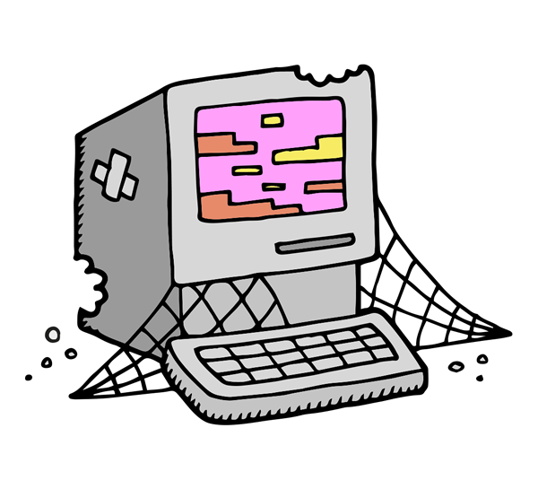
Identify Aims and Constraints
Why do we want to keep the material?
What are we trying to achieve?
For whom are we keeping it?
How do we test their expectations?
What are our constraints in terms of cost/resources?
Notes:
Why do we want to keep this stuff?
Collecting/Acquisition Policy
Organisational Goals
User Needs/Appetite
Value – historical, financial etc.
What are we trying to achieve?
Create a record of an event/organisation/individual
Provide access
Meet legal requirements
For whom are we keeping it?
Users now or in the future
What skills will they have – cognitive and technical
How do we test their expectations?
What are our constraints in terms of cost/resources?

Slide 18
Scenario: Magazine Coverdiscs 1990-2016
The scenario:
A large publisher has donated its complete archive of magazines from 1990 to the present day to your archive. As well as the printed magazines, many feature floppy disks, or in later years CD ROM discs, attached to the cover.
The challenge:
You must decide how to assess and preserve, and make available the digital element of this collection for researchers and members of the public.
Notes:
The coverdiscs run on a number of different computers and operating systems that were popular throughout the life of the magazine.
The coverdiscs are still wrapped up in plastic and have never been used.

Slide 19
Understand the Data, Context & Risks
What is the collection?
How does it break down?
Do we want to retain everything?
Are there any data protection
or other legal issues?
What risks do the different
parts of the collection face?
What are the highest
priorities for action?
The oldest discs may be more difficult to recover and should be addressed first.

Slide 20
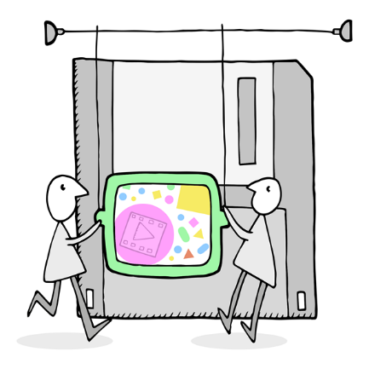
Explore the Options
What are our preferred preservation approaches?
Will we use one approach or a combination?
Emulation will allow us to ensure users retain the experience of using the software and games on the coverdiscs as they were when they were created. However, converting the files to an up-to-date format may allow wider access.
What actions should we take to achieve them?
What tools do we have available to carry them out?
Will we require additional support
to implement these actions?

Slide 21
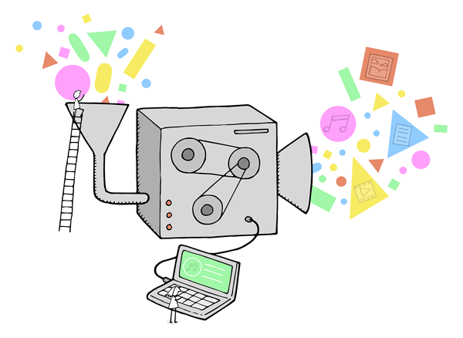
Evaluate and Make Decisions
Can we trial alternative approaches to aid evaluation?
Researchers with a specialism in the development of software applications may be able to feedback on how the data is more effectively presented.
What are our expectations of quality?
Do we want to prioritise certain criteria?
How will we validate our plans?
How will we document
our decisions?
How and when will we
update our plans?

Slide 22
Migration
“transferring or transforming (i.e. migrating) data from an ageing/obsolete format to a new format, possibly using new applications systems at each stage to interpret information…”
(Digital Preservation Handbook)
Can include:
From diverse formats to a single format (aka normalisation)
From an old version of a format to a new/current one
Whole file
Copying content
Pros? Cons?
Notes:
Group Discussion
Pros
Create homogenous collections
Access through current software
Potential for automation of process
Cons
Possible loss of functionality
Possible loss of content
Create errors

Slide 23
Emulation
“An emulator [...] is a programme that runs on a current computer architecture but provides the same facilities and behaviour as an earlier one. Emulation […] allows archives to preserve and deliver access to users directly from original files.”
(Digital Preservation Handbook)
Options include:
Developing custom emulator
Using existing services/tools
Pros? Cons?
Notes:
Group Discussion
Pros
File remains unchanged
File accessed in original environment
Authentic experience for user
Cons
Significant programming input required and/or
Reliance on 3rd party tools
Need skills to work original software

Slide 24
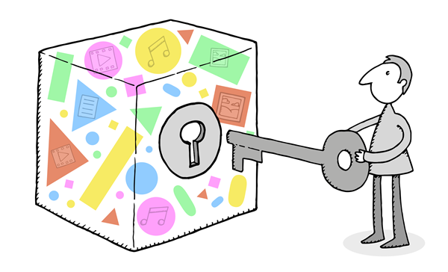
Other Strategies/Actions
Virtualisation
Bit-Level Preservation
Digital Archaeology
Hardware Preservation/Computer Museums

Slide 25
The Exercise
Consider the scenario and start developing your preservation strategy by answering the following questions:
What are the main challenges you face?
A single process for capturing/ripping the disks may not suitable for all the different kinds of disks present. Quality assurance will be needed to ensure the results are of a reasonable quality.
What would success look like?
Which tools will you use?
What will be your process?

Slide 26
Scenario: War Historian
The scenario:
A famous academic and war historian has donated his entire personal collection to your archive, including his desktop computer. The majority of his records are on this computer’s hard disk.
The challenge:
You must decide how to assess and preserve the information on this computer and decide how you will provide access to it for academics, researchers and members of the public.

Slide 27
And Finally:
Formal Preservation Planning

Slide 28
Formal Preservation Planning - PLATO
A set of software tools that implement the theoretical preservation planning concepts of OAIS
Much more detail, adds new concepts, makes it practical
Provides a step by step process for the user
Provides a mechanism for sharing plans and understanding

Slide 29
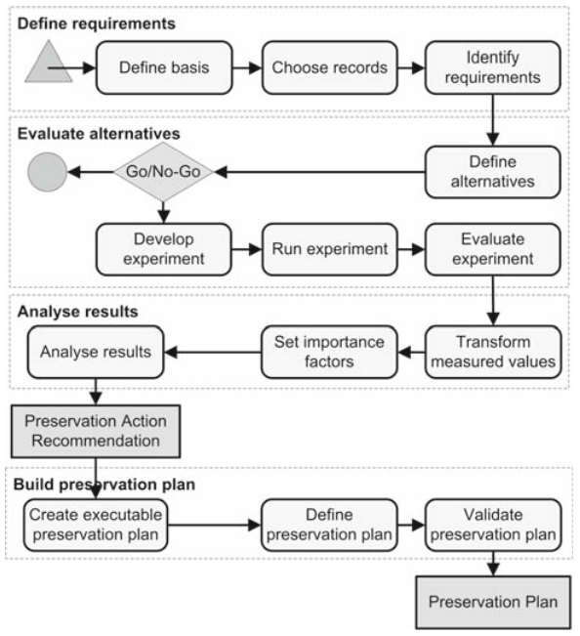
PLATO Planning Process
Diagram taken from: "Systematic planning for digital preservation: evaluating potential strategies and building preservation plans“

Slide 30
Advantages of PLATO
Lots of iterations of development addressing user feedback
Support for monitoring: SCOUT “Preservation Watch” tool
Can go beyond a stand alone decision support process, integrating with many software components
Documents decisions in a consistent manner
Ensures comprehensive and best practice approach
Notes:
Some negatives:
Appears intimidating, but the bar to entry is actually quite low
Some of the newer automated components of the toolset are unproven

Slide 31
Some Case Studies
LSE Preservation Planning Case Study
http://www.dpconline.org/component/docman/doc_download/863-2013-may-getting-started-london-planning-case-study-ed-fay
Step by Step Guide to Preservation at Portico
http://www.portico.org/digital-preservation/services/preservation-approach/preservation-step-by-step
Migration of Scientific Data Sets
http://www.ijdc.net/index.php/ijdc/article/view/202/271
Rhizome – Theresa Duncan CD-ROMs
http://rhizome.org/editorial/2015/apr/17/theresa-duncan-cd-roms-are-now-playable-online/

Slide 32
More from the DPC
Digital Preservation Handbook
http://handbook.dpconline.org/
Tech Watch Reports
http://www.dpconline.org/publications/technology-watch-reports
Stay in touch!
@SharonMcMeekin
sharon.mcmeekin@dpconline.org
@sdaythomson
sara.thomson@dpconline.org

