Slide 1
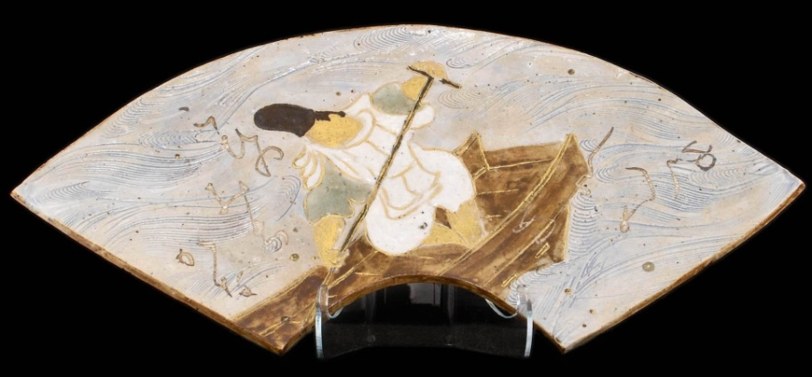
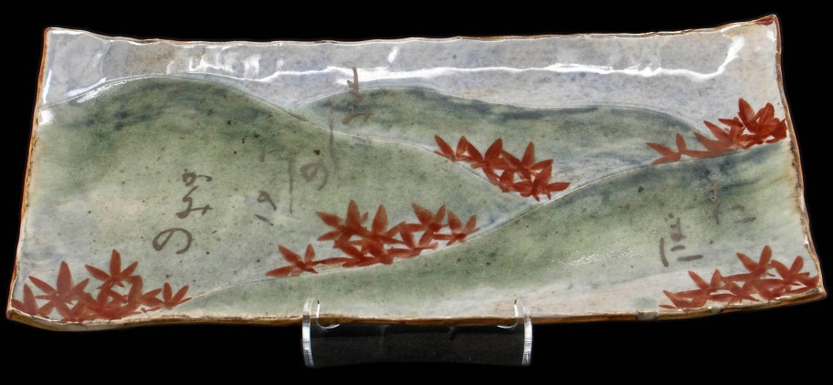
The Niiyama Japanese Poetic Pottery:
An Interactive Digital Presentation
Poem 46
Poem 24
Patrice-Andre Prud’homme | ppprudh@ilstu.edu | Illinois State University

Slide 2
Niiyama pottery: Making it interactive
Overview of the (Ogura) Hyakunin Isshu,
+ Japanese poetry and society, significance and compilation,
+ Niiyama’s hand-crafted pottery, exhibitions and demonstrations,
Digitization (pre- and post-process),
+ Administrative (donation, copyrights),
+ Content (research, metadata),
+ Operational and collaborative,
Interactive presentation, Process and funding
Digital preservation, digitalPOWRR
Notes:
Outline
Overview of the (Ogura) Hyakunin Isshu,
+ Japanese poetry and society, significance and compilation,
+ Niiyama’s hand-crafted pottery, exhibitions and demonstrations,
Digitization (pre- and post-process),
+ Administrative (donation, copyrights),
+ Content (research, metadata),
+ Operational and collaborative,
Interactive presentation, Process and funding
Digital preservation, digitalPOWRR

Slide 3
Historical background: The (Ogura) Hyakunin Isshu
Japanese poetry and society, significance and compilation
+ A central role in Heian aristocratic society,
+ Waka include poetic styles or tanka (verses)
++ Five lines, 31 syllable pattern of 5-7-5-7-7,
+ Fujiwara no Teika (or Sadaie) (1162-1241), waka poet, novelist, and compiler of the (Ogura) Hyakunin Isshu in 1235,
Niiyama’s hand-crafted pottery, exhibitions and demonstrations
+ In Niiyama’s ceramics, the sequence of the poems is different as the focus is much more on an interpretation of the poems (Niiyama and Myerscough, 1984),
+ Exhibitions and demonstrations of his ceramics between 1968 and 1984,
+ Illinois State University, 1975 to 1977
Notes:
Overview of the (Ogura) Hyakunin Isshu,
Japanese poetry and society,
From a public perspective where political power may have come into play, Japanese poetry had a central role in Heian aristocratic society.
Along with calligraphy and musical talent, the ability to compose waka (type of poetry in classical Japanese literature) in aristocratic society was essential.
Poetic styles or tanka and their significance,
These waka include poetic styles or tanka (verses) consisting of five lines with a thirty-one-syllable pattern of 5-7-5-7-7. For many years, tanka were the only form known to the Japanese.
These verses were encountered as a family card game, played at New Year.
Fujiwara no Teika
In the late Heian (794-1185) and early Kamakura periods, Fujiwara no Teika (or Sadaie) (1162-1241) was a waka poet, critic, and novelist,
Father and son redefined the function of poetic diction, that it should be that of the first three imperial anthologies, Kokinshu, Gosenshu, and Shuishu,
Teika was probably the most prolific compiler of exemplary anthologies,
He compiled the one-hundred-poem sequence (Ogura) Hyakunin Isshu in 1235, into which he added a poem of his (Poem 97),
Niiyama’s hand-crafted pottery, exhibitions and demonstrations
In Niiyama’s ceramics, the sequence of the poems is different as the focus is much more on an interpretation of the poems (Niiyama and Myerscough, 1984),
Niiyama’s hand-crafted pottery of the Hyakunin Isshu was completed between 1958 and 1968,
Worldwide exhibitions and demonstrations of his ceramics between 1968 and 1984,
Gave lectures, including at Illinois State University from 1975 to 1977 to which he donated the collection in 2001 (Japan Journal, 2002),

Slide 4
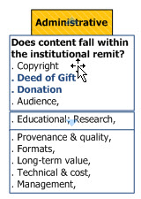
Niiyama pottery:
Administrative requirements (donation, copyrights),
“Japanese artist donates pottery, poetry to Milner” (Daily Vidette, January 2002),
“Library seeks display gallery worthy of Japanese potter’s gift” (Japan Journal, March 2002),
Notes:
Administrative requirements
Skipping Prospection through selection because collection had already been in the library for several years,
Administrative steps, primary focus here is Deed of Gift from a donation in 2002.

Slide 5
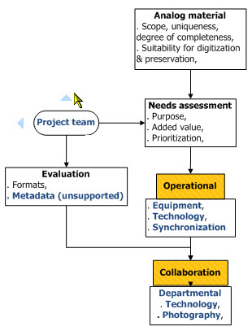
Niiyama pottery:
Planning
Content (research, metadata),
Operational and collaborative,
Notes:
Project planning
Project team (already in place),
Content (research and metadata, which none had been provided),
Operational for equipment, synchronization of tools and platforms,
Web design, accessibility,
Collaborative efforts (Funding, School of Art, College of Fine Arts for assistance with photography, Arts Technology, Japanese department, Web development),

Slide 6
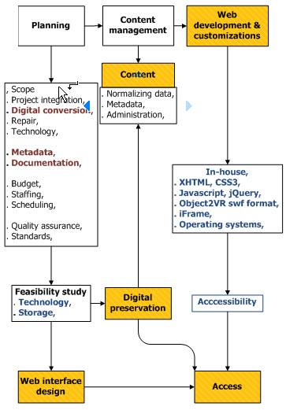
Niiyama pottery:
Interactive presentation
Digital conversion,
Technology,
Metadata,
Web design,
Web development,
Funding,
Access,
Digital preservation.
Notes:
The making of the interactive presentation
Digital conversion: Trial and error,
Technology: synchronization of Photo rig, rotating platform: Kaidan Magellan M-2500 3D Copy Stand for Rotational Object Photography and Camera: Canon EOS7D Digital SLR Camera,
Metadata: Many hours of research time,
Web design: Internal process,
Web development: Synchronization with IT, In-house: XHTML, CSS3; Javascript, jQuery; Object2VR swf format; iFrame; Operating systems,
Funding: Two grants for equipment,
Access: Website,
Digital preservation: Storage primarily at this point in time.

Slide 7
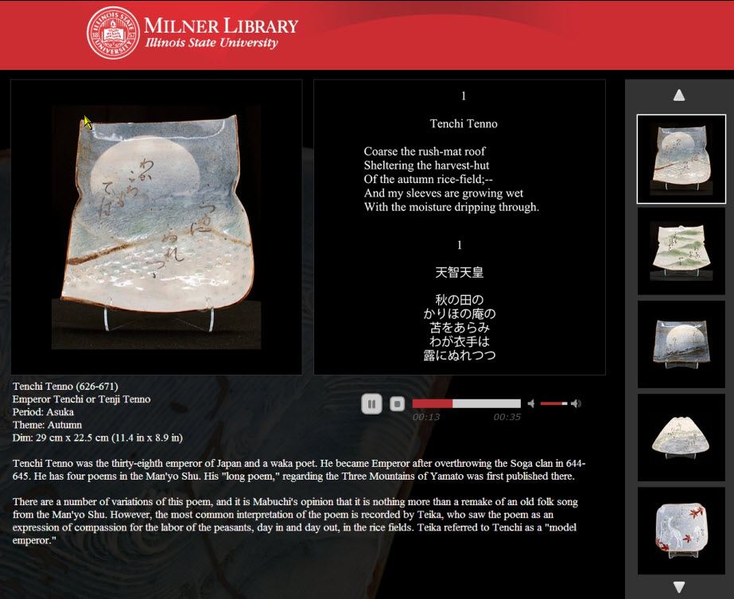
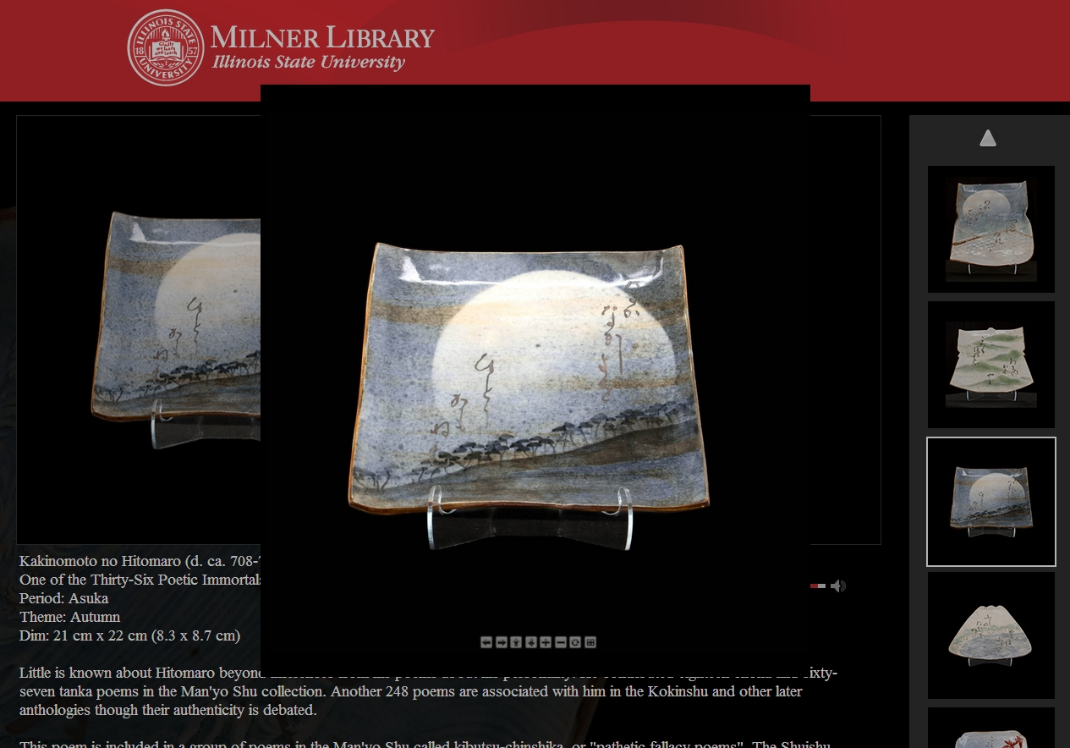
Niiyama pottery:
Website
Notes:
Website
Click on the image of the pottery, the page fades and the box with the interactive bits pops up over the top of everything

Slide 8
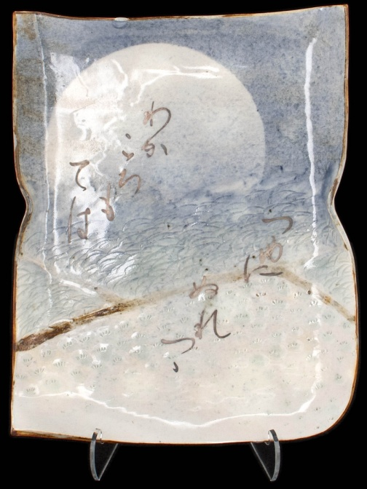
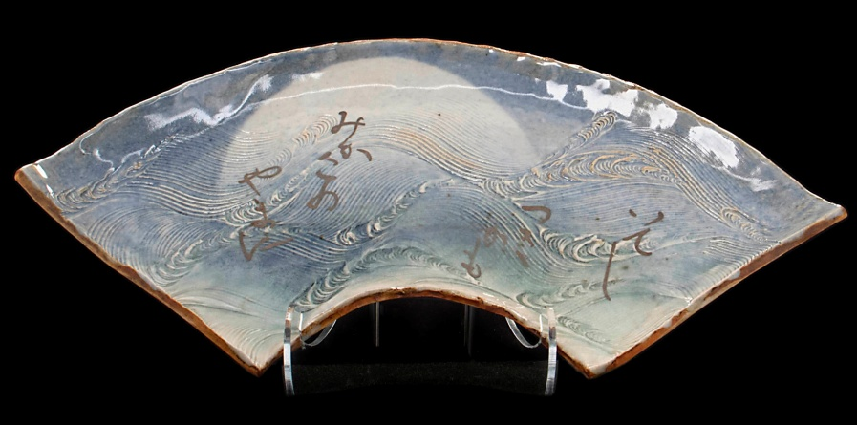
Niiyama pottery:
Interactive presentation
Poem 7
Poem 1
Abe no Nakamaro (ca. 701-770)
Emperor Tenji (626-671)
Notes:
Interactive presentation
Accessed via computer drive

Slide 9
Niiyama pottery:
Digital preservation
What is POWRR? IMLS-sponsored grant to investigate and recommend scalable, sustainable digital preservation solutions for small- and medium-sized libraries with restricted resources.
Deliverables
Tool grid evaluation,
Case studies,
Dissemination of findings,
Workshops, webinars
White paper (Dec. 2014)
digitalPOWRR.niu.edu
Notes:
Major steps of the POWRR grant
digitalpowrr.niu.edu with a Project Wiki (http://powrr-wiki.lib.niu.edu/index.php/Main_Page ) to report activities, sponsored by IMLS,
Period: 2011-2014 with white paper in 12/2014,
Collaborative effort across 5 academies universities with primary goal to investigate and recommend scalable, sustainable digital preservation solutions for small- and medium-sized libraries with restricted resources,
Advisory board representation,
Tool system testing and grid evaluation: MetaArchive (Bag It), Duracloud, Archivematica, Curators Workbench, Internet Archive, Preservica,
Other: Duke Data Accessioner and NARA File Analyzer and Metadata Harvester

Slide 10
Thank you!
Questions?
Patrice-Andre Prud’homme | ppprudh@ilstu.edu | Illinois State University
Notes:
Thank you.

