Slide 1
Building a Skilled Digital Preservation Workforce

Slide 2
The Issues…
New and developing field
Constantly moving target!
Lots of theory but more limited in experience of practice
New skills required
Training for existing staff
Job descriptions for changing roles and new hires
How to structure CPD?
Staff retention
Remember staff are both a key resource and asset
How to ensure continuity?

Slide 3
Starting to Make Progress
Make sure roles and responsibilities are clearly defined
Include as part of any planning and development work
Guidance and documentation
May result in new job descriptions
Undertake a skills audit
Benchmarking will help you identify gaps
Highlights training needs
Can help make a case for additional staff
DigCurV framework can be used as the starting point

Slide 4
The DigCurV Project
DigCurV - Digital Curator Vocational Education Europe
http://www.digcur-education.org/
Main activities
Identified and analysed existing training opportunities and methodologies
Training registry
Surveyed training needs
Identified key skills and competences
Focus groups, job adverts analysis
Created a curriculum framework
Tested results within communities
Promoted the results for use within and across countries
Notes:
DigCurV - Digital Curator Vocational Education Europe - was an EC-funded lifelong learning initiative.
The aim was to support and extend vocational training for digital curation and preservation staff in libraries, archives and museums.

Slide 5
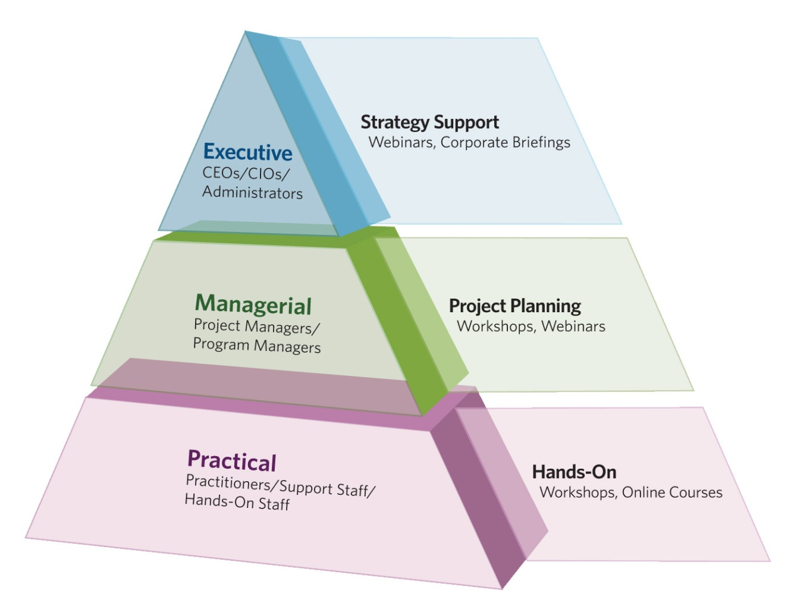
Levels for Training and Development: DPOE
From: ‘Training Needs Assessment Survey’ (2010). Digital Preservation Outreach and Education (DPOE). Washington DC, US Library of Congress. dpoe@loc.gov

Slide 6
DigCurV Lenses
Portfolio of three ‘lenses’ to reflect career progression: ‘Practitioner’, ‘Manager’ and ‘Executive’
Indicate digital curation skills and competences, and pathways of skills progression
Framework: i.e. will NOT specify a particular training curriculum

Slide 7
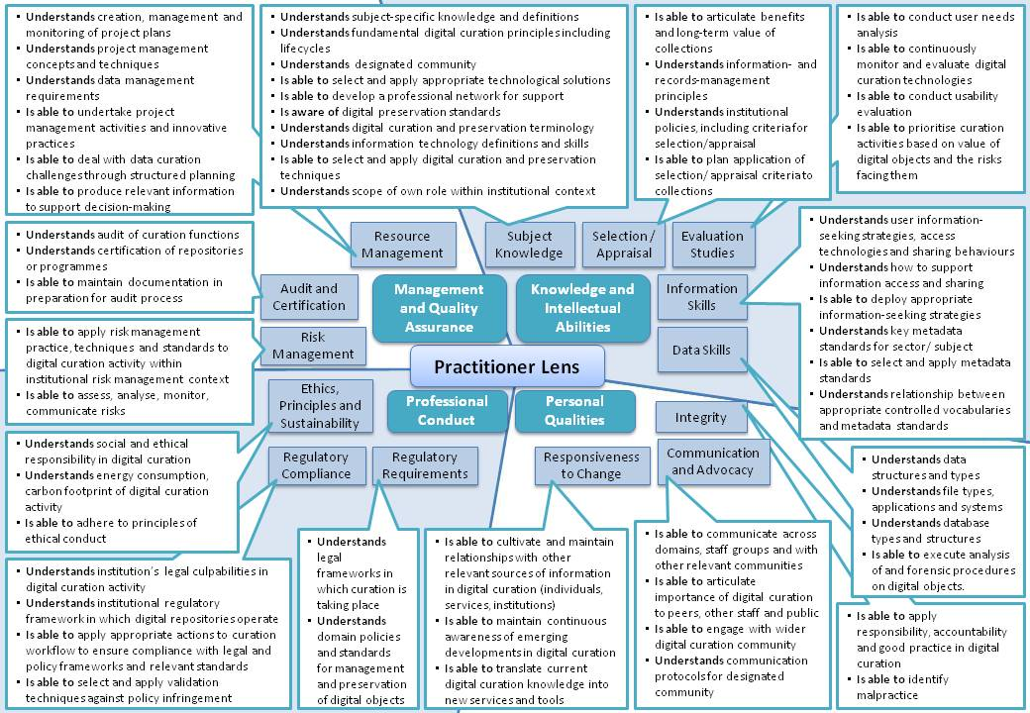
Practitioner Lens

Slide 8
A Mix of Skills

Slide 9
Progression Through the Levels
Practitioner
MQA2.10 – Is able to maintain documentation in preparation for audit process
Manager
MQA2.5 – Is able to lead repository through certification process
Executive
MQA2.2 – Is aware of benefits of audit process, and relevance of audit results

Slide 10
Using the DigCurV Framework for a Skills Audit
Identify roles with digital preservation responsibilities
Map roles to lenses of the DigCurV framework
Work with role holders to match skills to relevant lenses
Useful to mark on a scale
Self-assessment or collaborative process
Analyse results to identify:
Skills gaps
Training requirements
Additional roles that may be required
Can be carried out in the course of regular staff reviews/CPD activities

Slide 11
Other Uses for the Framework
Curriculum development
Developing new courses
Reviewing current courses
Continuing Professional Development
Benchmarking an individual’s skills against a particular lens
Goal setting for moving forward
Identifying relevant training courses
Course Accreditation
Framework for assessing relevance

